Slide 1
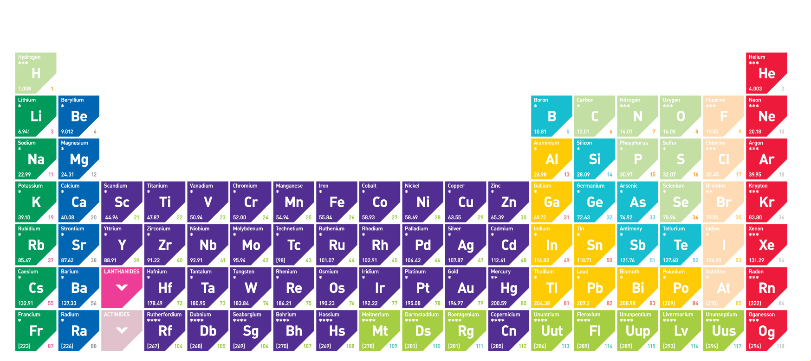
8Fc: Mendeleev’s Table
Do Now:
What are the names of the sections in the periodic table? (to the left and to the right?)

Slide 2
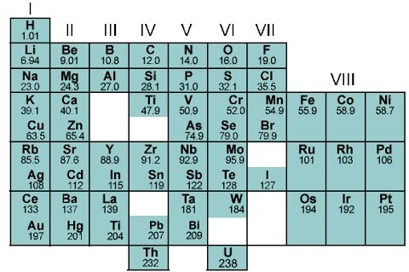
Mendeleev’s Table (video)
Watch the video and take notes
Notes:
(presentation)

Slide 3
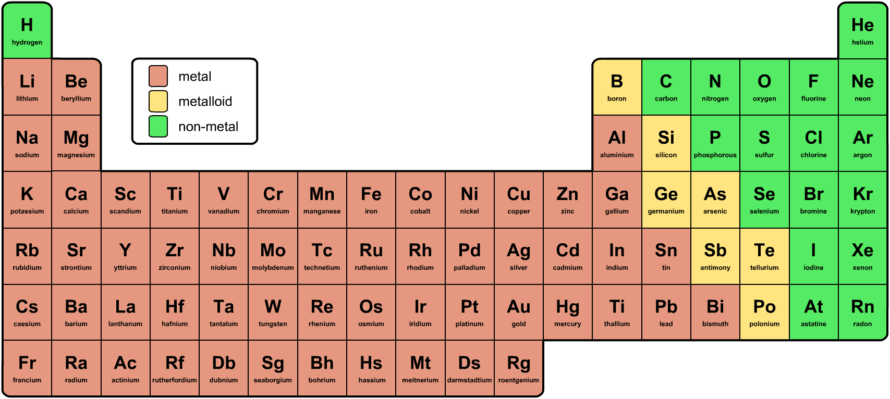
The Modern Periodic Table
Can you spot any patterns in how the elements are arranged in the periodic table?
Outline these blocks in different colours and write a key

Slide 4
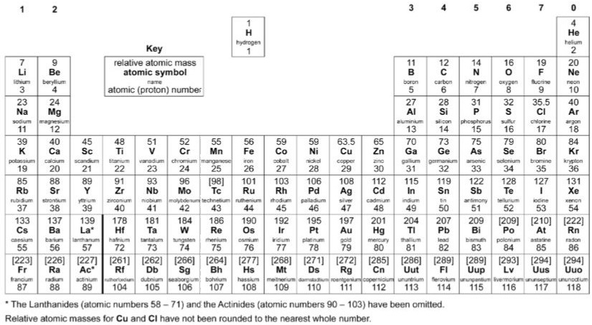
The modern periodic table tells us the relative mass of 1 atom of each element
1
H
Hydrogen
1
16
O
Oxygen
8
32
S
Sulphur
16
24
Mg
Magnesium
12

Slide 5
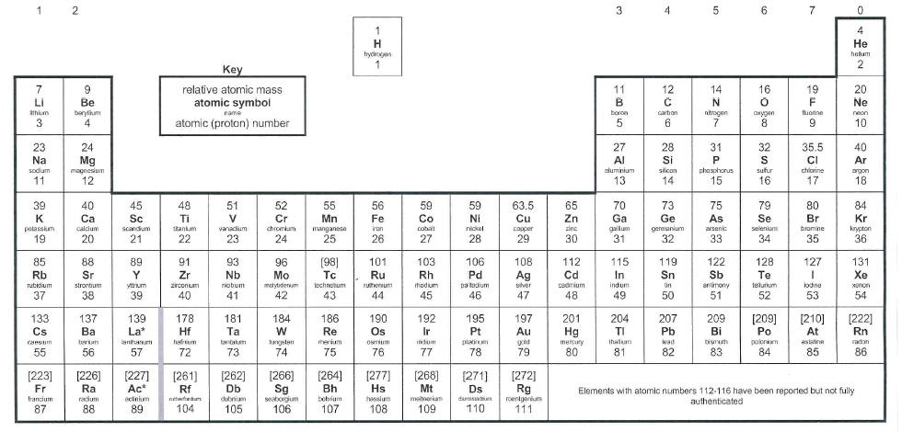
The elements in the periodic table are arranged in families called groups and periods. A period is a horizontal row, increasing in atomic number from left to right
1
2
3
4
5
6
7
Periods 1-7
Notes:
Photo credit: © 2008 Jupiterimages Corporation

Slide 6
A group is a vertical column in the periodic table.
Groups 1-7 & 0
Elements in the same group have similar properties
Annotate your table
Notes:
Photo credit: © 2008 Jupiterimages Corporation

Slide 7
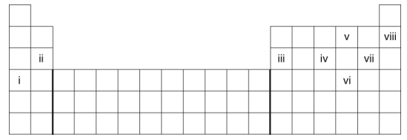
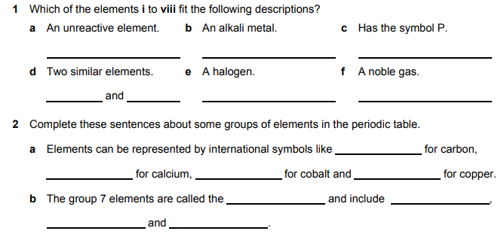

Slide 8
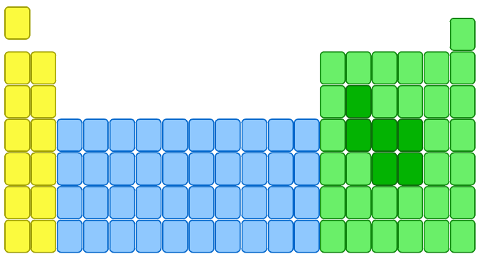
Group 1 – the alkali metals
The elements in group 1, on the left of the periodic table, are called the alkali metals.
lithium
Li
sodium
Na
potassium
K
rubidium
Rb
caesium
Cs
francium
Fr
These metals are all very reactive and are rarely found in nature in their elemental form.
Watch Video (https://www.youtube.com/watch?v=uixxJtJPVXk )https://www.youtube.com/watch?v=dZGDUKQa_6g
Make list of the alkali metals properties

Slide 9
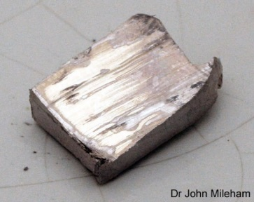
Properties of the Alkali Metals
They are soft and can be cut by a knife. Softness increases going down the group.
They have a low density. Lithium, sodium and potassium float on water.
They have low melting and boiling points.
They are good conductors of heat and electricity.
They all react with oxygen. alkali metal + oxygen → alkali metal oxide
They all react with water. alkali metal + water → alkali metal hydroxide + hydrogen
Reactivity increases going down the group
Notes:
Photo credit: Dr John Mileham
Image is of sodium, freshly cut. Sodium tarnishes very quickly – within approximately 20 seconds. In this image, you can see how it is already tarnishing, starting from the right hand side.

Slide 10
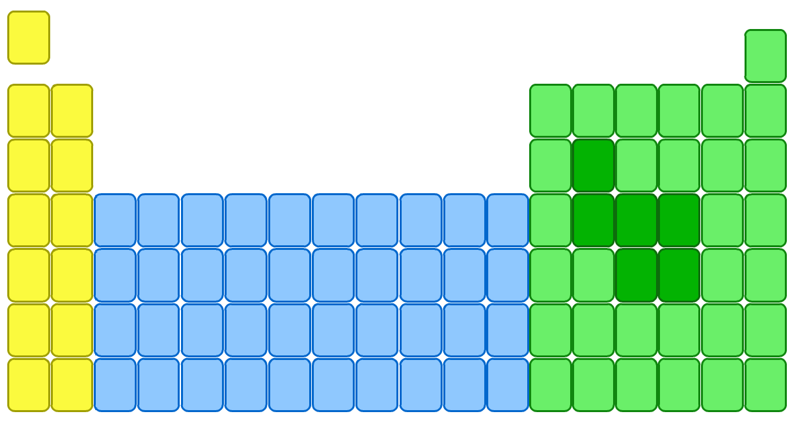
Group 7 – the Halogens
The elements in group 7 of the periodic table, on the right, are called the halogens.
F
fluorine
Cl
chlorine
Br
bromine
I
iodine
At
astatine

Slide 11
Properties of Halogens
Non metals – do not conduct electricity
Brittle and crumbly when solid
Poisonous and smelly
They become darker in colour down the group
They have low melting and boiling points which increase down the group
They all react with alkali metals. alkali metal + halogen $→$ alkali metal halide
Reactivity decreases down the group
Notes:
Photo credit: Dr John Mileham
Image is of sodium, freshly cut. Sodium tarnishes very quickly – within approximately 20 seconds. In this image, you can see how it is already tarnishing, starting from the right hand side.

Slide 12
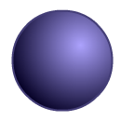
Halogen
Relative size
State
Melting point (°C)
Boiling point (°C)
-220
-118
gas
-101
-34
gas
-7
59
liquid
114
184
solid

Slide 13
Group 0 or 8 – the Noble gases
The elements in group 0, on the right of the periodic table, are called the noble gases.
Watch (video)
Make list of the noble gases properties
He
helium
Ne
neon
Ar
argon
Kr
krypton
Xe
xenon
Rn
radon

Slide 14
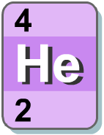
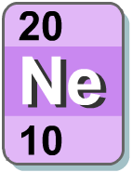
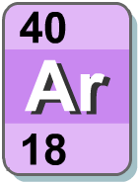
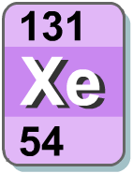
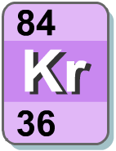
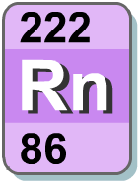
Properties of the Noble Gases
All noble gases are colourless, odourless and unreactive.
This makes them difficult to isolate and identify.
Because noble gases are so unreactive, there are few patterns, or trends, among the group.

Slide 15
