Slide 1
CW
8Ae Surface Area (WS)
How do you calculate the surface area of a rectangle or square?
?
How do you calculate the volume of a cube?
?
Calculate surface area of a 5cm cube
@hpscience

Slide 2
https://www.activeteachonline.com/default/player/document/id/358207/external/0
Use this worksheet
Print the next slide

Slide 4
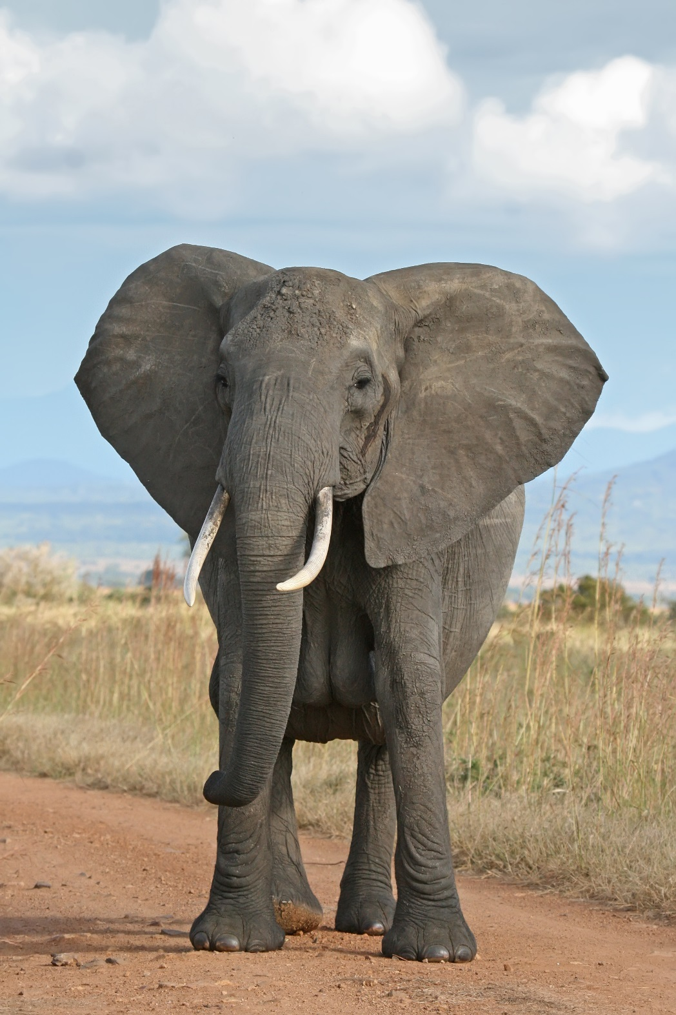
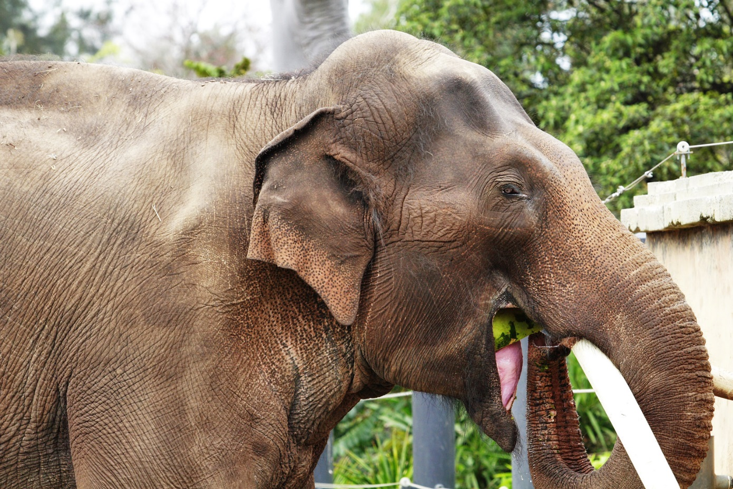
Why does the African elephant have bigger ears than the Asiatic elephants?
Clue: They live in hotter climates
Answer: the larger surface area helps them to loose body heat and stay cool

Slide 5
Surface area – the total area of the surface of an object

Slide 6
Increased surface area
There are lots of examples in living organisms where increased surface area speeds up the rate at which processes take place.
For example, the lungs have a large surface area to speed up how quickly we can absorb oxygen from the air.

Slide 7
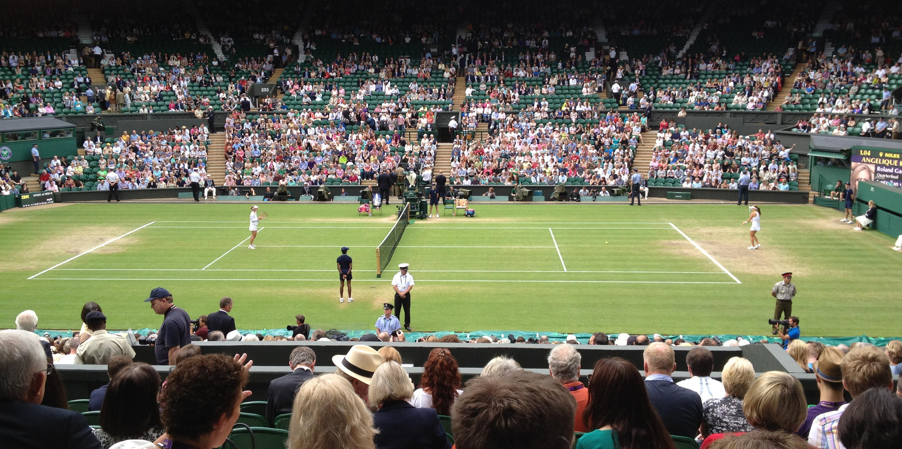
The total surface area of your lungs is the same size as a tennis court.
That’s bigger than the ceiling of the classroom you are sitting in.

Slide 8
What is a cube?
In the back of your books.
Describe a cube.
A cube is a 3-dimensional object.
It has 6 faces.
Each face is a square.

Slide 9
Calculate the surface area of a 10 cm cube.
1 face 10 cm x 10 cm = 100 cm²
X 6 faces 6 x 100 cm² = 600 cm²
Calculate the volume of a 10 cm cube.
10 cm x 10 cm x 10 cm = 1000 cm³ (ever heard of a dm³?)
What is the surface area to volume ratio? SA:vol (extension)
SA = 600 vol = 1000 600 to 100 6:10

Slide 10
Calculate the surface area of a 100 cm cube.
1 face 100 cm x 100 cm = 10,000 cm²
X 6 faces 6 x 10,000 cm² = 60,000 cm²
Calculate the volume of a 10 cm cube.
100 cm x 100 cm x 100 cm = 1,000,000 cm³ (ever heard of a dm³?)
What is the surface area to volume ratio? SA:vol
SA = 60,000 vol = 1,000,000 60,000 to 1,000,000
6:100

Slide 11
Stick this worksheet in your books and answer the questions.

Slide 12
We you chew your food you break it in to smaller pieces.
This increases/decreases the s_____ a___ of the food.
Therefore, there is a greater/lesser s_____ a___ for e______ to work on and break the food down further in to smaller more s_____ substances.
surface area
surface area
enzymes
soluble

Slide 13
The small i_______ also has a large surface area.
Therefore, it is adapted to it’s function.
The larger surface area means that it is able to absorb digested food more quickly.
intestine
Look at how we describe an adaptation.
We say what it is and what it does.
Try to remember this for exams and tests.

Slide 14
In the next lesson we shall find out more about the small intestines and absorption.

