Slide 1
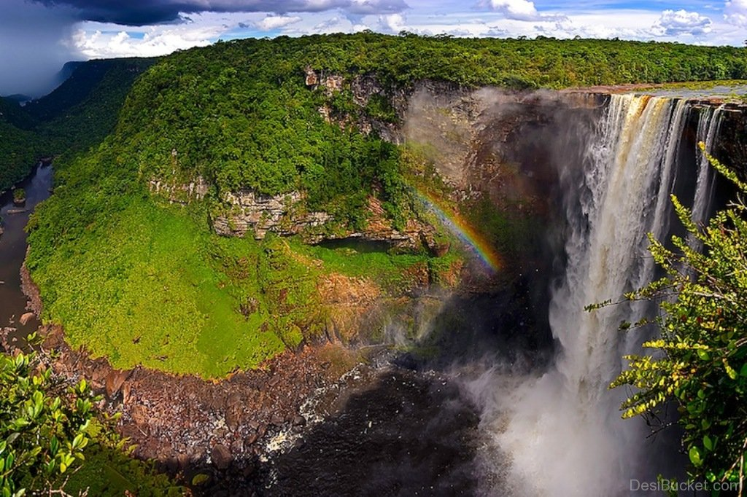
8Je1 Coloured Light
CW
Do Now:
Write down how you think rainbows are formed?

Slide 2
Objectives
Describe how to split light into different colours using a prism and correctly use the terms: spectrum, dispersion.
Recall the colours of the visible spectrum, in order.
Recall that filters can be used to make coloured light.
Recall the primary colours for light.
Describe how secondary colours of light and white light can be made from primary colours of light.
Explain how filters can be used to make coloured light.

Slide 3
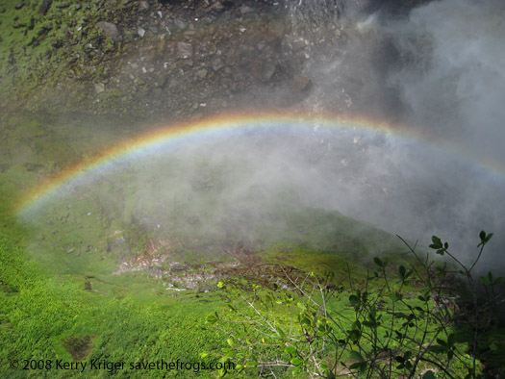
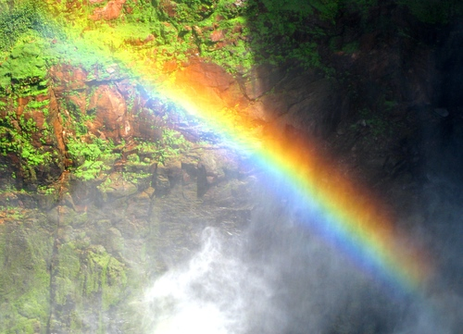
Why does this help it make its own rainbow?
Kaieteur Falls, Guyana
Highest one drop waterfall in the world

Slide 4
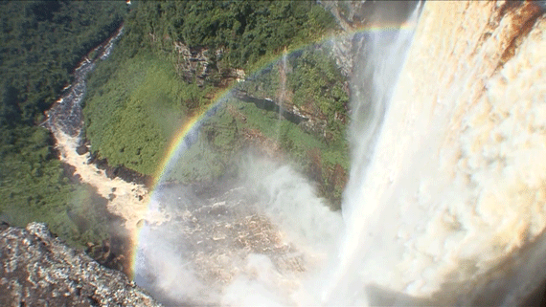

Slide 6
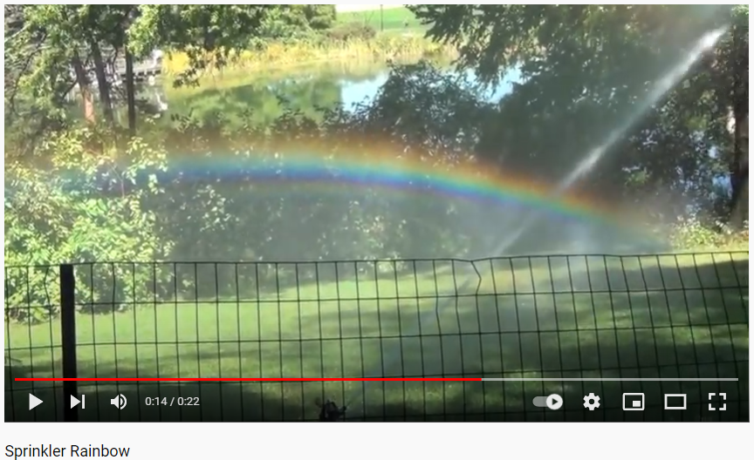

Slide 7
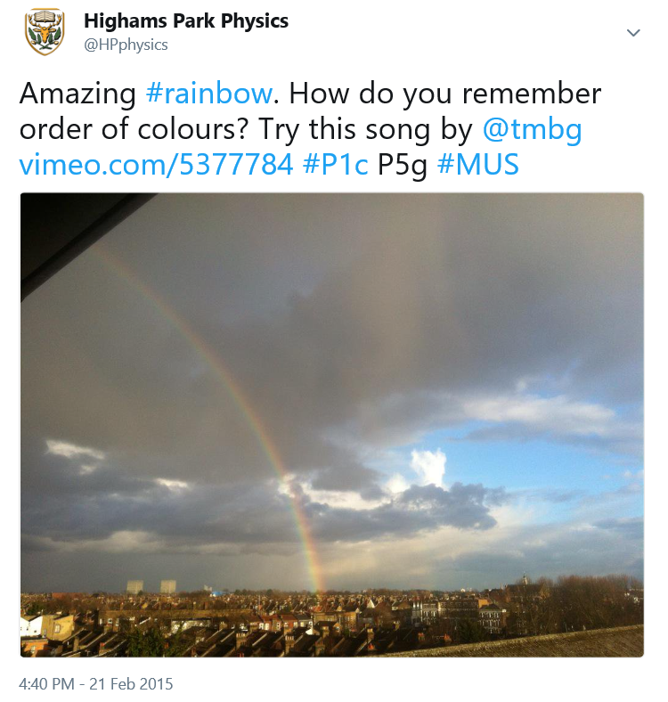
What can we use in the lab to create these colours?

Slide 8
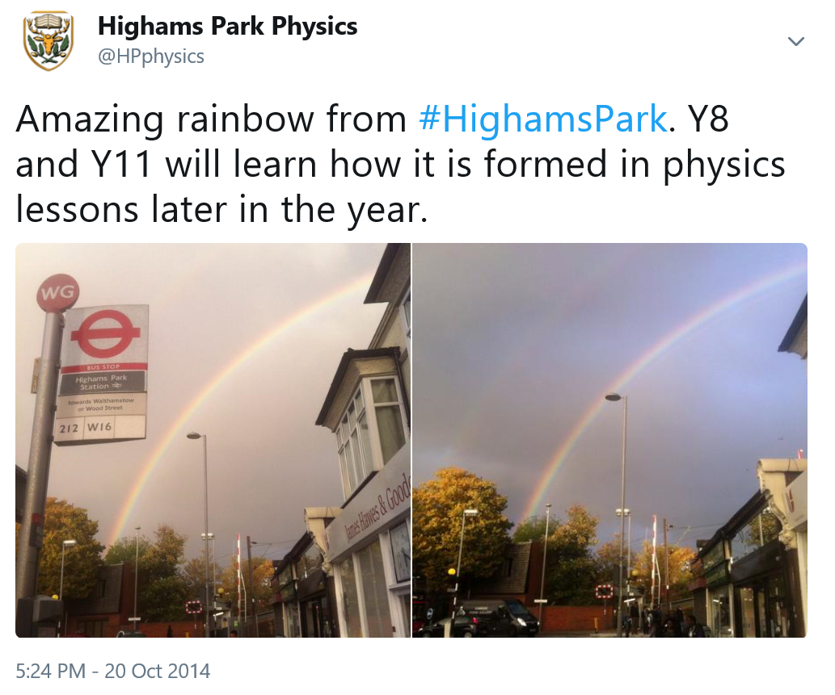

Slide 9
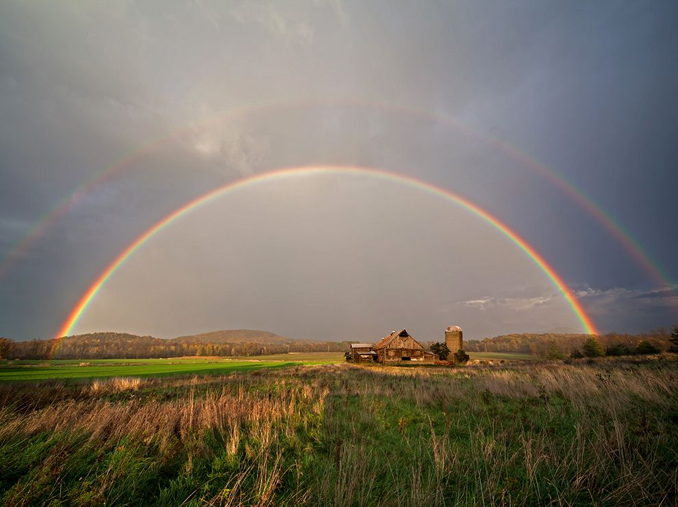
What can we use in the lab to create these colours?

Slide 10
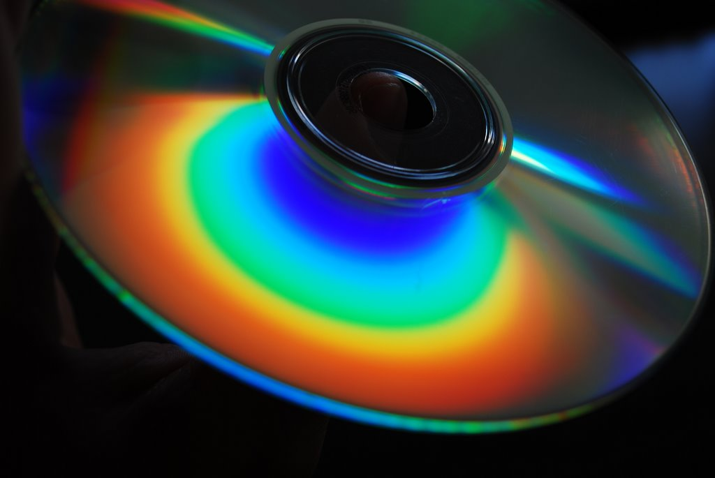
Have a look at the spectrum of colours formed by a CD or DVD.
Try changing the angle or the CD or where you look from.
Can you work out the order of the colours?

Slide 11
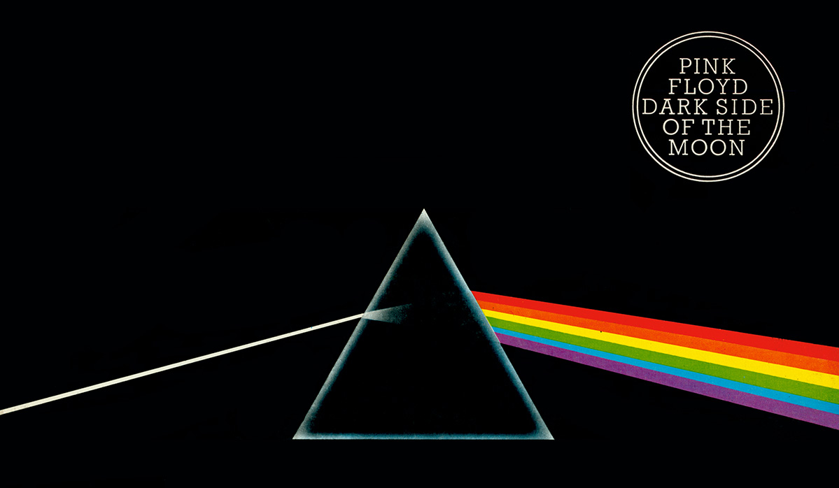
Has it got anything to do with the name of the album?!
What is this?

Slide 12
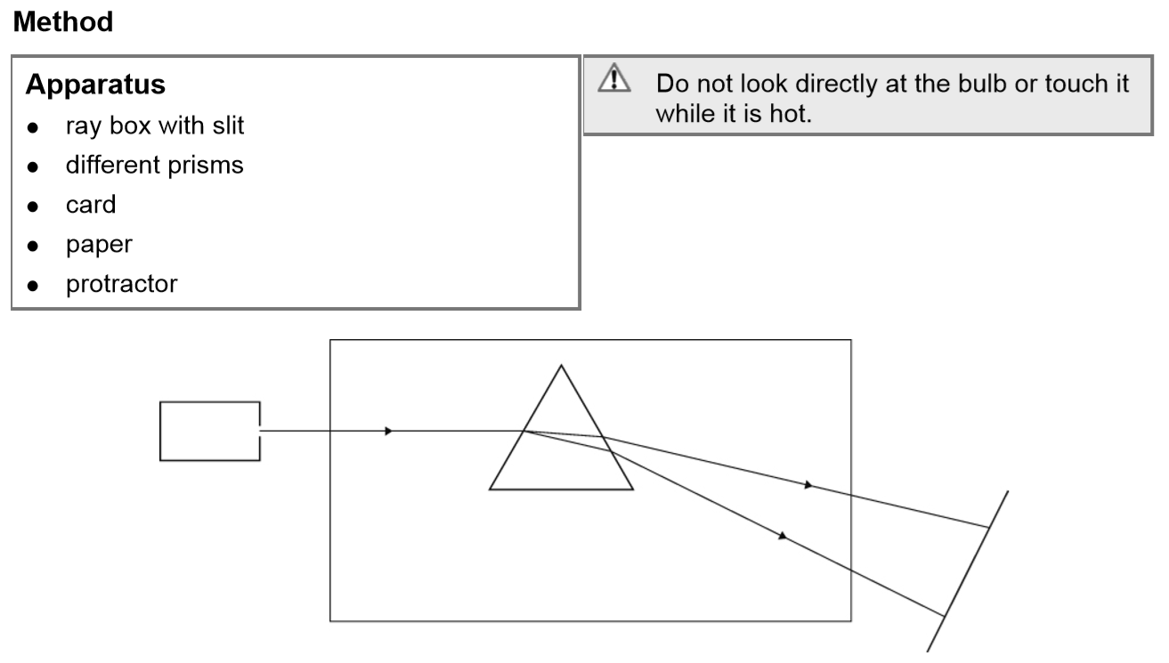
Set up the apparatus as shown.
Adjust the angle of incidence until you have a clear spectrum on the card.
Draw a diagram of what you have done, showing and labelling the order of the colours.
 Colour in the wedges of colour in order here.
How can we remember the order of the colours?

Slide 13
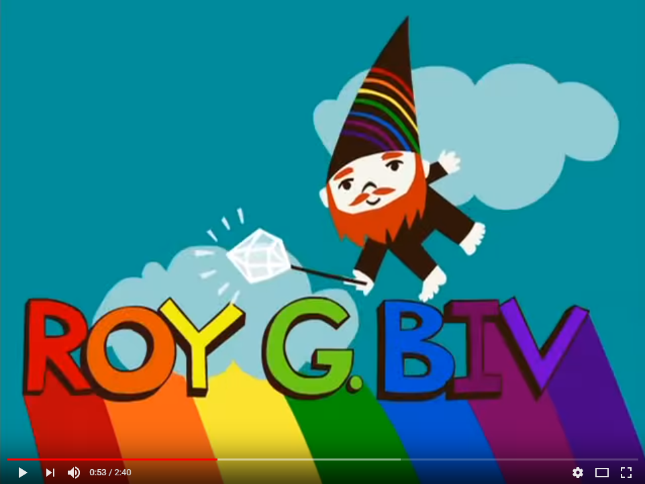

Slide 14
Stick in your diagram and label/colour the spectrum
Dispersion
Order of spectrum:

Slide 15
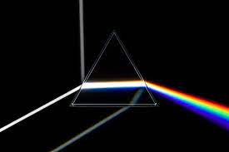
Dispersion
Write Down
Red light refracts (bends) the least
Violet light refracts (bends) the most

Slide 16
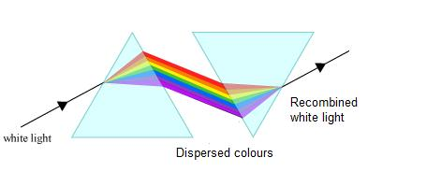
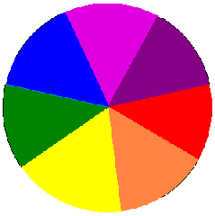
Join with another pair and use both prisms to see if you can recombine the spectrum into white light.
How should you position the 2nd prism?
Try a similar effect with your coloured disk by spinning it on a cocktail stick.

Slide 17
What colour light is this blank screen emitting?

Slide 18
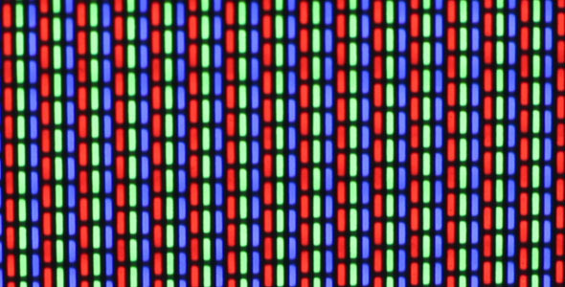
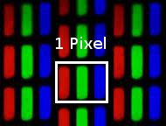

Slide 19
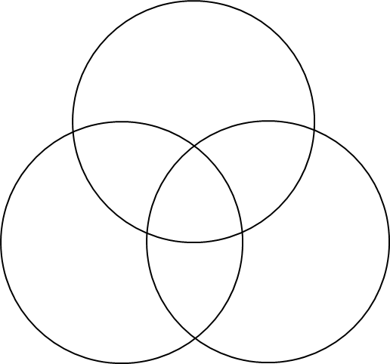
Combining Colours
Watch the combining primary colours demo.
 Colour in your diagram neatly, labelling the colours.

Slide 20
 Teachers: Click image to run Doddle interactive. Launch presentation on slide 9.
Students: log in to Doddle & search for Light Waves Part 5 - Colour.

Slide 21
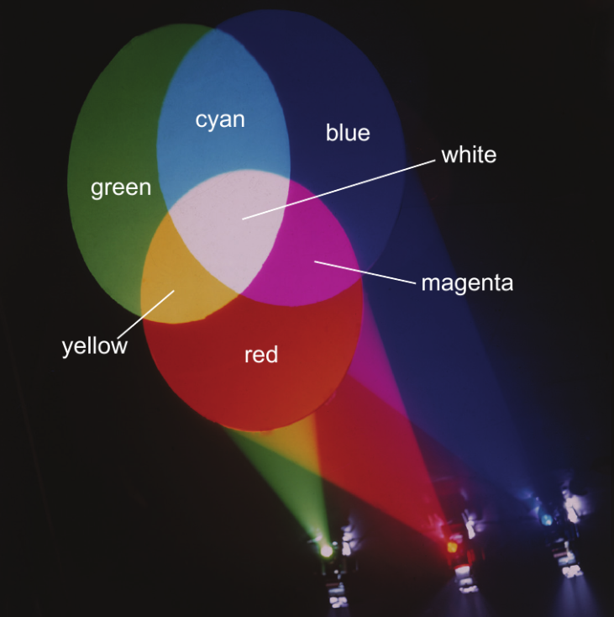
What colour light are these lamps emitting?
So how do we get the colours?
white

Slide 22
Reproduce your spectrum on a screen.
Slowly lower a red, blue or green filter into the path of the spectrum. Ignore any white section in the middle of the spectrum and concentrate on what happens to the red, blue & green colours.
What does a red filter do?
Does it turn ALL the colours red?

Slide 23
What does a red filter do?
Click image to run simulation.
Choose a single white single bulb & add filters

Slide 24
Write Down
A ___ filter absorbs all colours apart from ____ light.
red
red
We know a red filter does not turn all colours red because when placed in front of a spectrum…
Use coloured pencils to draw a similar diagram for a red, blue or green filter. Complete the explanation underneath.
Support: start with only red, green & blue light

Slide 25
Write Down
A ___ filter absorbs all colours apart from ____ light.
red
red
We know a red filter does not turn all colours red because when placed in front of a spectrum…
the filter blocked out the other colours leaving just the red.

Slide 26
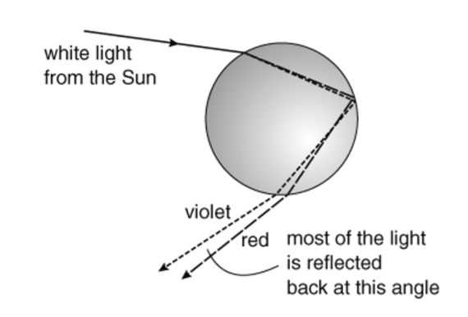
So how does this refraction mean we see a rainbow?

Slide 27
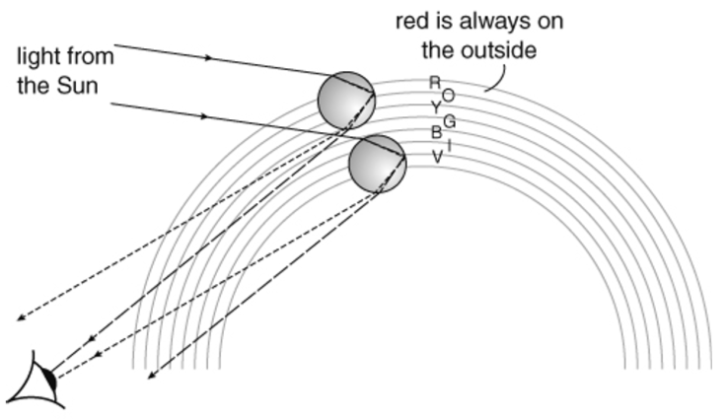

Slide 28
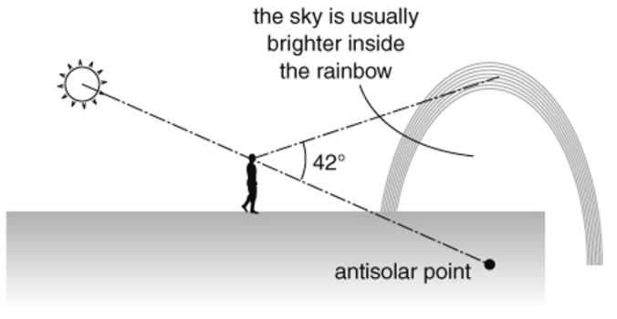
Try 8je3_rainbos_and_glories worksheet as extension work in your own time.

Slide 29
 Give a clue or definition for these keywords.
Hot seat
spectrum

Slide 30
 Give a clue or definition for these keywords.
Hot seat
secondary colours

Slide 31
 Give a clue or definition for these keywords.
Hot seat
dispersion

Slide 32
 Give a clue or definition for these keywords.
Hot seat
Roy G Biv

Slide 33
 Give a clue or definition for these keywords.
Hot seat
prism

Slide 34
 Give a clue or definition for these keywords.
Hot seat
filter

Slide 35
 Give a clue or definition for these keywords.
Hot seat
primary colours

Slide 36
 Give a clue or definition for these keywords.
Hot seat
absorb

