Slide 1
7Ha Handling Data

Slide 2
Variables
Three types of variable:
Independent: The variable where you decide the way it changes
Dependent: The variable that changes and gives you your result
Control: Variables that could change but you need to control it to make it a fair test

Slide 3
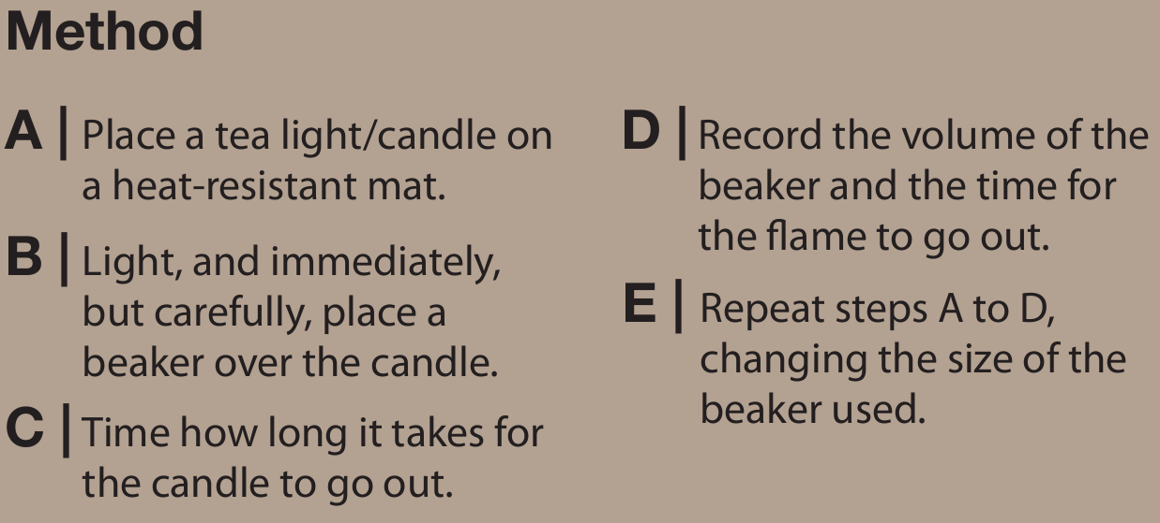
The burning candle experiment
Volume of air in beaker/ml | Burning time/s
100
250
300
600
1000
2000
Tip
Use some Blutac to block the gap in the upturned beaker.
The teacher will demonstrate the 2000ml beaker, then you can record the result

Slide 4
Results
This data is quantitative (made of numbers)
volume of air
In this experiment we are looking at how the _____________ affects the _____________
burning time
Independent variable:
Dependent variable:
Controlled variable:
Volume of air
Burning time
Candle

Slide 6
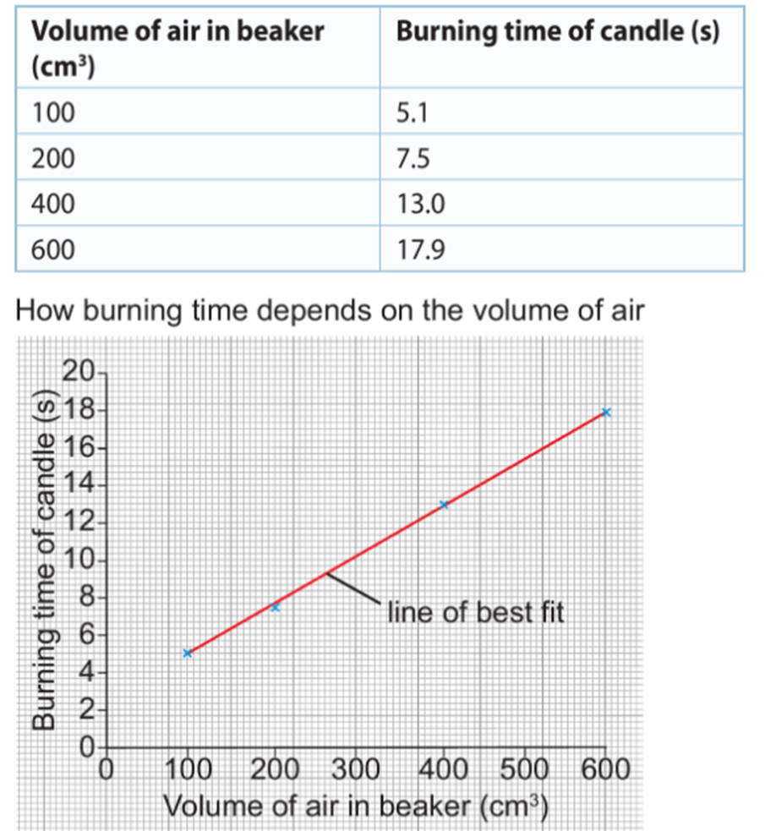
Plot a graph using your results.
This data is called continuous data
Conclusion
The points on the scatter graph follow a pattern so there is a relationship. We can make the relationship clearer by drawing a line of best fit

Slide 7
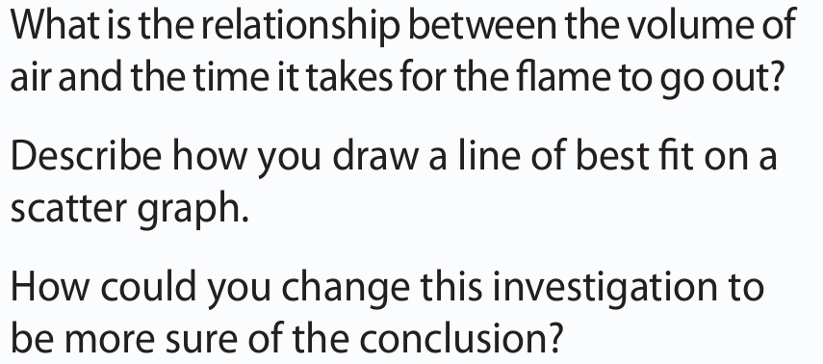
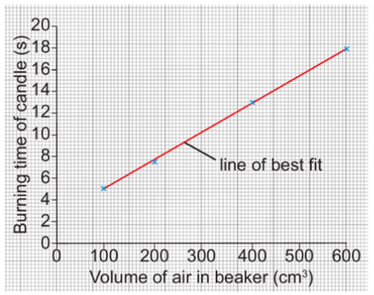
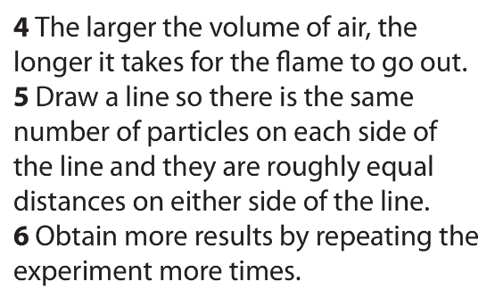
Predict using your graph what would the burning time be if you had a 500ml beaker.

