Slide 1
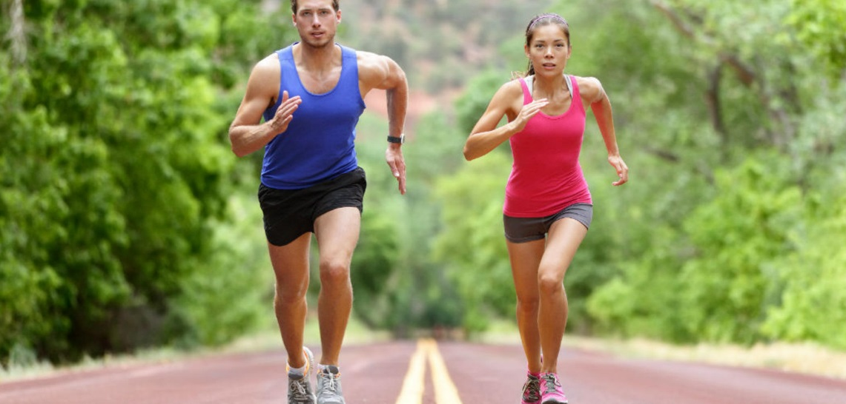
CW
8Ab Uses of nutrients
Name the 5 nutrients from last lesson.
What do we need nutrients for?
@hpscience

Slide 2
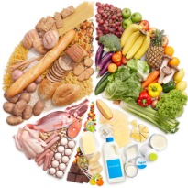
C
F
P
V
M`
Carbohydrates
Fats
Protein
Vitamins
Minerals

Slide 3
Different nutrients are used for different things in the body.
Do you know what any of these are used for?
Carbohydrates (starch and sugar)
Fats
Protein
Vitamins
Minerals

Slide 4
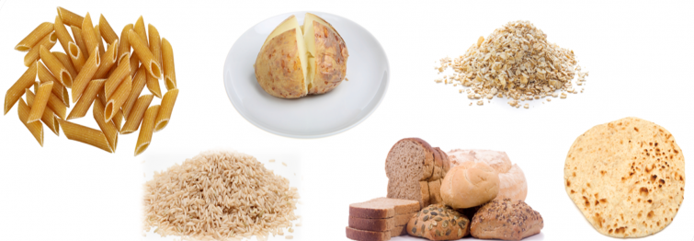
Carbohydrate
Carbohydrate (starch and sugar) is the body’s main source of e_____.
energy
What types of food contain lots of starch?
Remember the results from your food tests?
Potatoes, pasta, rice, bread and cereals contain lots of starch.

Slide 5
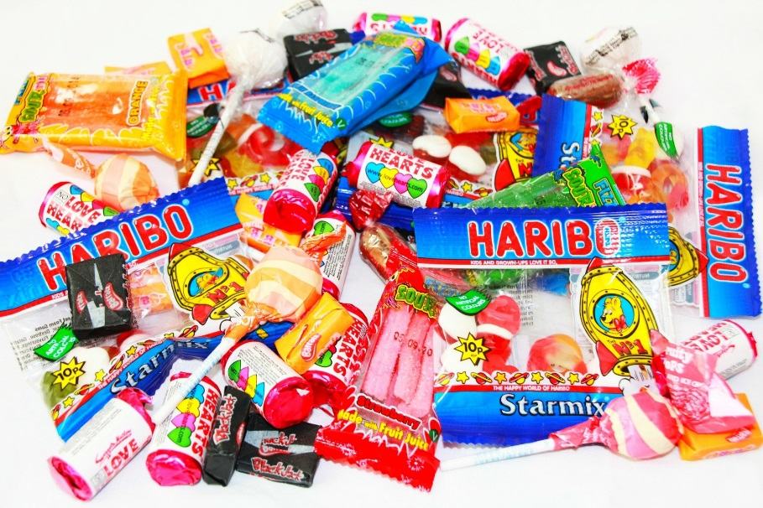
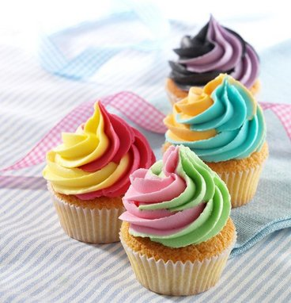
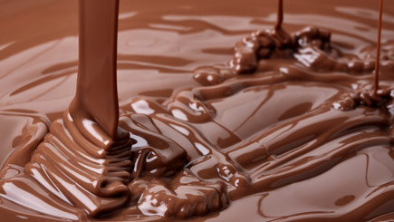
Sweet food can contain lots of sugar.
Starchy food needs to be broken down during digestion and provides energy more slowly and over a longer period of time than sweet food.

Slide 6
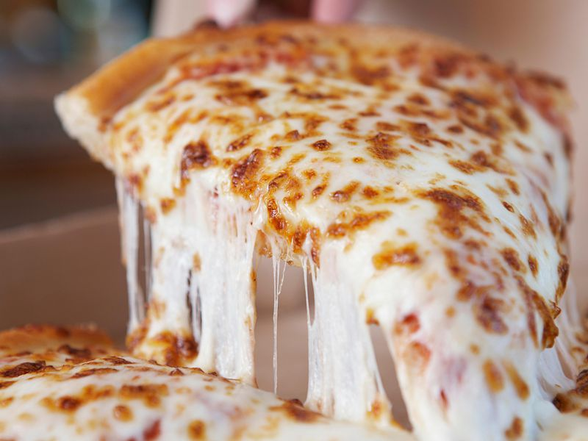
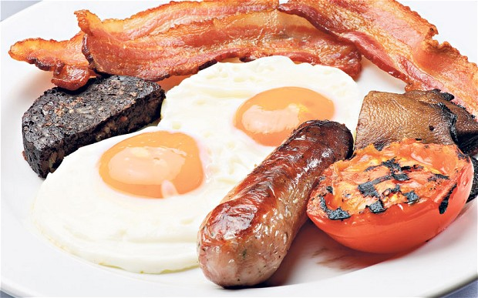
Fat
Fats can also provide the body with the energy.
Fat can be found in dairy products, e.g. cheese, and fried food, e.g. burgers.

Slide 7
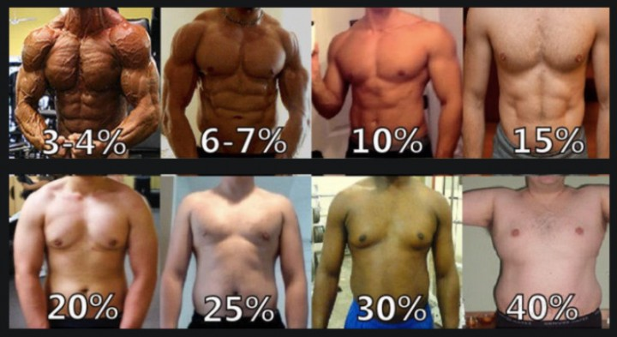
Fat is stored in the body so that the body always has a source of energy.
It is stored under the skin and can i______ us and help to keep us warm.
nsulate

Slide 8
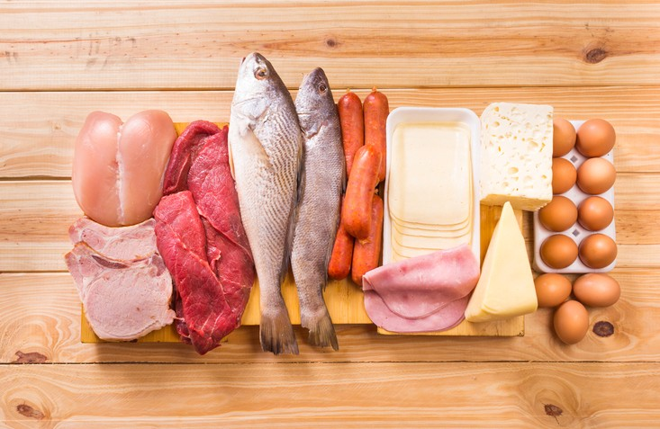
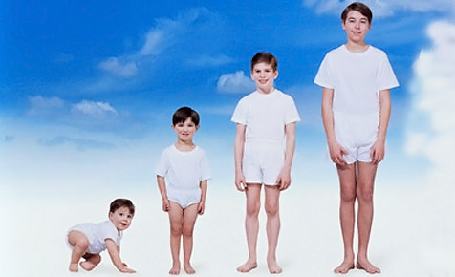
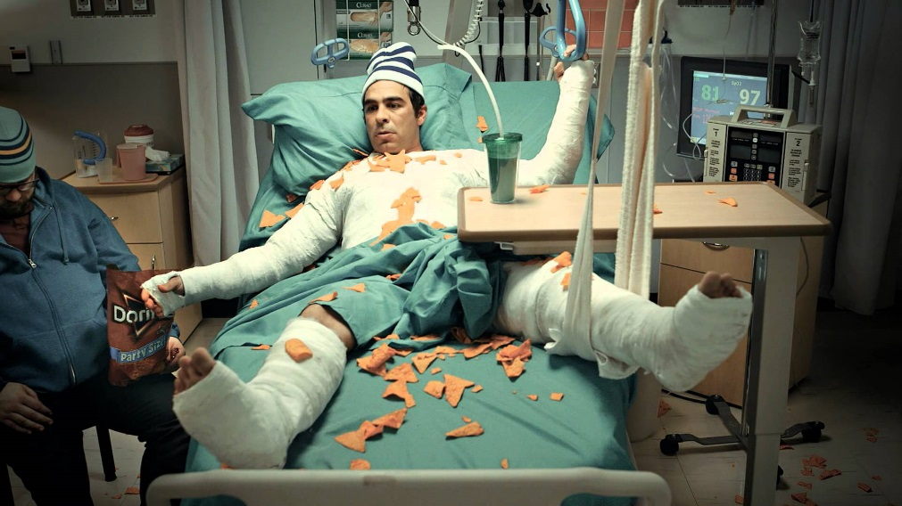
Protein
Proteins are needed for g_____ and r____.
growth
repair
We get protein from food like meat, fish, eggs, cheese, beans and milk.

Slide 9
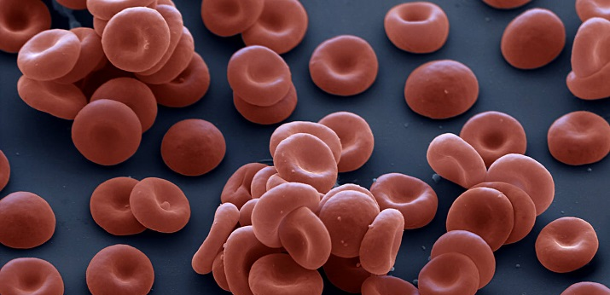
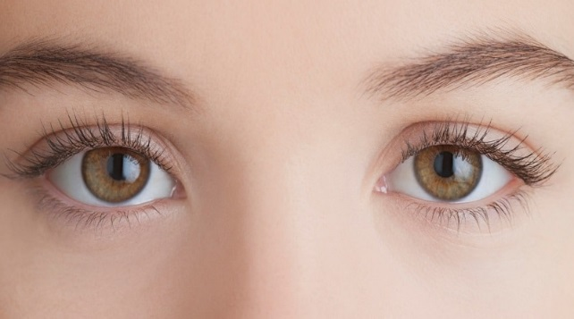
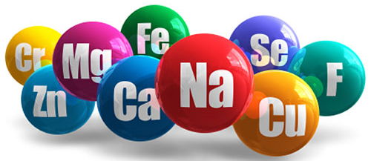
Vitamins and minerals
Vitamins and minerals are only needed in very small quantities but they are still very important.
Vitamin A is needed for healthy skin and eyes (from fish)
Vitamin C sticks the cells together in tissues (from fruit)
Calcium is needed for strong bones (from dairy products)
Iron is needed to make red blood cells (from meat and beans)

Slide 10
https://www.nhs.uk/conditions/vitamins-and-minerals/
Worth a quick look

Slide 11
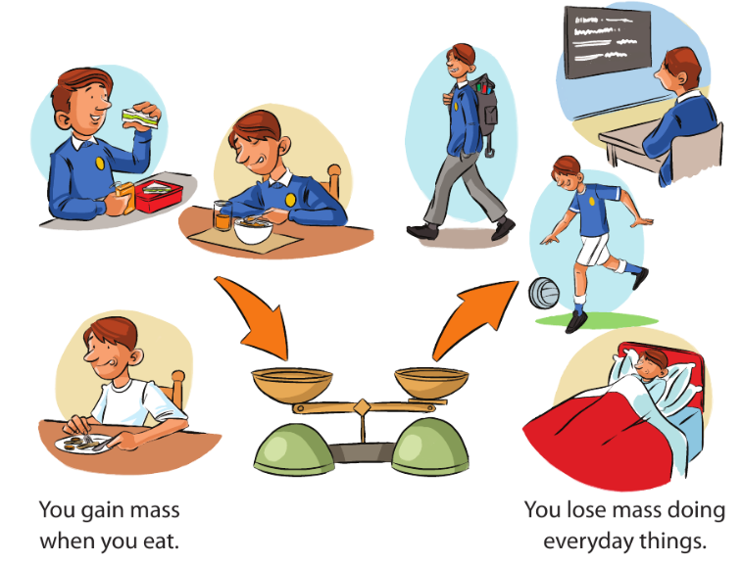
Transferring energy

Slide 12
When you eat, the fuel in your food causes you to gain mass.
Throughout the day you use this fuel and you lose mass.
What happens if you consume (eat) more fuel than you use?
How would you say it scientifically?
Write it in the back of your books

Slide 13
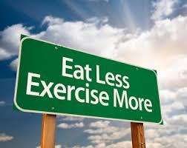
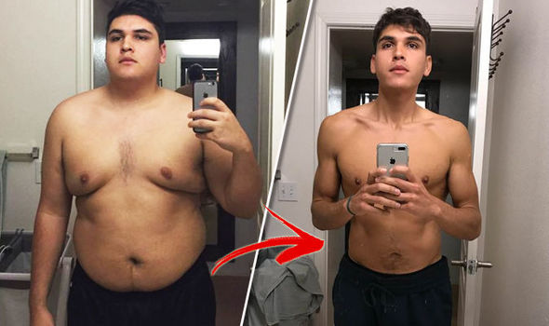
If you consume more energy/fuel than you use then you will gain mass.
To loose mass you must consume less than you use.

Slide 14
The amount of energy in food is measured in kilojoules (kJ).
This energy is released and used in cells in a process known as r________.
The energy is transferred (moved) from the nutrients we eat and used to grow, move, think and keep warm.
respiration
We will learn a lot more about respiration in unit 8C – Breathing and respiration

Slide 15
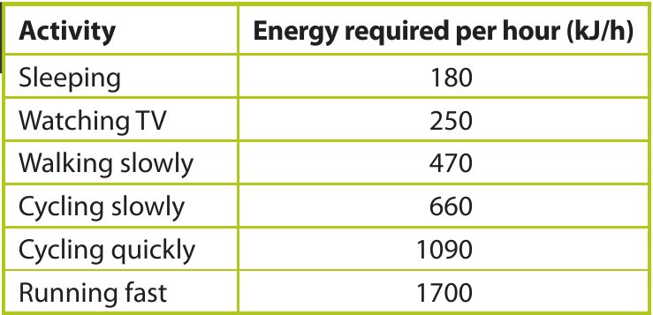
How do different activities affect the amount of energy required?
Where would playing football or swimming fit in to this table?

Slide 16
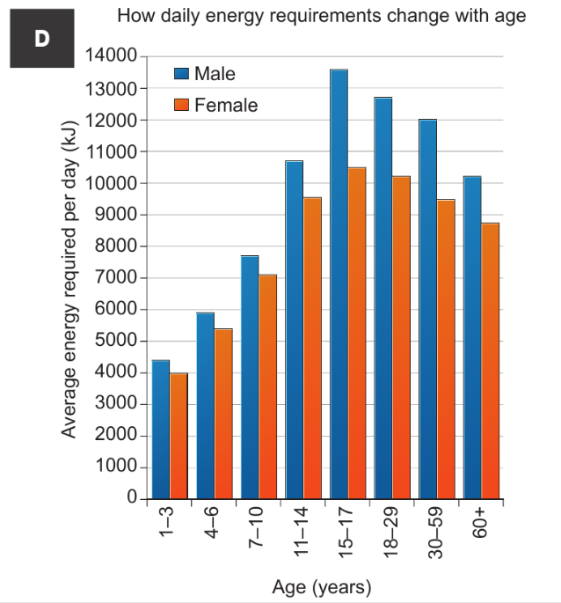
Discuss this graph with a partner and describe what it shows.

Slide 17
How does age and gender affect our daily energy requirements?

Slide 18
Objectives
Recall why we need food (energy, growth and repair, health).
Recall how food acts as a fuel for the body.
Recall some good sources of carbohydrates, fats, proteins
Recall that if a person’s energy intake is different from the amount of energy that they need, their mass will change.
Describe the general uses of carbohydrates, fats (lipids), proteins, vitamins and minerals by the body.

Slide 19
Objectives
Describe the relationships between diet, exercise, age, sex and energy.
Explain why body mass changes if energy input into the body does not match energy output.
Recall sources of some individual vitamins and mineral salts (e.g. vitamin A, vitamin C, calcium, iron).
Describe the roles of vitamin A, vitamin C, calcium and iron in the body.

