Slide 1
8Ia1 The Particle Model
CW
Do Now:
Sketch how particles are arranged in solids, liquids and gases
Which one do many students get wrong & how?
solid
liquid
gas

Slide 2
Compare your particle diagrams to the PhET simulation.
solid
liquid
gas
Which one do many students get wrong & how?

Slide 3
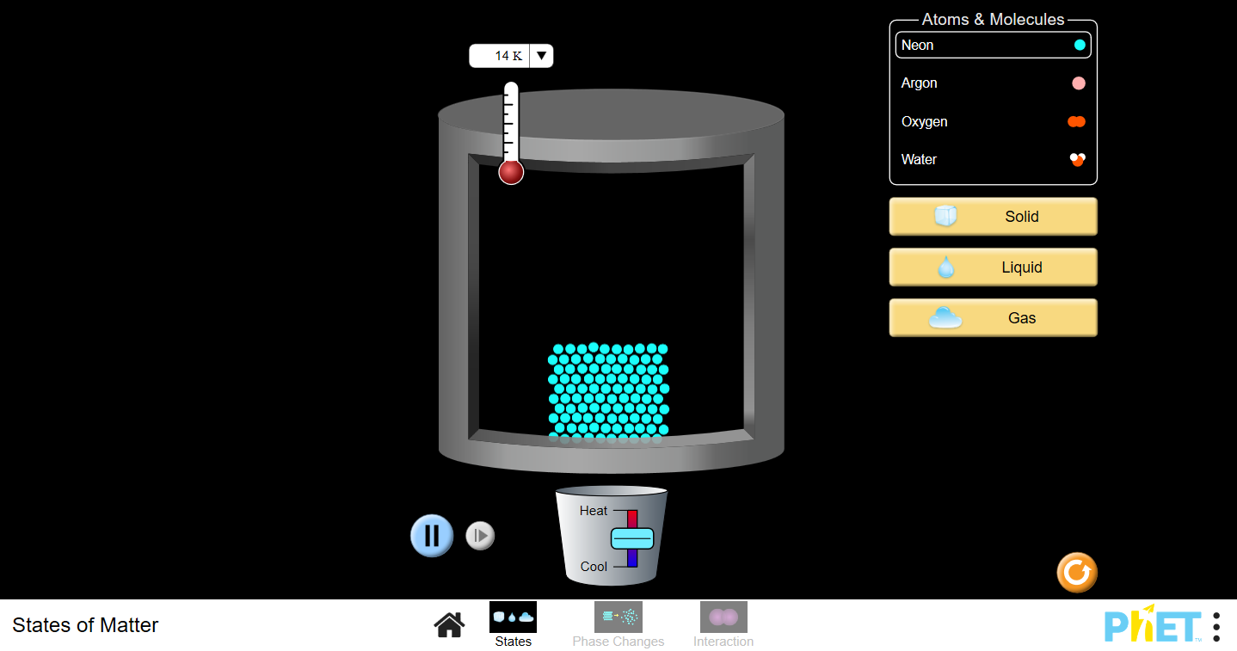

Slide 4
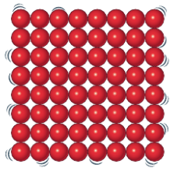
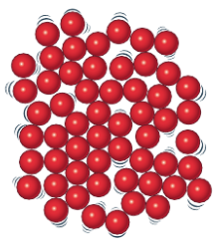
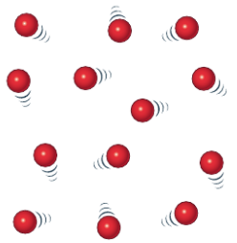
Check your work
solid
liquid
gas
most particles should be touching

Slide 5
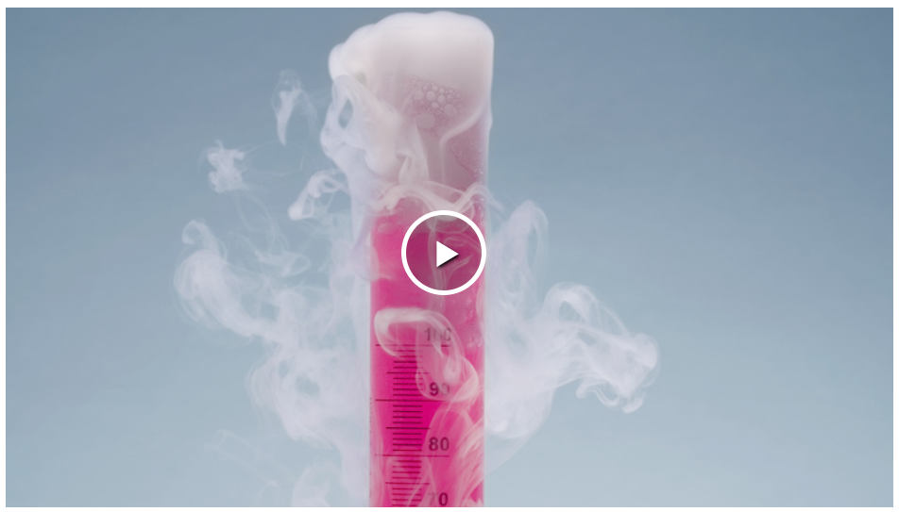

Slide 6
Copy & Complete
Solids keep their _______and ________; they cannot flow and are difficult to __________.
shape
volume
compress
shape
Liquids keep their ________but not their _______; they can flow and are difficult to _________.
volume
compress
shape
Gases can change their_______ and ________; they spread out and are easy to __________.
volume
compress
volume shape compress

Slide 7
How does the particle model explain these properties?
Why can you squash a gas but not a liquid or solid?
Why can liquids & gases flow but not solids?

Slide 8
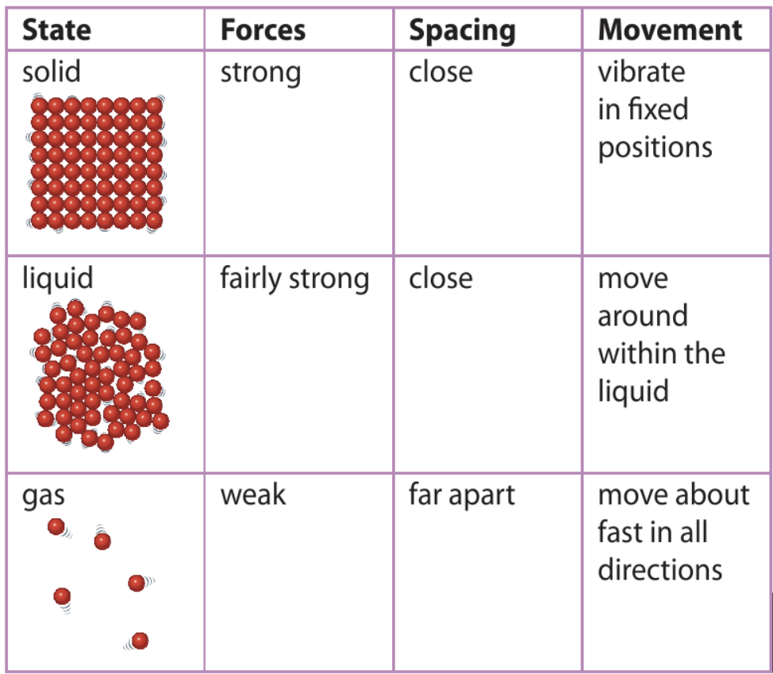
Copy or stick in the table and fill in any blank sections you can.

Slide 9
Add a description of the forces and movement of particles for each state from the animation.

Slide 10
Can you improve the
spacing descriptions?
(all particles touching neighbours)
What other observations does the particle model explain?
(most particles touching neighbours)
What did Einstein explain using particles?

Slide 11
My Learning Journey……
Completed
Developing | Securing | Exceeding
Describe the 3 states of matter in terms of shape, volume and compressibility.
Identify some consequences of changing an objects temperature.
State what is meant by diffusion, contraction and expansion.
Use quantitative information on expansion and contraction.
Use the particle model to explain properties of solids, liquids and gases and how temperature affects them.
Describe how the volume of a substance changes at different temperatures.
Use the particle model to explain expansion and contraction and different temperatures.

Slide 12
https://www.youtube.com/watch?v=-zvCUmeoHpw

Slide 13
https://www.youtube.com/watch?v=-zvCUmeoHpw

Slide 14
Copy & Complete
Brownian motion: tiny specks of dust in air or water can be seen jiggling around as they are ___ by moving air or water ________.
hit
particles
How fast do they travel?
How do smells travel?

Slide 15
How does he particle model explain this?
If I make a smell (!) here, when will you notice it?

Slide 16
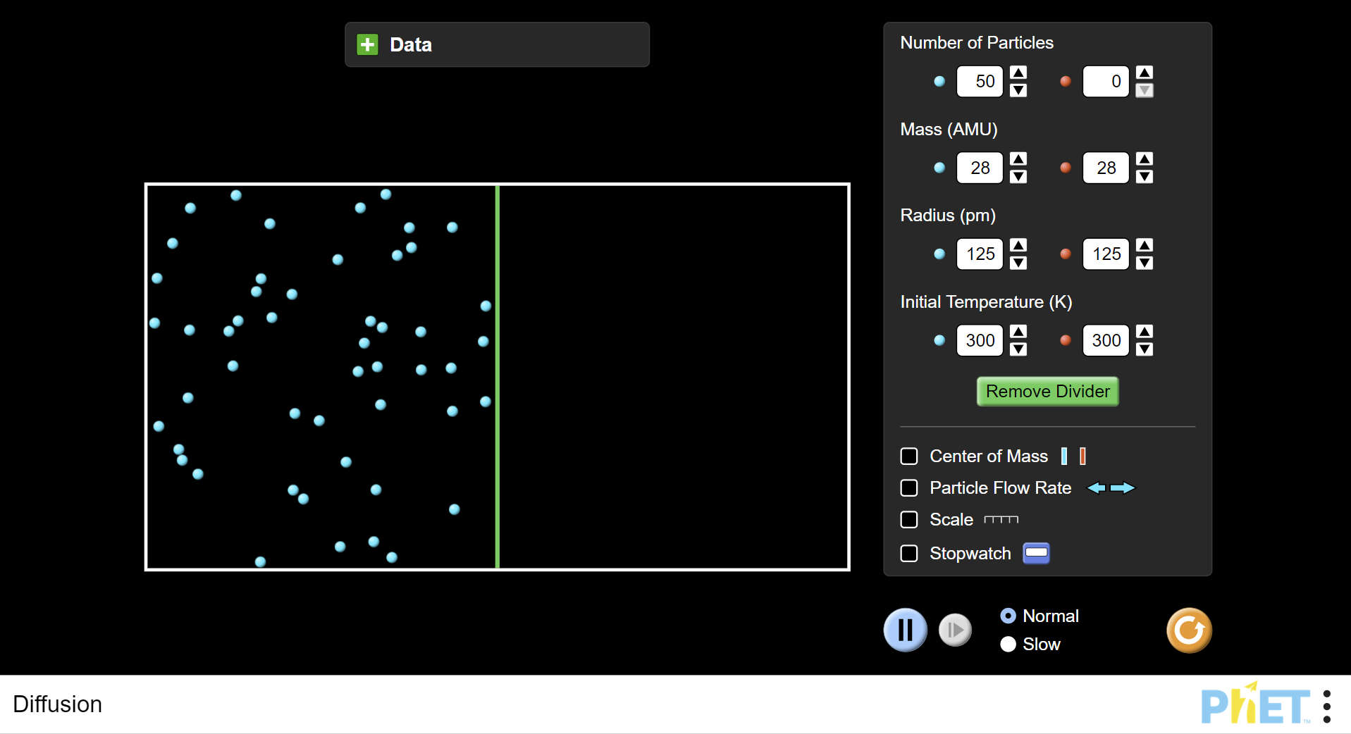

Slide 17
Copy & Complete
Diffusion: gases or liquids mix because the particles are always _______.
moving
How does a thermometer work?

Slide 18
Why is there a gap in this road?
At what time of year might the gap be smaller?

Slide 19
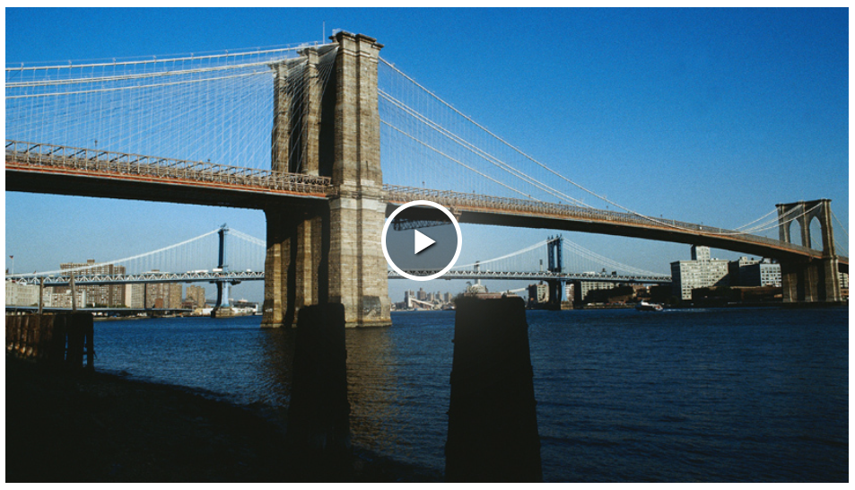

Slide 20
Copy & Complete
Expansion & Contraction
What happens to the density?
expand
Materials ________ when heated because particles get hotter and move faster, so take up more space.
Density decreases.
contract
Materials ________ when cooled because the particles get colder and move slower, so take up less space.
How could we act this out using you as particles?
Density increases.

Slide 21
What has happened to the density of this solid?

Slide 22
Why is there a gap in this road?
At what time of year might the gap be smaller?

Slide 23
My Learning Journey……
Completed
Developing | Securing | Exceeding
Describe the 3 states of matter in terms of shape, volume and compressibility.
Identify some consequences of changing an objects temperature.
State what is meant by diffusion, contraction and expansion.
Use quantitative information on expansion and contraction.
Use the particle model to explain properties of solids, liquids and gases and how temperature affects them.
Describe how the volume of a substance changes at different temperatures.
Use the particle model to explain expansion and contraction and different temperatures.

Slide 24
Hot seat
 Give a clue or definition for these keywords.
Particle model

Slide 25
Hot seat
 Give a clue or definition for these keywords.
Expansion

Slide 26
Hot seat
 Give a clue or definition for these keywords.
Diffusion

Slide 27
Hot seat
 Give a clue or definition for these keywords.
Compress

Slide 28
Hot seat
 Give a clue or definition for these keywords.
Contraction

Slide 29
Hot seat
 Give a clue or definition for these keywords.
States of matter

