Slide 1
Anti-Bullying Week 2021

Slide 2
Aims for today’s session:
To understand what LGBT+ bullying is and why it is harmful.
To understand how you can play a part in making your school a safer space for LGBT+ people.

Slide 3
What is anti-LGBT+ bullying?

Slide 4
What is LGBT+?
Lesbian When a woman is attracted to other women. For example, some people have two mums.
(e.g. a woman loves a woman)
Gay When a man is attracted to other men. For example, someone might have two dads.
(e.g. a man loves a man)
Bisexual Somebody who is attracted to men and women.
(e.g. a man loves a woman OR a man)
Transgender When someone’s gender (whether they’re a boy or a girl) doesn’t match what people thought they were when they were born.
(e.g. a girl who was assigned ‘boy’ at birth)

Slide 5
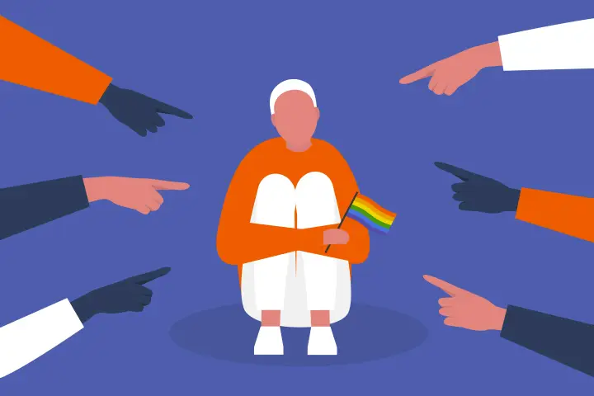
What is anti-LGBT+ bullying?
Anti-LGBT+ bullying is where people are discriminated against and treated badly because they are LGBT+. People who are not LGBT+ can also experience anti-LGBT+ bullying if someone thinks they are LGBT+.

Slide 6
What is anti-LGBT+ bullying?
LGBT+ bullying can look like:
Making comments about a person’s gender or sexuality that deliberately makes them feel uncomfortable
Calling a person names or teasing them
Hitting, kicking, punching or physically hurting them
Inappropriate sexual comments or gestures
Refusing to work or cooperate with someone because of their real or perceived sexual orientation
Making nasty comments about a person online
Mocking or imitating someone’s voice, mannerisms etc.
(Taken from Bullies Out)

Slide 7
The impact of anti-LGBT+ bullying
Notes:
Suitable for a title with six to seven words.

Slide 8
While you watch the videos, think about these questions:
How do you think it changed how they felt about their identity?
How did the bullying make this person feel?
How did it impact their daily life?

Slide 9
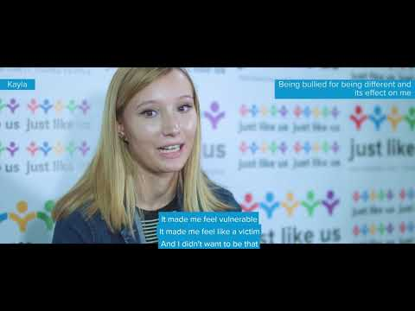
Kayla: my LGBT+ story

Slide 10
What can you do to make school a safer place?

Slide 11
What would you do if witnessed anti-LGBT+ bullying?
How did the bullying make this person feel?
How did the bullying make this person feel?
How might you talk to a friend you saw doing this?
Would you intervene?
Would you tell adults? Who?

Slide 12
What to do if you experience LGBT+ bullying
Remember, it is not your fault.
Talk to an adult at school
Talk to an adult at home
Talk to a friend
You can also go to these organisations if you would like support:
0300 330 0630
https://switchboard.lgbt/
https://www.childline.org.uk/

