Slide 1
International Foods

Slide 2
Persimmon: Israel

Slide 3
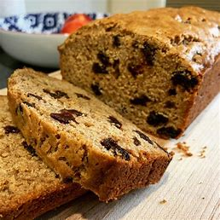
Spiced Bun: Jamaica

Slide 4
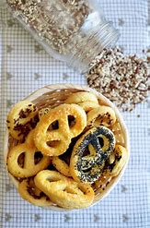
Covrigei De Casa: Romanian Savoury biscuits

Slide 5
Fursecuri Si Prajituri – Romanian Cookies

Slide 6
Albanian Traditional Biscuits

Slide 7
Cassava Chips – Indonesia /Guyana

Slide 8
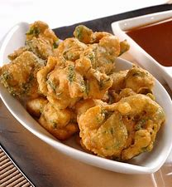
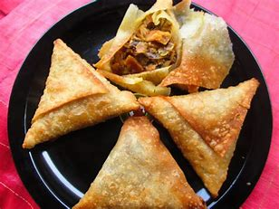
Pakoras and Samosas: Pakistan

Slide 9
Salted Sticks: Poland

Slide 10
Turkish Delight: Turkey

Slide 11
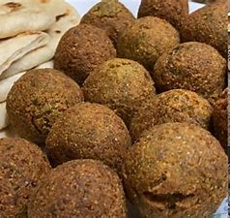
Falafel: Mediterranean

Slide 12
“Bakes”/Salt fish Fritters Barbados/Jamaica

Slide 13
Fish Cutlets: Sri Lanka

Slide 14
Patties: Jamaica

Slide 15
Milk Toffee: Sri Lanka

Slide 16
Mexican Blackbean Chili Chocolate Brownie

Slide 17
Suppli - Italy

Slide 18
Dalir Bora (Lentil Pakora)- Bangladesh

Slide 19
Sweet Potato Pudding (Jamaica)

