Slide 1
Resources
Worksheets
7Gc2 explaining Brownian Motion
7Gc5 using the nano scale
h/w recommendation
7Gc7 – Numerical measuring movements
Active Learn exercises
Practical

Slide 2
Objectives
Describe Brownian motion.
State where Brownian motion can be observed.
Explain how Brownian motion occurs, using particle theory.
Convert metres to nanometres and vice versa.

Slide 3
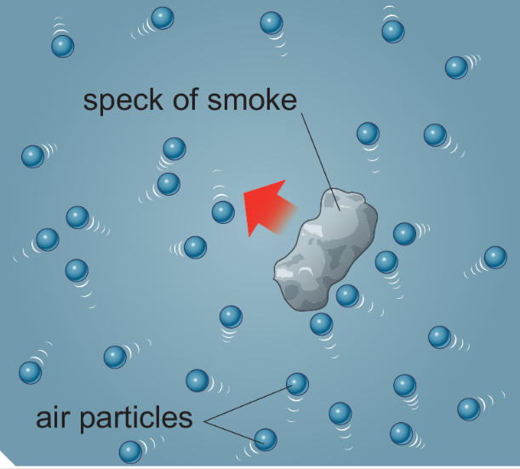
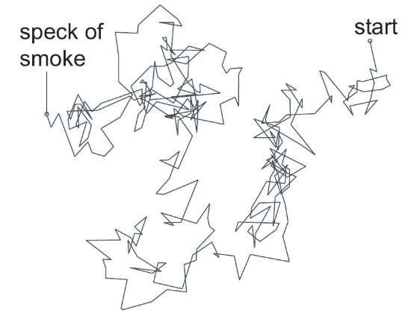
7Gc Brownian Motion
CW
Watch video & presentation on p112 or https://www.youtube.com/watch?annotation_id=annotation_1111465409&feature=iv&src_vid=4m5JnJBq2AU&v=NHo6LTXdFns
Stick in pictures and copy the definition
Brownian Motion is the erratic(random) movement of small specks of matter caused by being hit by the moving particles that make liquids or gases

Slide 4
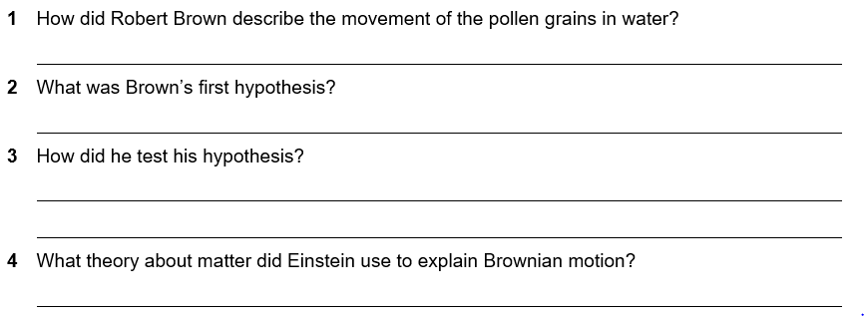
7Gc 2 Explaining Brownian Motion
He said they moved in a random, jerky way as if they were ‘dancing on the water’
At first Brown thought the pollen was alive
He used 100 year old pollen and this showed the same movements.
The particle theory of matter

Slide 5
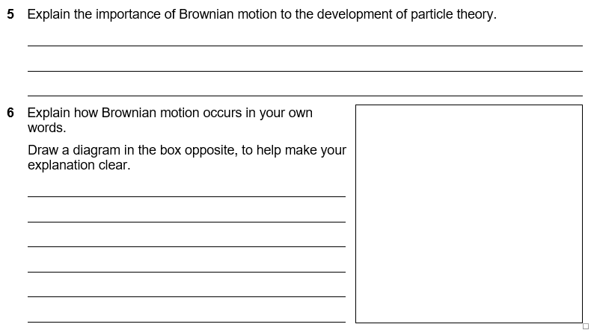
Einstein and others used the ideas of matter being made up of tiny moving particles to explain Brownian motion in detail. This was the conclusive proof of the idea and so the particle theory was confirmed
Brownian motion is produced by the tiny water particles hitting the pollen unevenly, so if many water particles hit one side of the pollen it is moved in the opposite direction. As the water particles’ movements are random the movement of the pollen is random

Slide 6
Comparing sizes
How big are the particles in solids, liquids and gases?

Slide 7
The particles that make up solids, liquids and gases are very small.
The best way to imagine them is to start from 1 metre and divide by 10 time after time.
You have to go down this scale quite far before you cannot see features with your eyes.
Below this, microscopes allow you to see the details.
However, even the most powerful microscopes (electron microscopes) cannot see particles of matter.

Slide 8
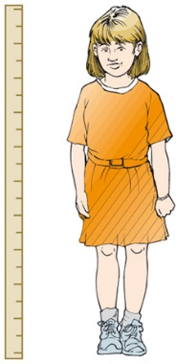
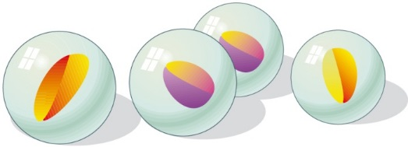
DVDs
0.1 metre
÷ 10
÷ 10
0.01 metre
1 centimetre, 1 cm
÷ 10
1 metre
Marbles
All of these are visible with your naked eyes.
© Pearson Education Ltd 2014. Copying permitted for purchasing institution only. This material is not copyright free.
Notes:
8

Slide 9
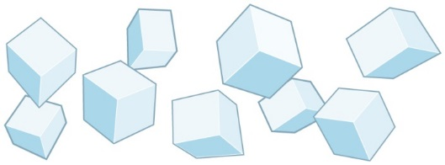
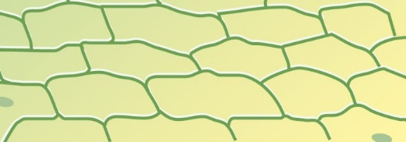
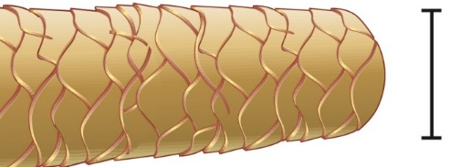
Salt crystals
Plant cells
÷ 10
÷ 10
0.00001 metre
0.001 metre
1 millimetre, 1 mm
0.0001 metre
÷ 10
Thickness of human hair
The salt and hair are visible with your naked eyes.
A microscope is needed to see the plant cells.
© Pearson Education Ltd 2014. Copying permitted for purchasing institution only. This material is not copyright free.
Notes:
9

Slide 10
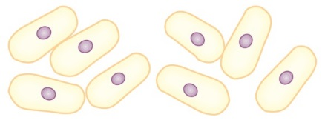
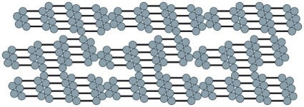
Small bacteria
Large molecule
0.000001 metre
1 micrometre, 1 μm
0.00000001 metre
÷ 10
÷ 10
0.000000001 metre 1 nanometre, 1 nm
÷ 10
0.0000001 metre
Virus
Atoms and small molecules
Bacteria and viruses can be seen through an electron microscope, but not even the most powerful microscopes can see atoms and molecules.
© Pearson Education Ltd 2014. Copying permitted for purchasing institution only. This material is not copyright free.
Notes:
10

Slide 11
Complete w/s 7Gc- 5

Slide 13
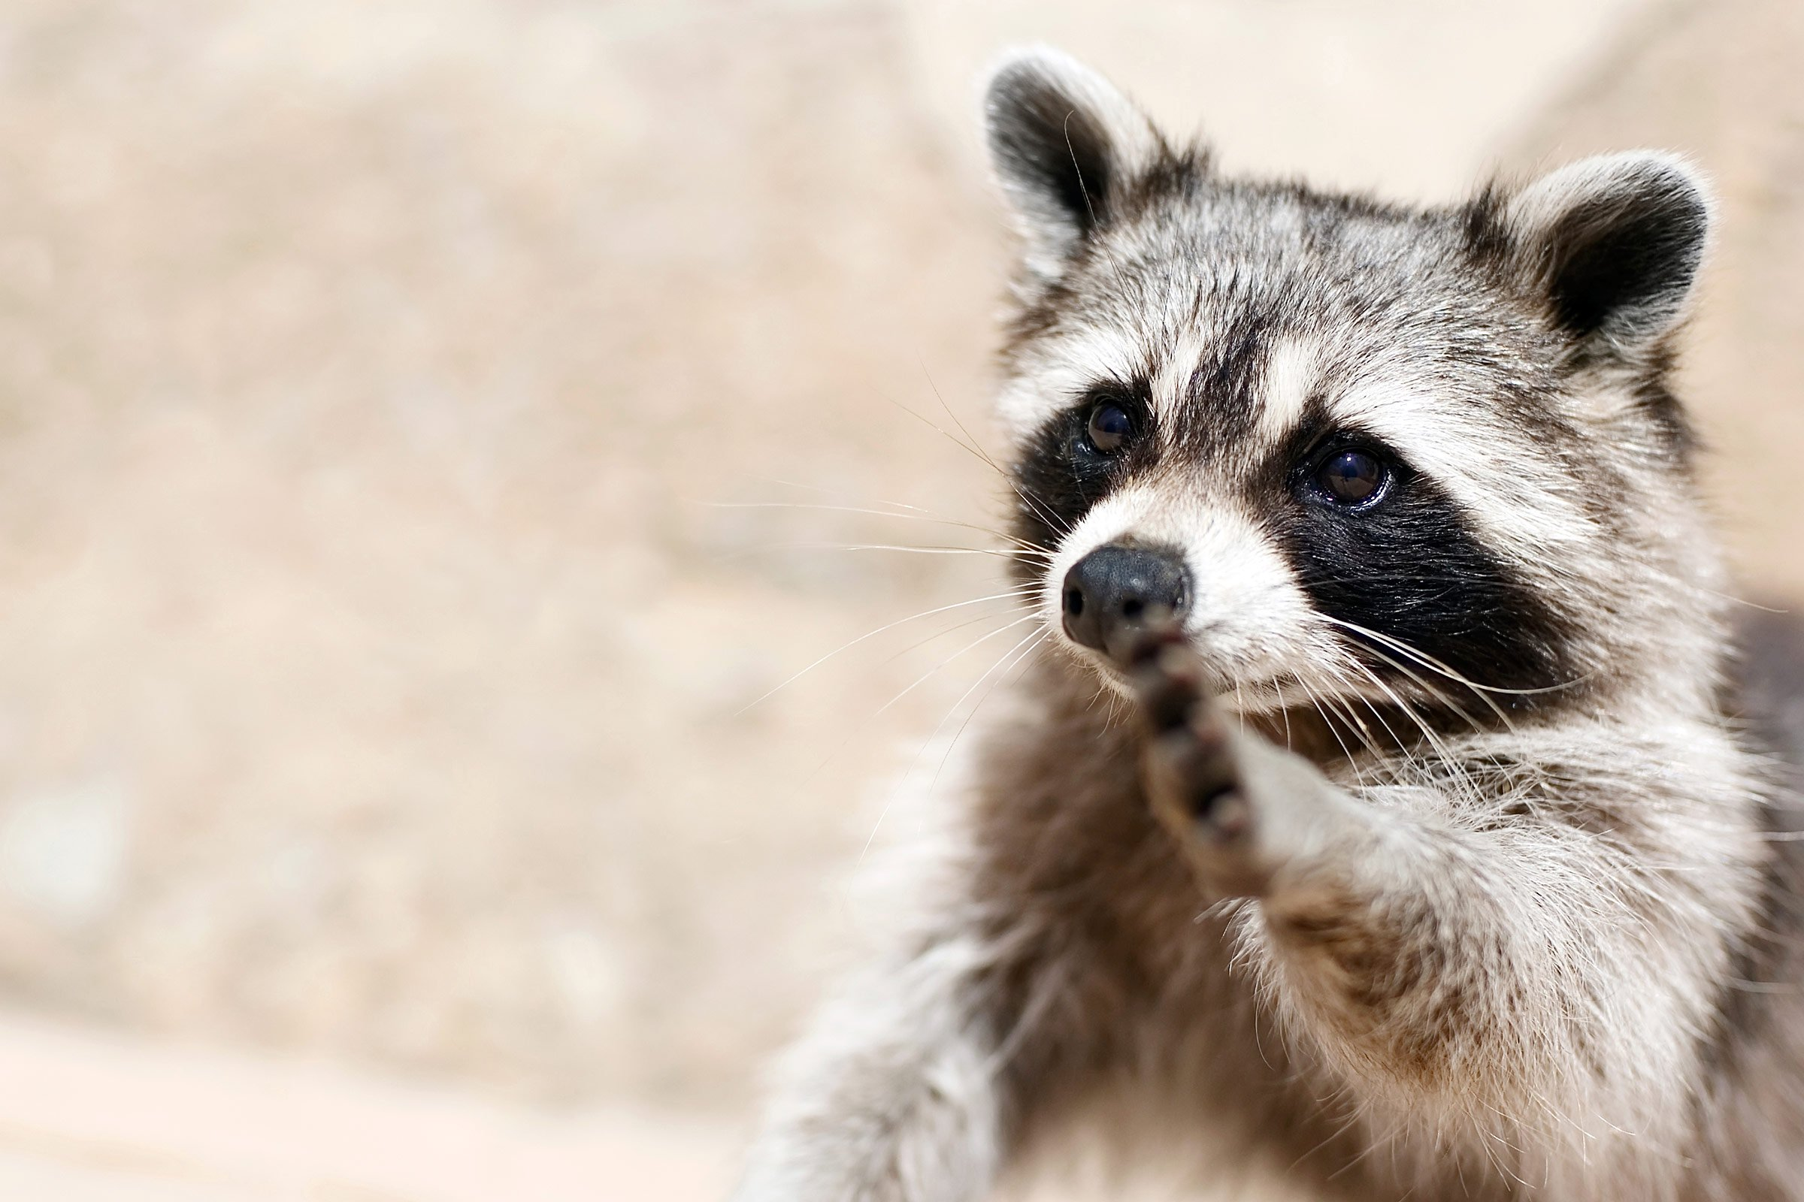
Homework:
7Gb7 measuring movements
Active learn:
Exercises 7Gc developing, secure & exceeding
Date due:

Slide 14
Key words

Slide 15
Thinking skills
Brownian motion

Slide 16
Consider all the possible answers to this statement:
A tiny speck floating on some water is seen to be moving slightly.
Possible answers
End show
© Pearson Education Ltd 2014. Copying permitted for purchasing institution only. This material is not copyright free.

Slide 17
Consider all the possible answers to this statement:
A tiny speck floating on some water is seen to be moving slightly.
It is being blown by the wind.
Someone is blowing on it.
The speck is a tiny organism that is moving.
Water particles are bumping into it.
Possible answers
Back to start
End show
© Pearson Education Ltd 2014. Copying permitted for purchasing institution only. This material is not copyright free.

Slide 18
Objectives
Describe Brownian motion.
State where Brownian motion can be observed.
Explain how Brownian motion occurs, using particle theory.
Convert metres to nanometres and vice versa.

