Slide 1
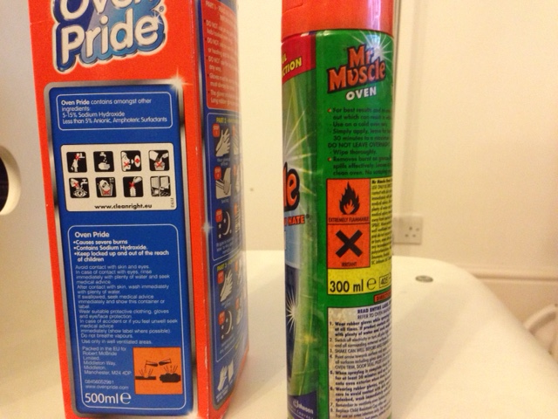
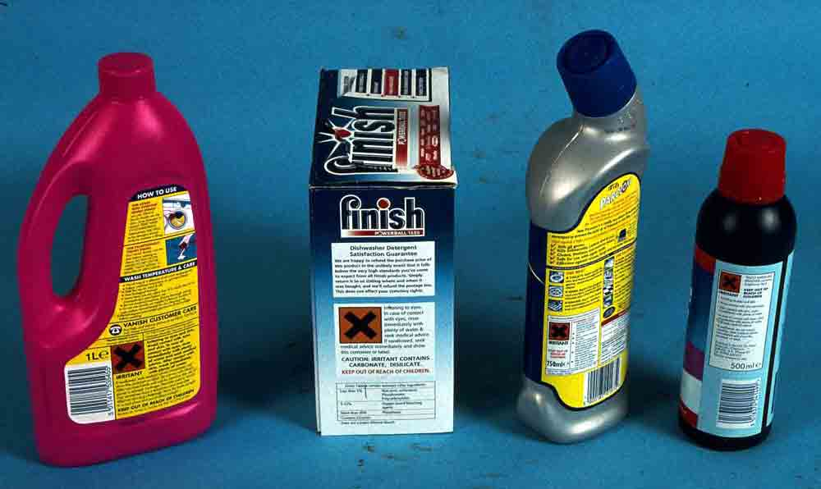
7F: Acids and Alkalis 7Fa: Hazards
Do Now:
How do we know if a substance is dangerous?

Slide 2
On many household items you will find hazard symbols
How many different ones can you see?

Slide 3
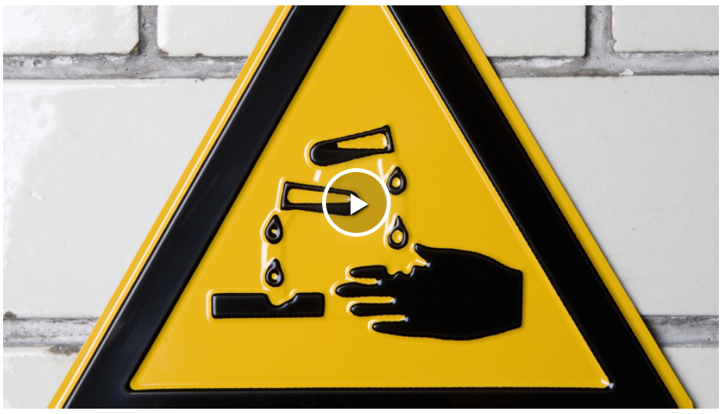
Notes:
Click the link and use the following details to log in:
dcallanan@highamsparkschool.co.uk
Highams1

Slide 4
Answer in your book
Hazard symbol would you see on an acid?
What are the safety precautions when using acids?
List 3 examples of acids
Corrosive
Wear goggles and use gloves
Citric acid, hydrochloric acid, vinegar, lemon juice, tea

Slide 5
What are acids and alkalis and where can you find them?
What are the safety precautions when using acids?
Watch and make notes on acids, alkalis and give 3 examples of each

Slide 6
Copy & Complete
Acids and ________ are substances found in homes and ______. They can be __________ which means they can attack metals, stone or skin.

Slide 7
Answers
alkalis
Acids and ________ are substances found in homes and ______. They can be __________ which means they can attack metals, stone or skin.
labs
corrosive
Watch and make notes

Slide 8
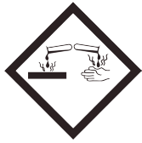
Stick in & Complete
Oxidizing (may intensify fire)
Compressed Gases
Harmful to the Environment
Flammable
Risk of Serious Health Effects
Explosive
Corrosive to skin or metals
Toxic
Irritant

Slide 9
What do hazard symbols mean?
https://quizizz.com/admin/quiz/5c63d42ca7d584001a1a4668/hazard-symbols-and-safety-in-the-lab
Notes:
https://quizizz.com/admin/quiz/5c63d42ca7d584001a1a4668/hazard-symbols-and-safety-in-the-lab
https://www.doddlelearn.co.uk/app/teacher/launch-content/bf6760c7-11ea-4f38-aebf-f7836d5f6a20
https://www.doddlelearn.co.uk/app/teacher/launch-content/1cec1fa6-db4e-4cb9-91e6-501f3255fe34 7Ea Acids in action
Chemical Reaction (Part One) Worksheet 1 accompanies this slide.

Slide 10
What do hazard symbols mean?
Notes:
7Ea Acids in action

Slide 11
Stick in the table in your books and complete with hazard description .
Where can these symbols be found?
Why do we use these symbols

Slide 12
Are all acids corrosive?
Copy & Complete
Acids and alkalis used in labs are often d_______ with water, which makes them less dangerous. Although not corrosive, these acids can be i_________, causing inflammation and soreness
iluted
rritants
What happens when you get vinegar in a cut? Why?

Slide 13
Practical: Comparing Acids
Health and Safety
Must wear goggles
Acids and Alkalis are corrosive therefore must be handled with safety and sensibly
You will be working in pairs
Anyone messing will be banned from doing practicals for this unit.

Slide 14
Results
Acid | What did you see happening
X
Y
Z

Slide 15
Method
A Fill a test tube one-third full with acid X
B Put one of the marble chips in the tube.
C Watch what happens for about two minutes. Write your observations in the table.
D Do the same with acid Y and acid Z in new test tubes.
E When the tests are finished pour the liquids away (do not let marble chips go down the drain).

Slide 16
Results
Acid | What did you see happening
X
Y
Z

Slide 17
Considering Your Results
1 I think the most hazardous acid was _______________________________________________
2 The least hazardous acid was ______________________________________________
3 I thought this because ___________________________
_______________________________________________

