Slide 1
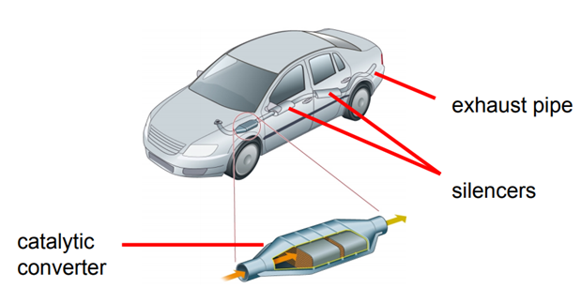

Slide 2
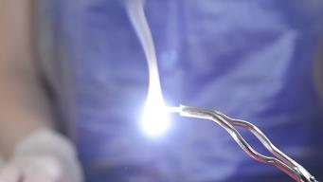
Word Equations
reactants → products
Magnesium reacts with oxygen to become magnesium oxide.
tin + oxygen → tin oxide.

Slide 3
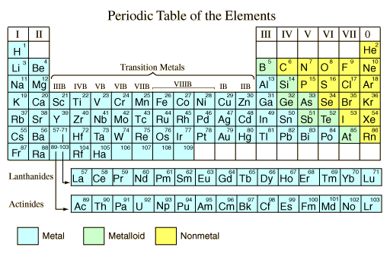
When non-metal elements react with metal elements to form compounds, they are spelt with -ide at the end.
Complete these word equations
lead + oxygen →
aluminium + chlorine →
zinc + sulphur →
calcium + fluorine →
lead oxide
aluminium chloride
zinc sulphide
calcium fluoride

Slide 4
Practical:
You will heat up three different metal elements in the blue flame of a Bunsen burner and observe the changes. Each of the elements will react with oxygen to form a new substance.
Your teacher will instruct on to how to do the practical safely
Metal | Appearance before heating | Appearance after heating | Name of the product
Copper
Iron
Magnesium

Slide 5
Write word equations for each of the reactions:
copper + oxygen →
iron + oxygen →
magnesium + oxygen →
copper oxide
iron oxide
magnesium oxide

Slide 6
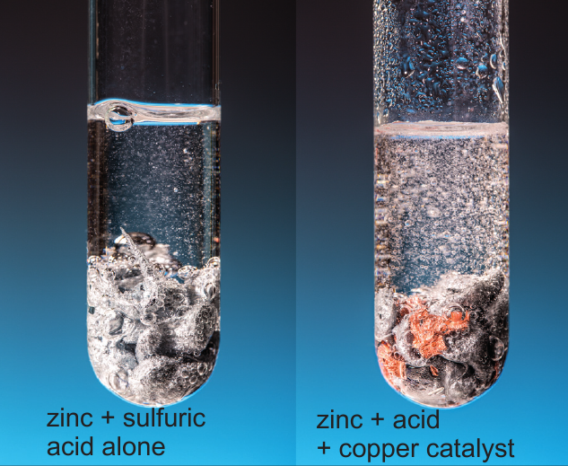
Catalysts
Catalysts are substances that can speed up a chemical reaction and remains unchanged. Some metals are catalysts for some reactions.
Practical:
Add the sulphuric acid to some magnesium in a test tube and observe how quickly the bubbles of gas are formed.
Repeat this, but this time add some copper.

Slide 7
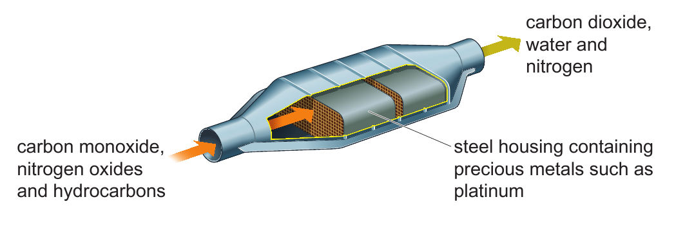
Catalytic converters
Chemical reactions in catalytic converters change harmful gases from the engines exhaust into less harmful ones.
Very expensive metals
Write a word equation describing the chemical reactions in the catalytic converter.
Carbon monoxide + nitrogen oxides + hydrocarbons → carbon dioxide + water + nitrogen

