Slide 1
Objectives
Recall examples of everyday substances that are alkalis.
Recall the colour changes associated with litmus indicator.
Describe how indicators are used to distinguish between acidic, alkaline and neutral solutions.
Use solutions of known acidity/alkalinity in order to deduce a colour chart for an indicator.
Explain why litmus is purple in neutral solutions.
Evaluate the effectiveness of different indicators.

Slide 2
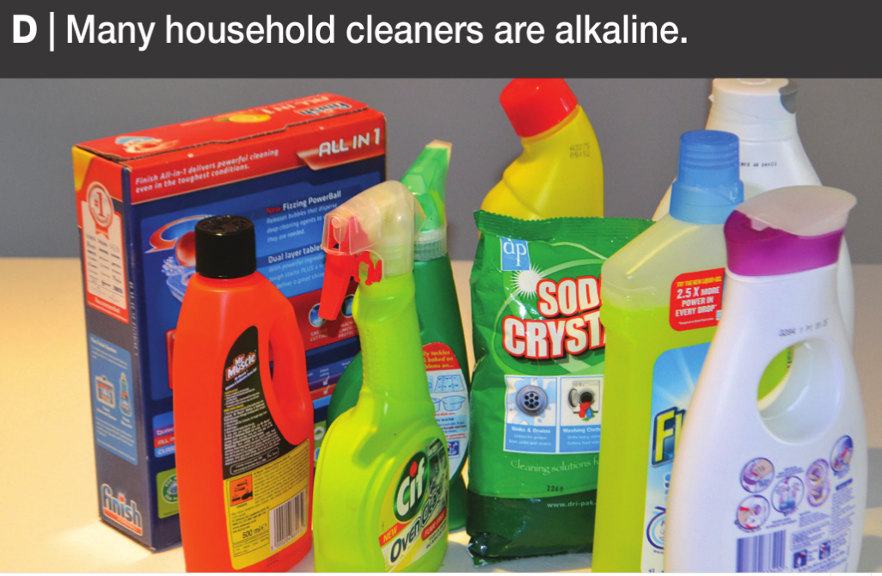
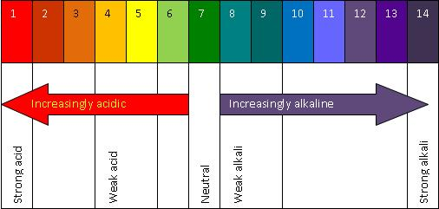
CW
7Fb indicators
Can you give examples of everyday substances that are alkali?
@hpscience

Slide 3
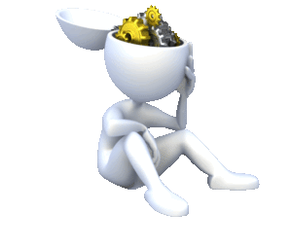
Stick this pH scale into your book.
Answer the following questions in full sentences.
Hint: Use your book to help you. What indicator did we use in our first practical?
What does the pH scale tell us?
The pH scale tell us…
2. What can I use to test whether a solution is acid, alkaline, or neutral?
To test whether a solution is acid, alkaline or neutral I could use….

Slide 4
How can we tell if something is an acid?
 Discuss in pairs what do you think indicator means?
Copy and complete the word fill.
I_______ are substances that change c_____ to tell you if something is acidic, a______, or n______.
They are often made from coloured p_____ e.g. red c_______.

Slide 5
What is an indicator?
The colours from plants that change colour when mixed with different types of substances are called indicators.
Litmus is a commonly used indicator. It can be added to filter paper, or used as a liquid. Litmus is made from lichen, which grows on stone and rock.
alkali
neutral
acid

Slide 6
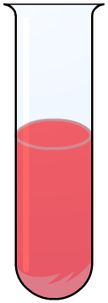
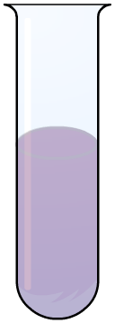
What is an indicator?
Litmus can be blue or red. Blue litmus turns red under acidic conditions (< pH 4.5), and red litmus turns blue under alkaline conditions (> pH 8.3).
What colour do you think litmus is under neutral conditions?
alkali
neutral
acid

Slide 7
The litmus test
Notes:
Teacher notes
A is alkaline
B is acidic
C is neutral

Slide 8
Making indicators from plants

Slide 9
How would the pH scale for red cabbage indicator be different universal indicator?

Slide 10
Practical – Red Cabbage Indicator .
Risk Assessment and Health and Safety
Must wear goggles.
Acids and Alkalis are corrosive therefore must be handled with safely and sensibly.
Working with hot water, be careful when pouring hot water to avoid any burns. Run under cold tap if an accident occurs.
Anyone seen misbehaving will be sent out and banned from doing practicals for this unit!!

Slide 11
Table of results
Copy and complete the table.
Tables MUST be drawn neatly.

Slide 13
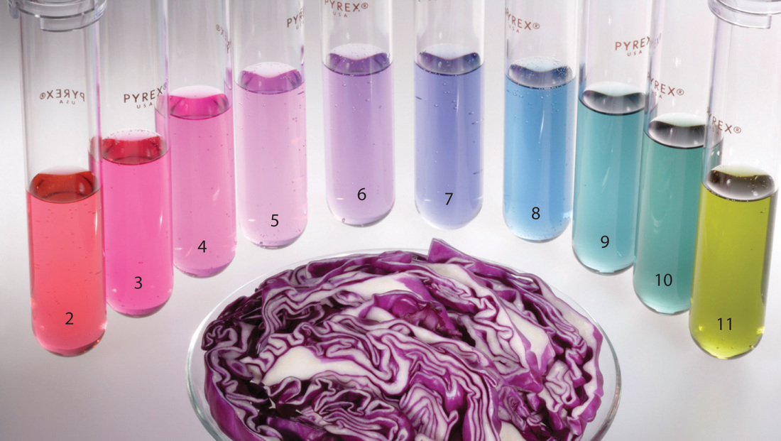
Practical – Red Cabbage Indicator .
This practical is in 2 parts.

Slide 14
Task: answer the following questions in your books

Slide 15
Answers

Slide 16
Ext.

Slide 17
Answer

