Slide 1
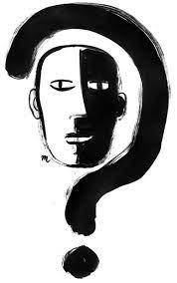
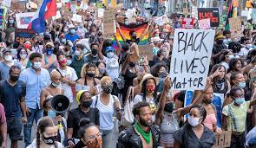
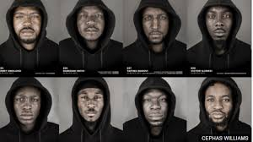
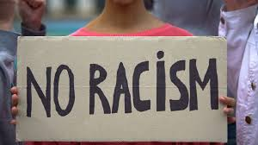
RACISM
BY KARIMA SRHIR , JESSICA ADDO ,MADELAINE CAIGER BROWN

Slide 2
institutional racism

Slide 3
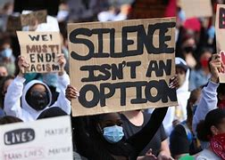
What is institutional racism?
" institutional racism " describes societal patterns / structures that impose oppressive or otherwise negative conditions on the basis of race or ethnicity
Oppression may come from business, the government, the health care system, schools, or the court, among other institutions

Slide 4
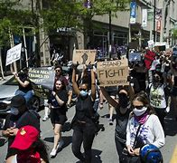
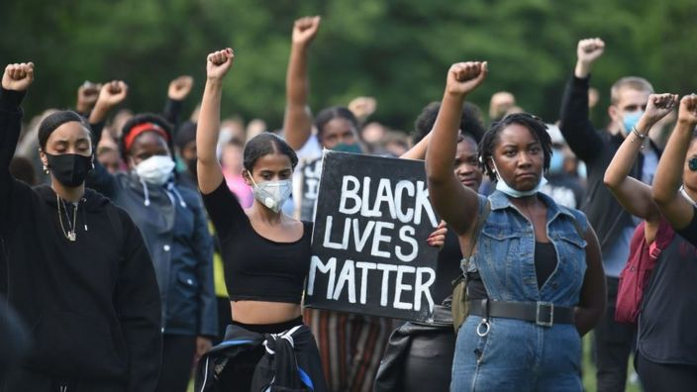
What is institutional racism?
Racism can take many forms… such as verbal or physical abuse
Other elements of racism are harder to see, like in schools or workplaces operating in a way that discriminates against a person because of their race
Meaning people from certain backgrounds are at a disadvantage or treated differently
This is called systemic, structural or institutional racism

Slide 5
Ending racism in business: 'We've still got work to do’ - Jamelia Donaldson
Some business in the UK take part in black pound day
The idea is for people to make a deliberate effort to spend money at black-owned businesses, either physically or online, on the first Saturday of every month
Jamelia says she deliberately puts black female employees in positions of leadership in her company - because her business is trying to reach black women consumers
"So, I do think it is important that Black Pound Day happens every month. If it was just one month of the year like Black History Month then we won't have that visibility and they will forget about us.”
"We need that consistency because it helps normalise shopping black and [that] there are black business owners and black shoppers."

Slide 6
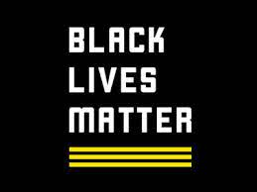
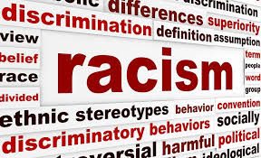
Racial stereotypes
Racial stereotypes are automatic and exaggerated mental pictures that we hold about all members of a particular racial group. When we stereotype people based on race, we don’t take into account individual differences. Because our racial stereotypes are so rigid, we tend to ignore or discard any information that is not consistent with the stereotype that we have developed about the racial group.
Are Our Racial Stereotypes Harmful?
However, in most cases, racial stereotypes are harmful because they ignore the full humanity and uniqueness of all people. When our perceptions of different races are distorted and stereotypical, it’s demeaning, devaluing, limiting, and hurtful to others. In some cases, people who are repeatedly labeled in negative ways will begin to develop feelings of inferiority. Sometimes, these feelings of inferiority can lead to self-fulfilling prophecies that perpetuate the stereotype.
Racial stereotypes affect society from within schools, workplaces and jail. Often black men are targeted. They are the majority of excludees, fired employees and prisoners.

Slide 7
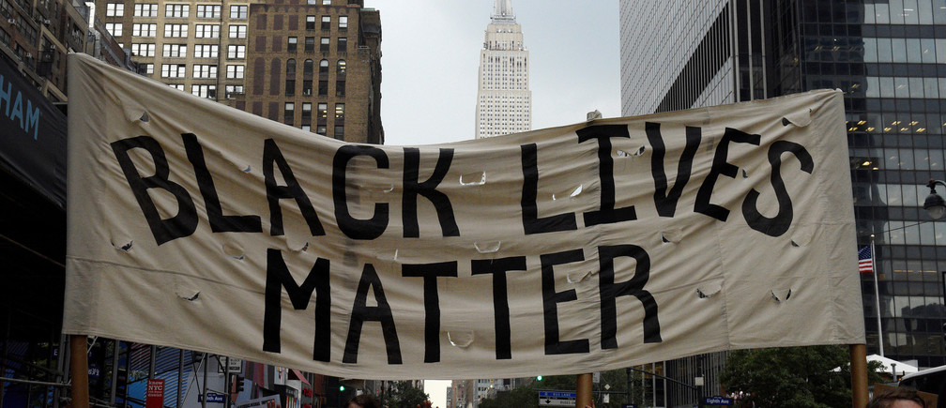
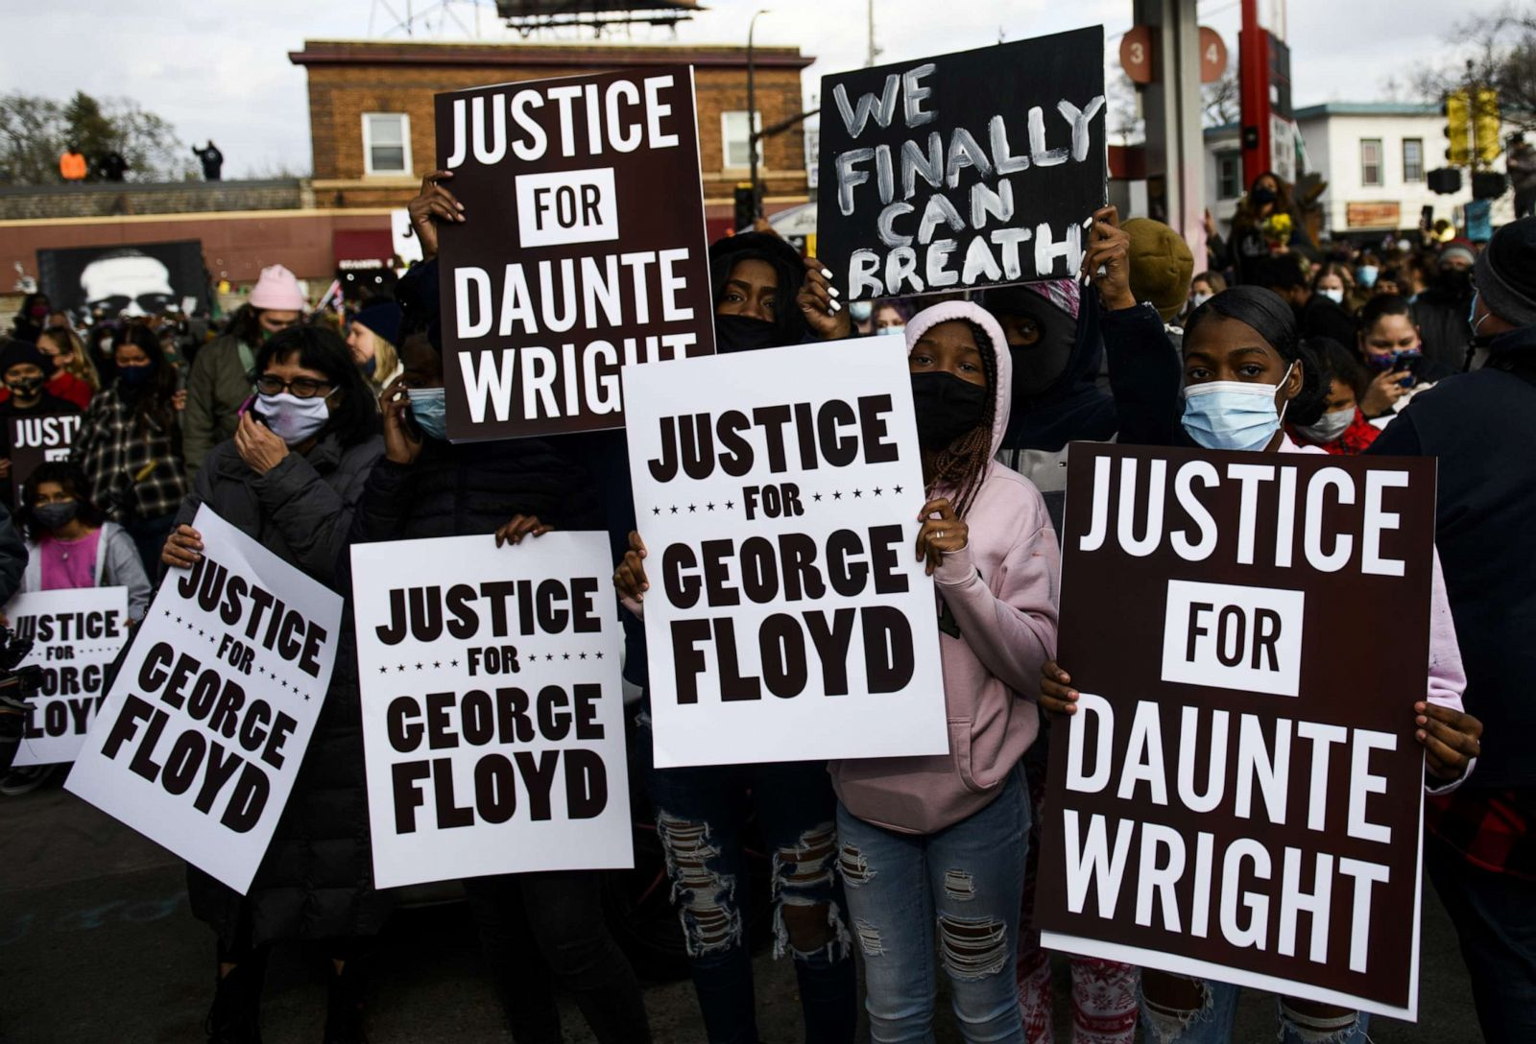
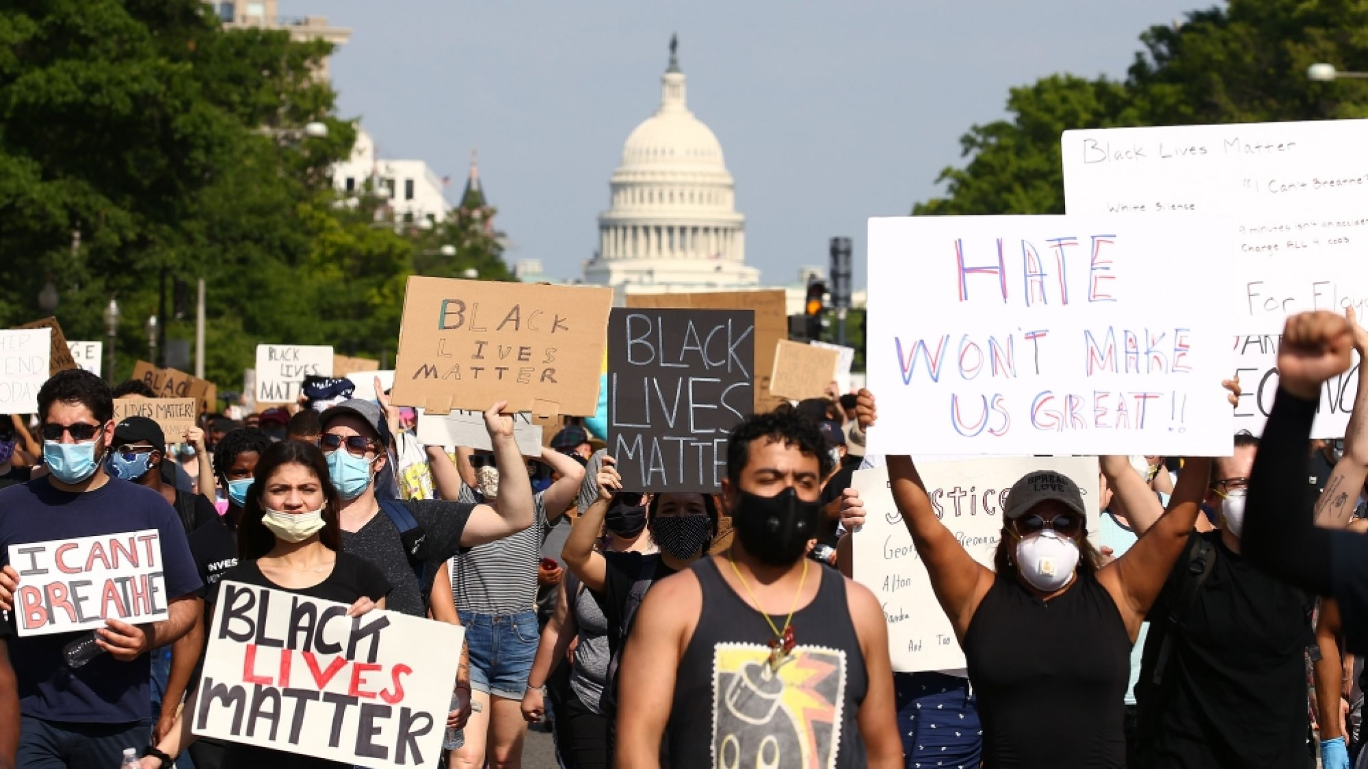
Black Lives matter movement

Slide 8
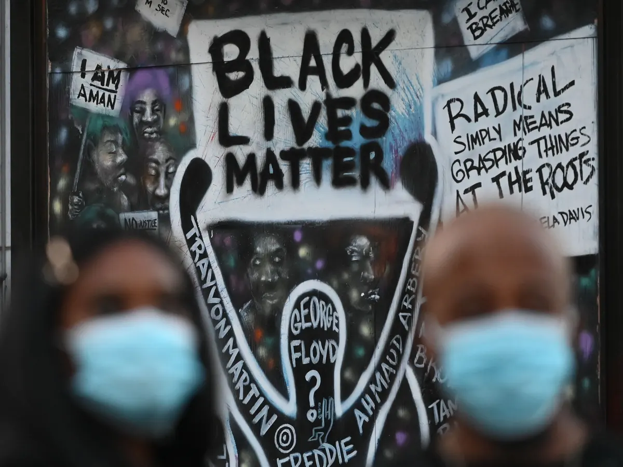
The BLM movement
In 2013 the Black Lives Matter movement was created after the murder of Trayvon Martin. It is a global organisation in the UK, US, Canada and so on, it was created in order to get rid of white supremacy.
Black Lives Matter is not spreading a message saying only black lives matter but rather black lives matter too as they have been oppressed for years and not seen as important
People usually take part in peaceful protests as the movement does not promote violence
BLM also goes against police brutality as it is a big problem in America as well as the UK

