Slide 1
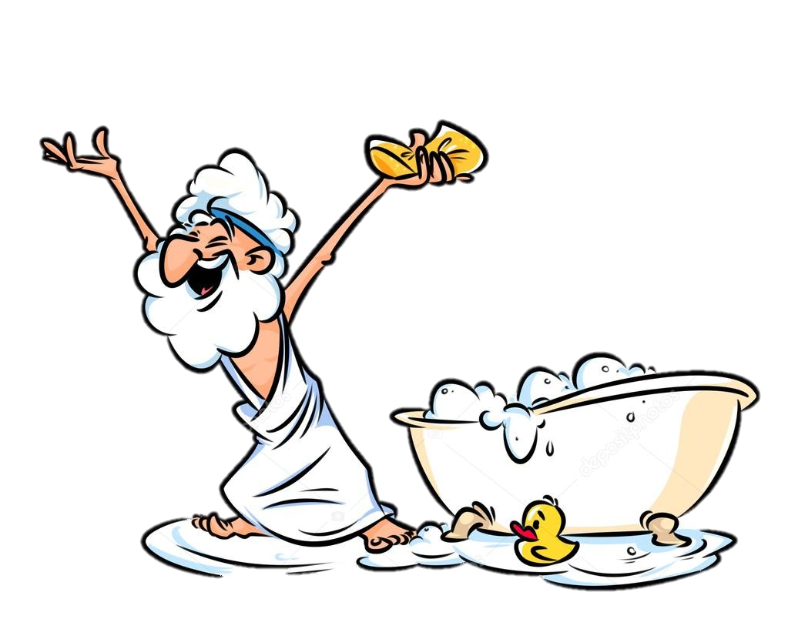
8Ga2: Metal Properties
What tests could we do to find out whether something is metal or not?

Slide 2
Requisitions
Equipment | Worksheets
Copper Iron Magnesium Oxygen Gas Jars DEMO: Zinc & Sulphuric Acid & Copper Catalyst

Slide 3
Word Equations
Write Down
$$reactants →products$$
$$A+B →C+D$$
For example:
Magnesium reacts with oxygen to become magnesium oxide
$$Magnesium+Oxygen →Magnesium Oxide$$
Try this:
Tin reacts with oxygen to form tin oxide

Slide 4
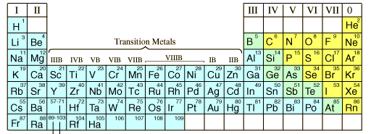
Write Down
When non-metal elements react with metal elements to form compounds, they are spelt with –ide at the end.

Slide 5
Complete these word equations
$lead+oxygen →$
$aluminium + chlorine →$
$zinc+sulphur →$
$calcium+fluorine →$
$$lead oxide$$
$$aluminium chloride$$
$$zinc sulphide$$
$$calcium fluoride$$
Self Asses ? /4

Slide 6
Practical – Reactions with Oxygen
You will heat up three different metal elements in the blue flame of a Bunsen burner and observe the changes.
Each of the elements will react with oxygen to form a new substance.
Metal | Appearance before heating | Appearance after heating | Name of the product
Copper
Iron
Magnesium

Slide 7
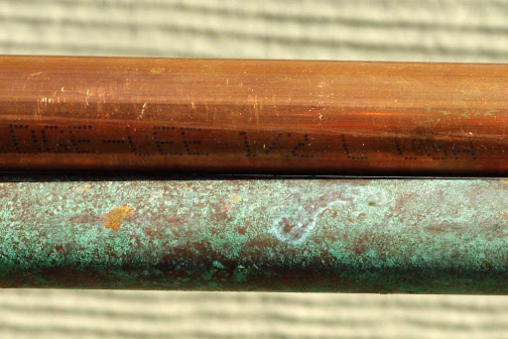
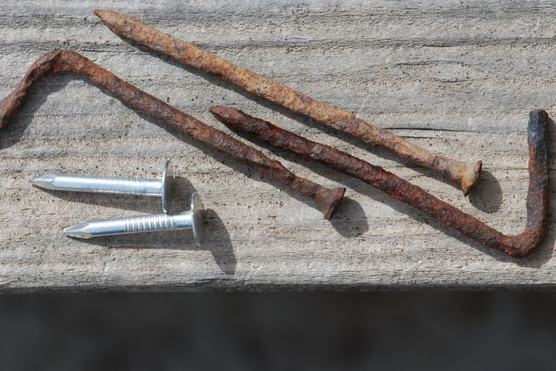
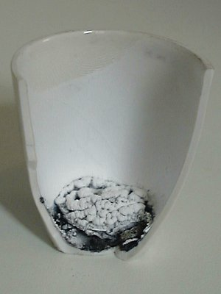
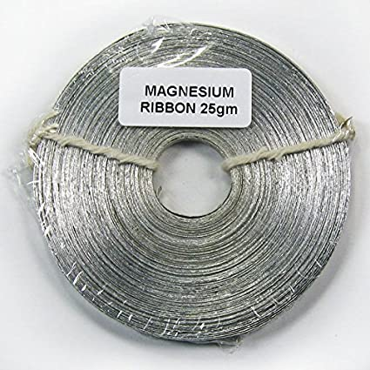

Slide 8
Practical – Reactions with Oxygen
Do Now:
Name the products formed when each of the metals were reacted with oxygen
Metal | Appearance before heating | Appearance after heating | Name of the product
Copper
Iron
Magnesium

Slide 9
Write word equations for each of the reactions:
copper + oxygen →
iron + oxygen →
magnesium + oxygen →
copper oxide
iron oxide
magnesium oxide

Slide 10
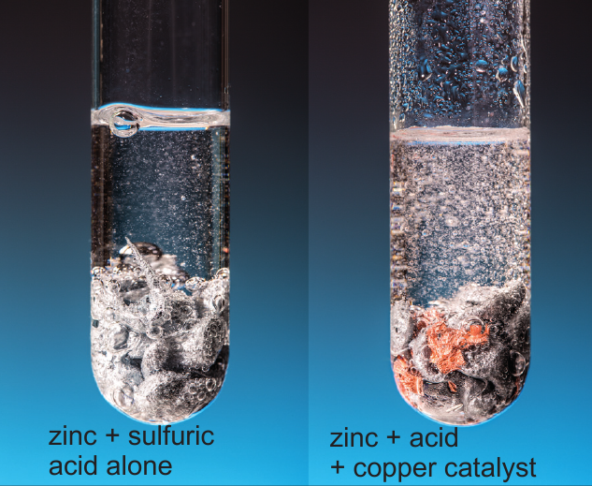
Catalysts
Write Down
Catalysts are substances that can speed up a reaction but remain unchanged themselves
Demonstration
Sulphuric acid and magnesium in a test tube – note how quickly the bubbles are formed.
The test is run again with some copper added – in what way did the reaction change?

Slide 11
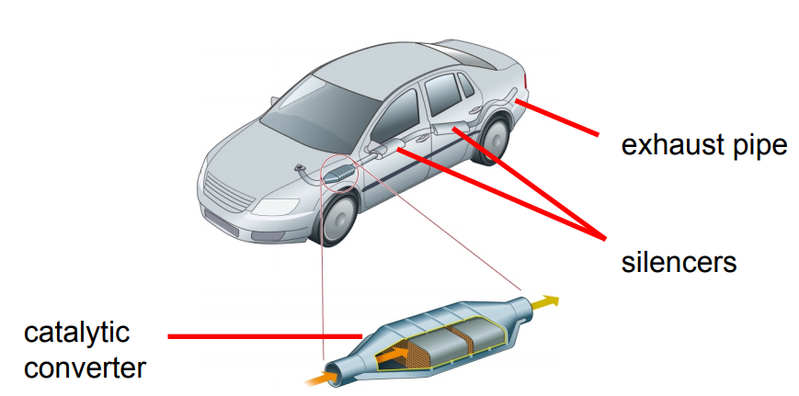
Write Down
Catalytic Converters
Chemical reactions in catalytic converters change harmful gases from the engines exhaust into less harmful ones.

Slide 12
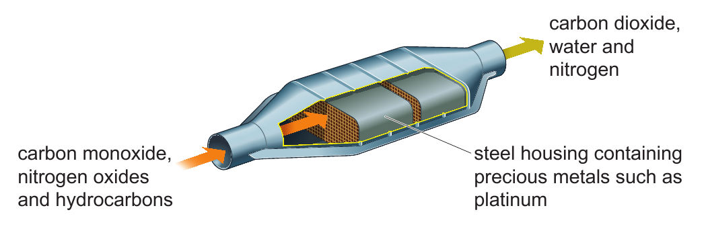
Catalytic Converters
Write a word equation describing the chemical reactions in the catalytic converter.
Carbon monoxide + nitrogen oxides + hydrocarbons $→$carbon dioxide + water + nitrogen

