Slide 1
Breast Cancer Awareness

Slide 2
Introduction
One-quarter of cases are diagnosed in women aged 75 and over
Just over 10,000 women are diagnosed with breast cancer under the age of 50 every year in the UK
Of these, around 7,600 women will be in their 40s. Around 2,300 women in the UK are diagnosed aged 39 or under, or just 4% of all cases.
400 men are also diagnosed.
Notes:
Introduction
Each year more than 41,700 women in the UK are diagnosed with breast cancer. Around 300 men each year are also diagnosed.
Breast cancer causes more than 12,400 deaths each year in the UK.
Cancer Research UK 2002

Slide 3
What can we do to help?
Bring a £1 to donate to Cancer Research UK
Collections made at the gate
Society Awareness Day
Our Awareness Day 15.10.20

Slide 4
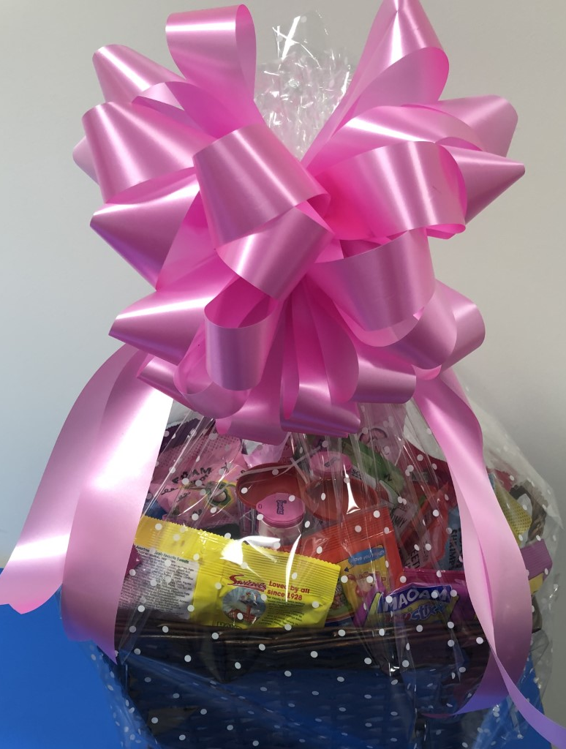
Lets make it a House competition!
The best dressed staff member earns 5 House Points for their House
The best dressed student earns 5 House Points for their House
10 House Points up for grabs and Sweet Hamper for the winning student

