Slide 1
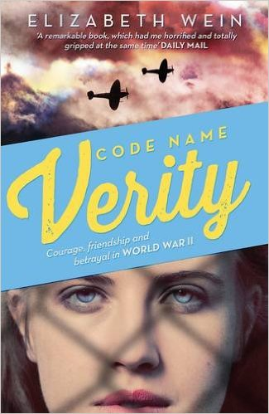
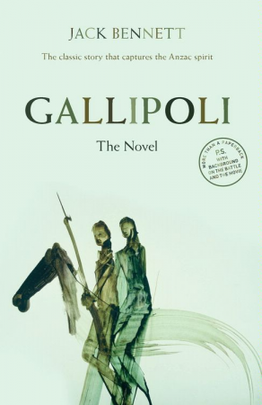
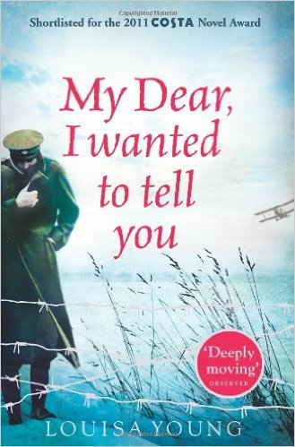
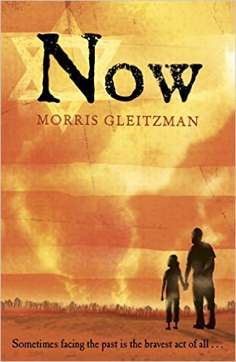
Books in our library on the topic of war

Slide 2
Shortlisted for the Carnegie Medal, Code Name Verity is a bestselling tale of friendship and courage set against the backdrop of World War Two.
Only in wartime could a stalwart lass from Manchester rub shoulders with a Scottish aristocrat, one a pilot, the other a special operations executive. When a vital mission goes wrong, and one of the friends has to bail out of a faulty plane over France, she is captured by the Gestapo and becomes a prisoner of war. The story begins in ‘Verity’s’ own words, as she writes her account for her captors.
Truth or lies? Honour or betrayal? Everything they’ve ever believed in is put to the test . . .
Elizabeth Wein is a leading voice in young adult historical fiction. Her novel Rose Under Fire was nominated for the Carnegie Medal and shortlisted for the Costa Award 2014.
Fans of The Book Thief and Carmen Reid's Cross My Heart will love this.
Look out for Elizabeth's other books Black Dove, White Swan and Rose Under Fire.
Elizabeth Wein was born in New York, and grew up in England, Jamaica and Pennsylvania. She is married with two children and now lives in Perth, Scotland.
Elizabeth is a member of the Ninety-Nines, the International Organization of Women Pilots. She was awarded the Scottish Aero Club's Watson Cup for best student pilot in 2003 and it was her love of flying that partly inspired the idea for her bestselling, award-winning novel Code Name Verity.
‘A remarkable book’ Daily Mail

Slide 3
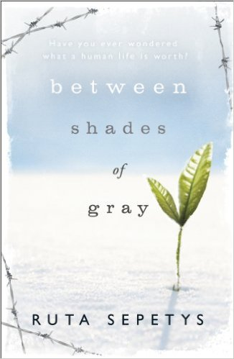
Between Shades of Gray is a haunting and powerful Second World War novel by Ruta Sepetys
That morning, my brother's life was worth a pocket watch . . .
One night fifteen-year-old Lina, her mother and young brother are hauled from their home by Soviet guards, thrown into cattle cars and sent away. They are being deported to Siberia.
An unimaginable and harrowing journey has begun. Lina doesn't know if she'll ever see her father or her friends again. But she refuses to give up hope.
Lina hopes for her family. For her country. For her future. For love - first love, with the boy she barely knows but knows she does not want to lose . . .
Will hope keep Lina alive?
Set in 1941, Between Shades of Gray is an extraordinary and haunting story based on first-hand family accounts and memories from survivors.

Slide 4
A novel of overwhelming emotional power, Birdsong is a story of love, death, sex and survival. Stephen Wraysford, a young Englishman, arrives in Amiens in northern France in 1910 to stay with the Azaire family, and falls in love with unhappily married Isabelle. But, with the world on the brink of war, the relationship falters, and Stephen volunteers to fight on the Western Front. His love for Isabelle forever engraved on his heart, he experiences the unprecedented horrors of that conflict - from which neither he nor any reader of this book can emerge unchanged.

