Slide 1
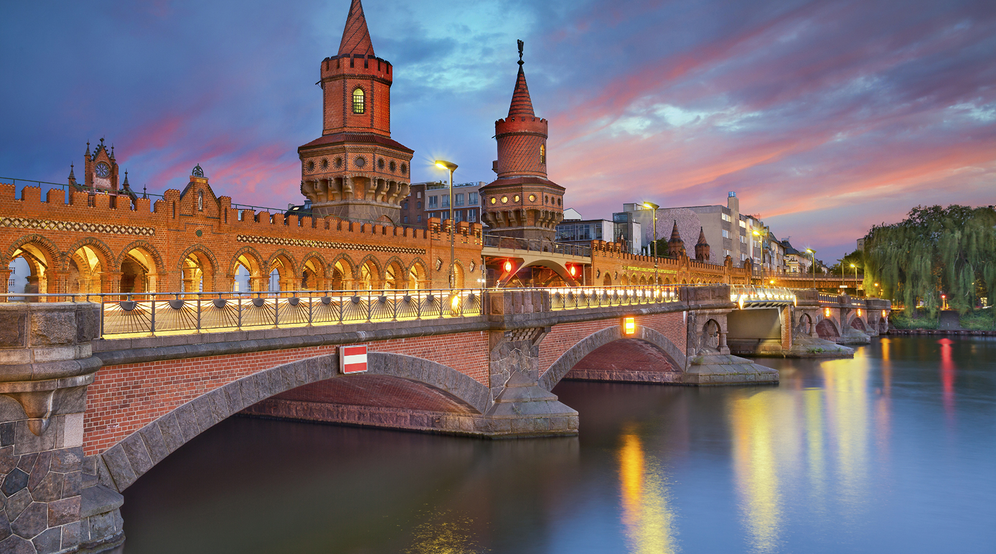
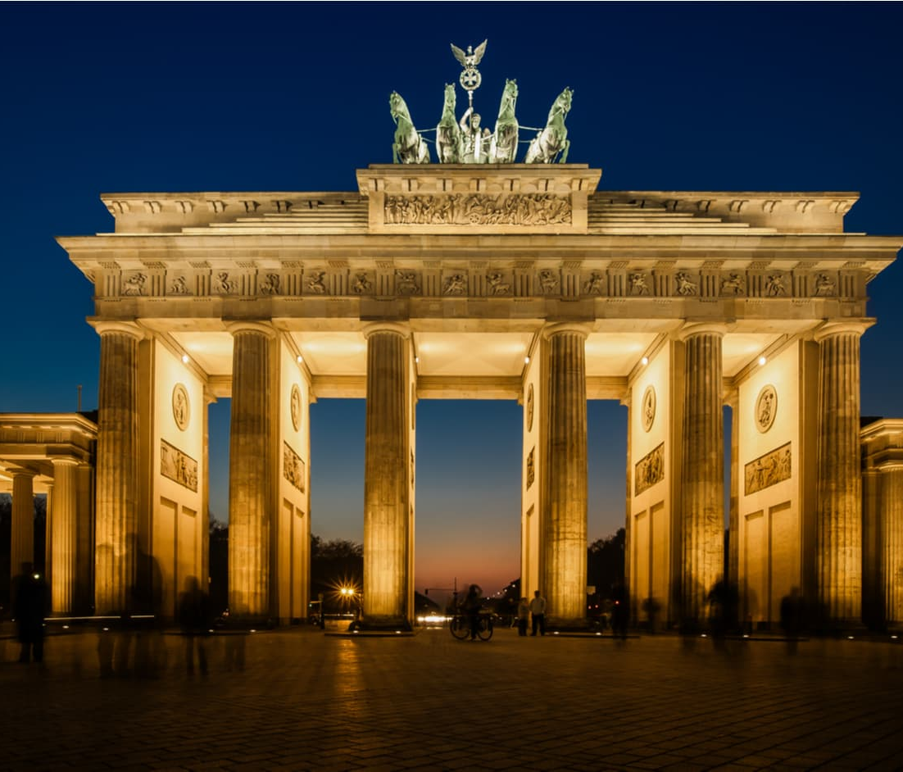
TRIP TO BERLIN,GERMANY!
4 day adventure trip to Berlin, covering GCSE content from the Cold War and Nazi Germany!

Slide 2
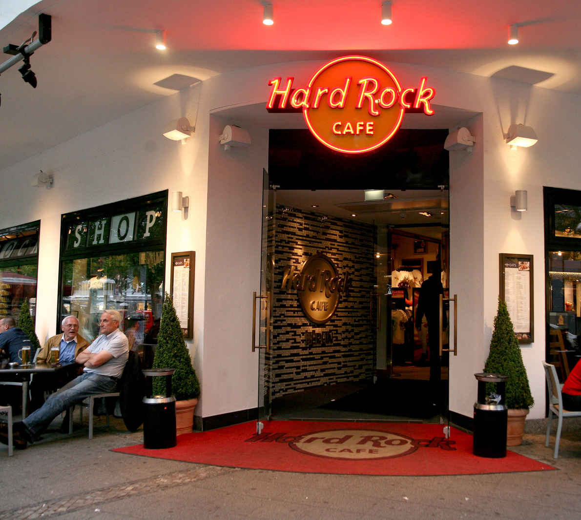
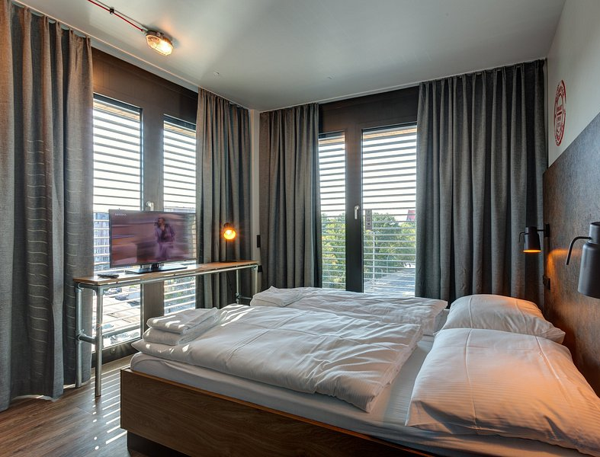
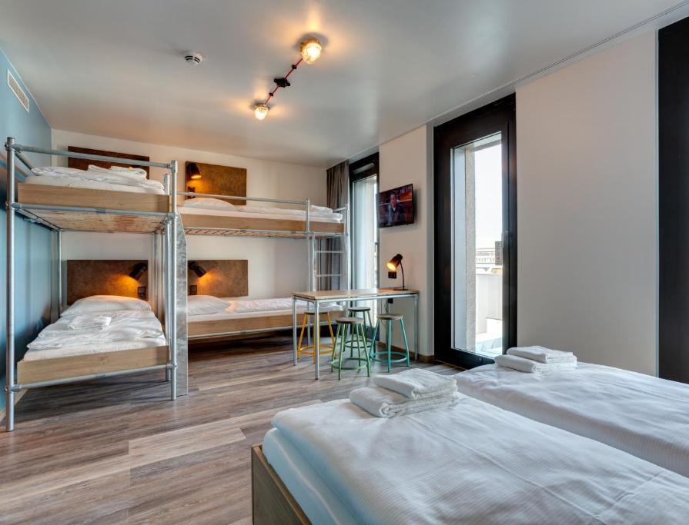
Approx. £800 including flights, accommodation, food and all activities!

Slide 3
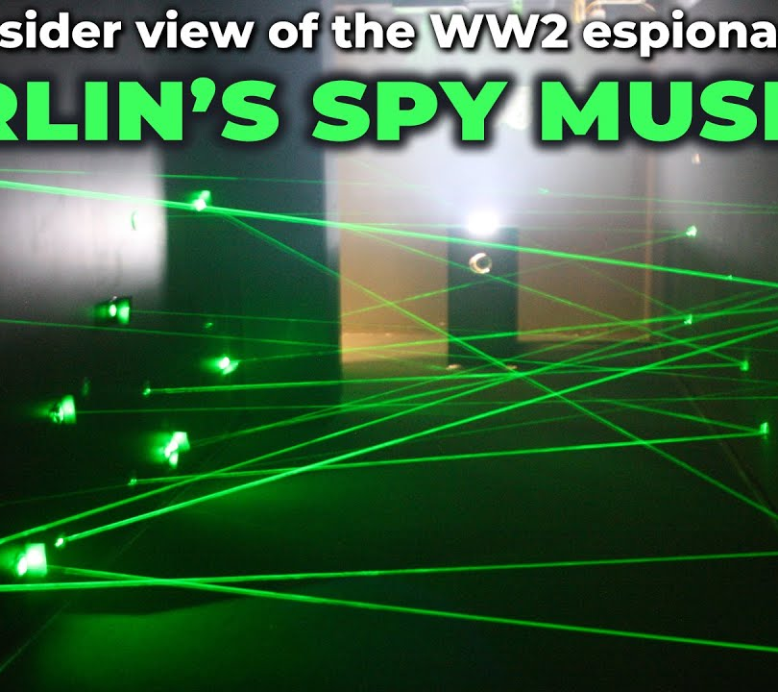
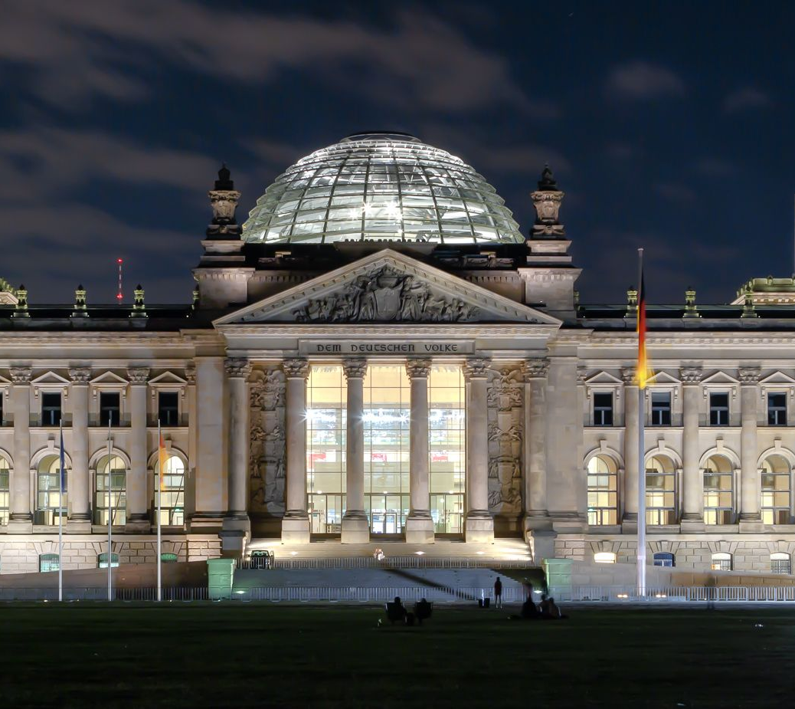
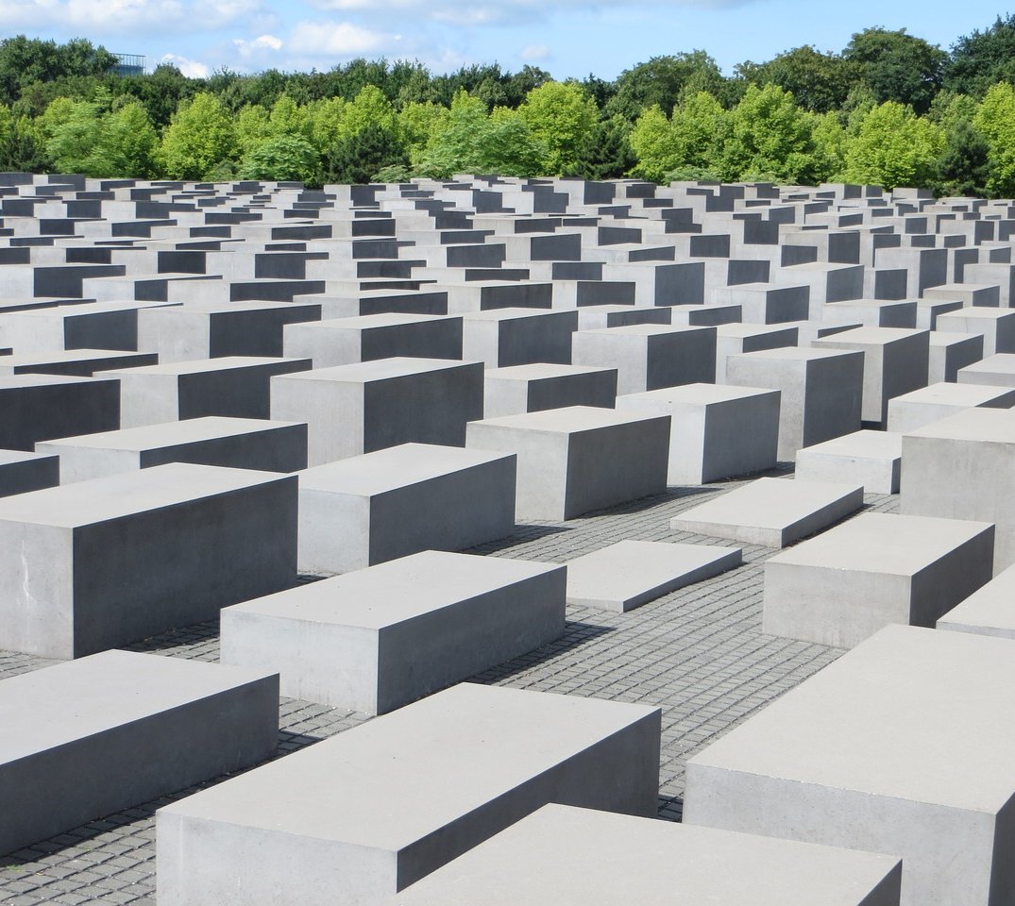
Activities include:
Day trip to Sachsenhausen Concentration Camp
Topography of Terror
Visit to Reichstag
Visit to Stasi Prison
Berlin Wall Memorial
Visit to Spy Museum
Bowling
Shopping

Slide 4
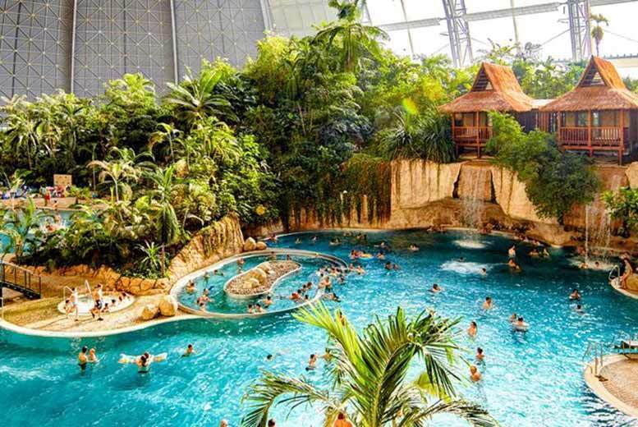
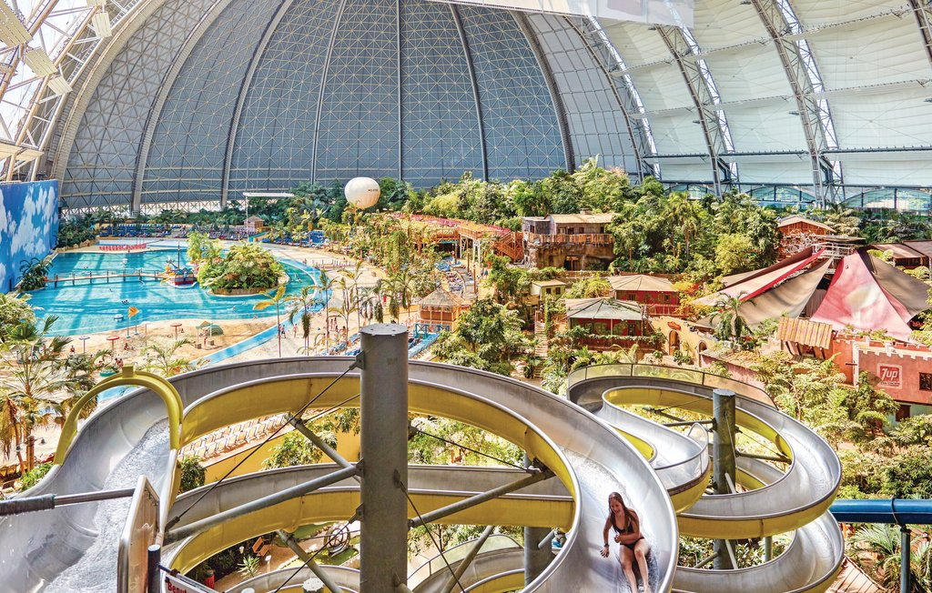
Trip to Berlin Tropical Island water park!

