Slide 1
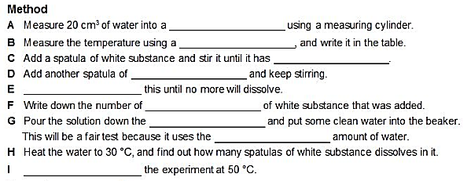
7Eb Solutions
CW
Do Now:
Stick in your worksheet and complete the method

Slide 2
Requisitions
Equipment | Worksheets
7Eb.3 Practical | 7Eb.3 Worksheet] 7Eb.5

Slide 3
7Eb.3 Temperature & Solubility
beaker
thermometer
dissolved
white substance
Repeat
spatulas
drain
same
Repeat

Slide 5
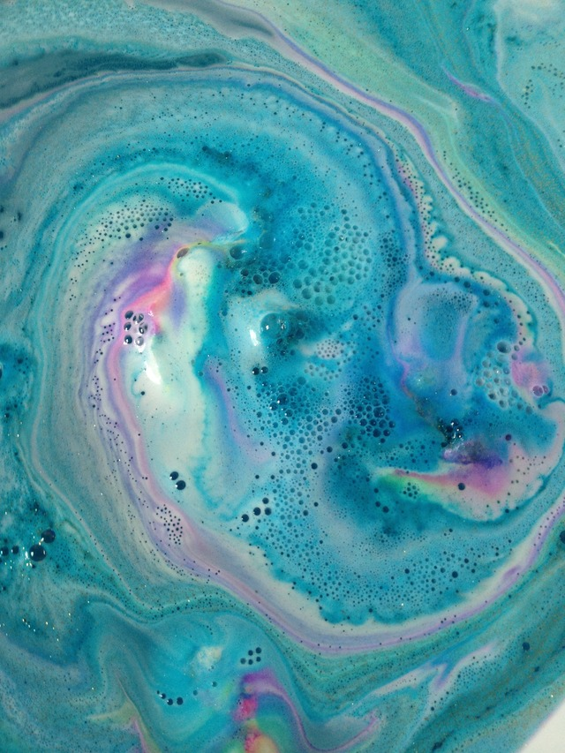
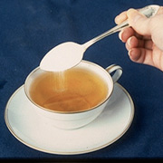
Describe the Images

Slide 6
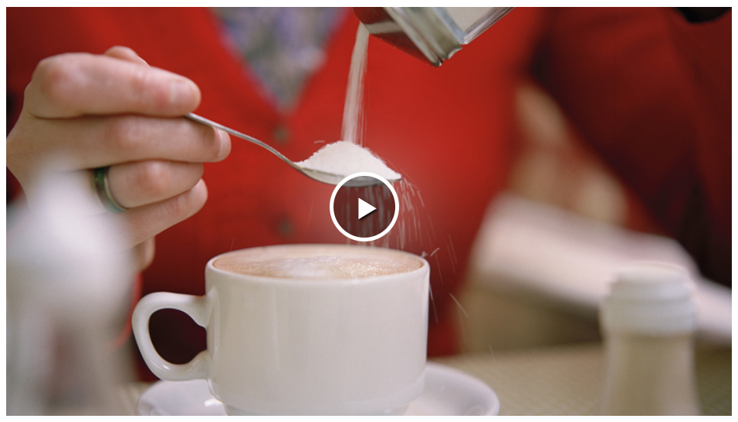

Slide 7
Copy & Complete
Some substances dissolve in a liquid to make a ________. The dissolved substance breaks up into pieces so ______ that light can pass straight through the _______. Therefore solutions are __________. A solution can be coloured or ________ depending on the substances in it.
solution
small
solution
transparent
colourless

Slide 8
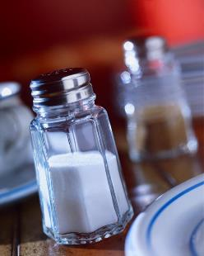
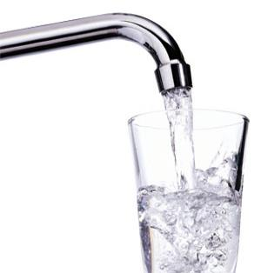
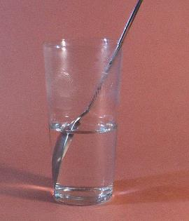
+
=
What is the a) solute b) solvent c) solution in the images above?

Slide 9
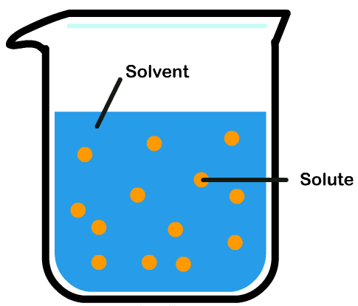
The liquid in a solution is called the ____________ The substance that is dissolved is called the _________
Copy & Complete
solvent
solute

Slide 10
A liquid in which other substances dissolve | A mixture formed when a substance dissolves in a liquid | The amount of substance that dissolves in a given amount of liquid
See through | When a substance splits up and mixes with a liquid to make a solution | Something that will dissolve in a liquid
Something that will not dissolve in a liquid | When a solution contains the most solute that will dissolve in the solvent | The substance that has dissolved in a liquid to make a solution
Dissolves
Insoluble
Soluble
Solution
Saturated
Solubility
Solvent
Solute
Transparent

Slide 11
Dissolves – when a substance splits up and mixes with a liquid to make a solution
Insoluble – Something that will not dissolve in a liquid
Soluble- Something that will dissolve in a liquid
Solution – a mixture formed when a substance dissolves in a liquid
Saturated – When a solution contains the most solute that will dissolve in the solvent
Solubility – the amount of substance that dissolves in a given amount of liquid
Solvent – a liquid in which other substances dissolve
Solute – the substance that has dissolved in a liquid to make a solution
Transparent – see through

Slide 12
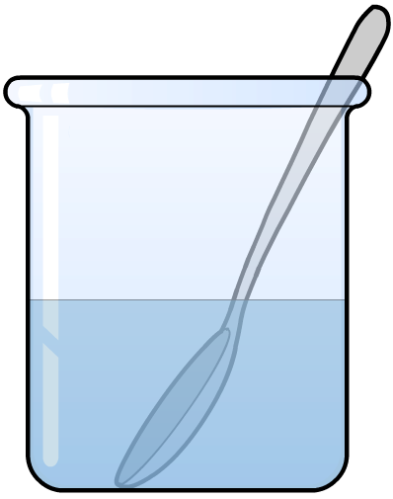
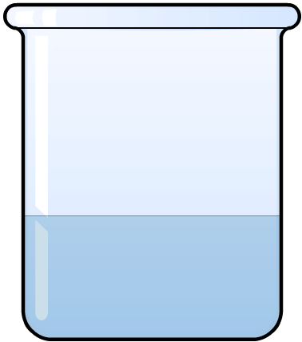
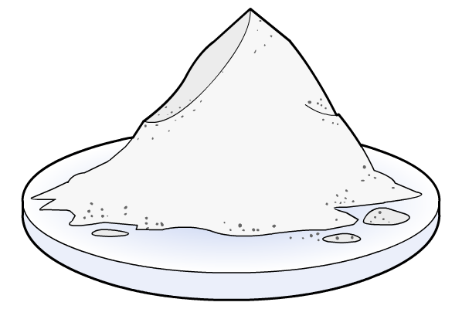
Conservation of Mass
If 10g of salt is added to 50g of pure water, what is the mass of the solution?
Mass of Solution = Mass of Solvent + Mass of Solute
+
➔
?
50 g
+
10 g
➔
60 g

Slide 13
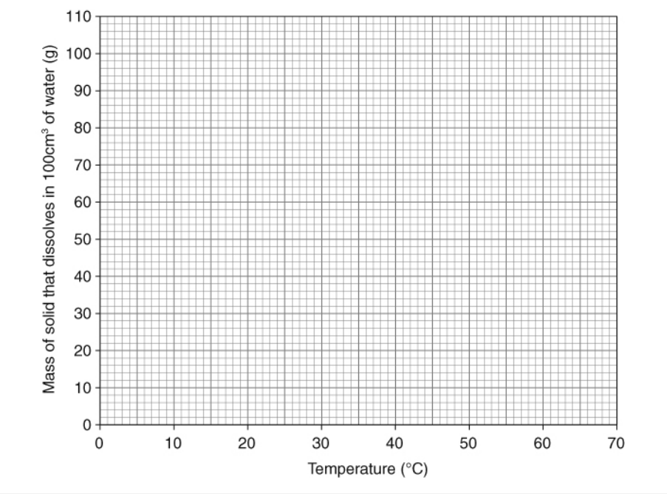
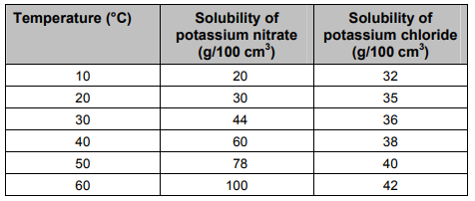
Complete 7Eb.5

Slide 14
When the temperature goes up, the mass of solid that dissolves (goes up/goes down/stays the same).
At 10 °C, more potassium (chloride/nitrate) dissolves.
At 40 °C, more potassium (chloride/nitrate) dissolves.
At 55 °C, you would expect (31/36/41/48) grams of potassium chloride to dissolve.
To get 70 grams of potassium nitrate to dissolve, you would need to heat the water to about (25/35/45/55) degrees.

