Slide 1
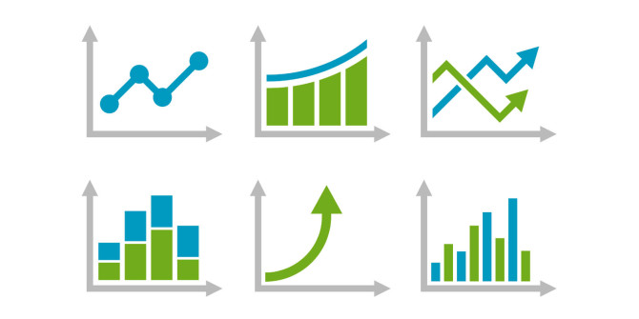
C/W
30/07/2018
7Lf – Graphs & Remembering
Back of your book - Write a list of as many different types of graphs and features of a graph as you can think of.
Why do we use graphs in Science?

Slide 2
Key Skills to learn
Working Scientifically | Literacy & Communication
Identify line graphs and scatter graphs, and extract information from them.
Evaluate different ways of remembering information
Present data in line graphs and scatter graphs.
Identify patterns in scatter graphs.

Slide 3
We use graphs to show how one variable compares to another.

Slide 4
This line graph shows how one variable (distance) changes as the another variable (time) changes.

Slide 5
Graphs can be used to look for a relationship (link) between two quantitative variables.
What does ”quantitative” mean?
Quantitative means the variable is measured with a number (i.e. a quantity).

Slide 6
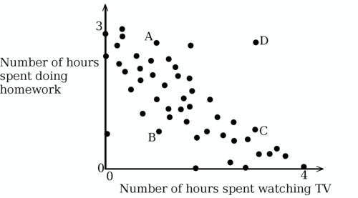
This scatter graph is missing something that would help us explain the relationship between the variables.
What is missing?
A line of best fit is the “best” straight line that can be drawn through the points.

Slide 7
What is the relationship this graph shows?
As (variable on x-axis) increases…..
Variable on y-axis (increases/decreases)
This is positive correlation.

Slide 8
Turn to page 188-189.
Read through and answer questions 1-5 in FULL SENTENCES.
Line graph Scatter graph Relationship
Correlation Line of best fit

Slide 9
Self assess.

Slide 14
Key Skills to learn
Completed
Working Scientifically | Literacy & Communication
Identify line graphs and scatter graphs, and extract information from them.
Evaluate different ways of remembering information
Present data in line graphs and scatter graphs.
Identify patterns in scatter graphs.

Slide 15
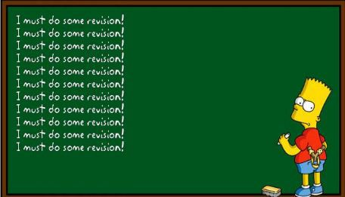
How can we remember what we’ve learnt?
What methods do we use to remember when we revise?

Slide 16
How can we remember what we’ve learnt?
Mnemonics
Words or phrases that can help you to remember lists of things (extra helpful if you need to remember the order!)………e,g. MRS GREN.

Slide 17
How can we remember what we’ve learnt?
Concept maps
Often facts in science are linked together and your brain finds it easier to remember facts if it understands the links. To help us do this we can make a Concept/Mind Map.

Slide 18
How can we remember what we’ve learnt?
Extension
Can you make up your own mnemonic?
Task - Make a revision concept map for our unit on sound.
Use a double page of your book starting it on the left hand side.
Use diagrams, colours & underlining to highlight the key parts.

Slide 19
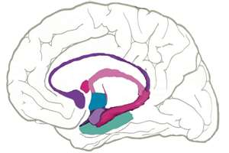
How sound travels…
4) The ear then sends a message to the brain
Air molecules
1) An object makes a sound by vibrating
2) The vibrations pass through air by making air molecules vibrate
3) These vibrations are picked up by the ear

Slide 21
 Give a clue or definition for these keywords.
Hot Seat

Slide 22
Hot seat
 Give a clue or definition for these keywords.
Longitudinal

Slide 23
Hot seat
 Give a clue or definition for these keywords.
Superposition

Slide 24
Hot seat
 Give a clue or definition for these keywords.
Correlation

Slide 25
Hot seat
 Give a clue or definition for these keywords.
Sound wave

Slide 26
Hot seat
 Give a clue or definition for these keywords.
hertz

Slide 27
Hot seat
 Give a clue or definition for these keywords.
Amplitude

Slide 28
Hot seat
 Give a clue or definition for these keywords.
Transverse

Slide 29
Hot seat
 Give a clue or definition for these keywords.
Decibel

Slide 30
Hot seat
 Give a clue or definition for these keywords.
Energy

Slide 31
Hot seat
 Give a clue or definition for these keywords.
Intensity

Slide 32
Hot seat
 Give a clue or definition for these keywords.
Crest

Slide 33
Hot seat
 Give a clue or definition for these keywords.
Frequency

Slide 34
Reqs
Class practical
Demos
Slinky
Worksheets & Books
16 x Photocopies of page 188-189 of Yr 7 Exploring Science Textbook.

