Slide 1
Ma journée scolaire

Slide 3
Les réponses
Je quitte =
J’arrive =
Je retrouve =
On commence =
Je mange =
Je chante =
On recommence =
Je rentrer =
I leave
I arrive
I meet *with my friends*
We start
I eat
I sing
We restart
I come back

Slide 4
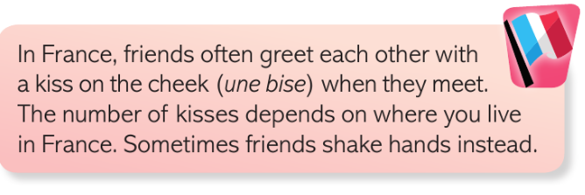
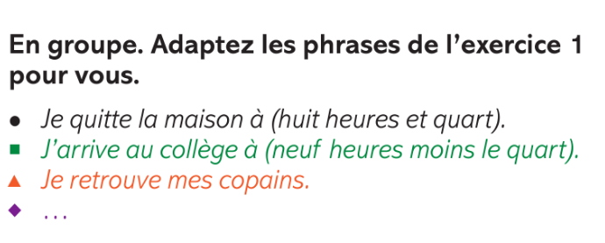
https://vimeo.com/200149286

Slide 5
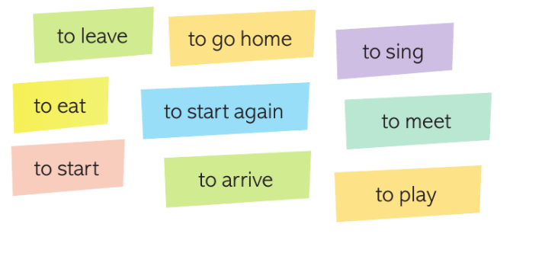
arriver
quitter
retrouver
commencer
manger
chanter
rentrer
recommencer

Slide 6
Les réponses
Je quitte =
J’arrive =
Je retrouve =
On commence =
Je mange =
Je chante =
On recommence =
Je rentrer =
I leave (verbe quitter = to leave)
I arrive (verbe arriver = to arrive)
I meet *with my friends* (verbe retrouver = to meet)
We start (verbe commencer = to start)
I eat (verbe manger = to eat)
I sing (verbe chanter = to sing)
We restart (verbe recommencer = to restart)
I come back (verbe rentrer = to come back)

Slide 7
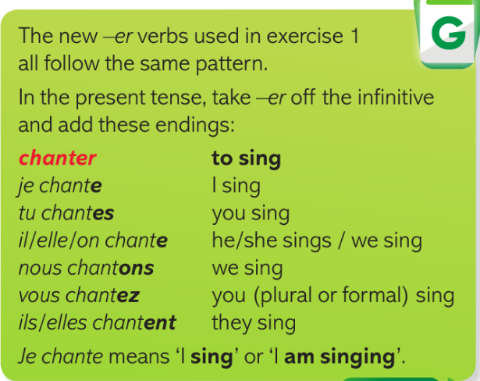
https://www.activeteachonline.com/product/view/id/997/page/40/mode/dps?modal=/player/video/id/801168

Slide 9
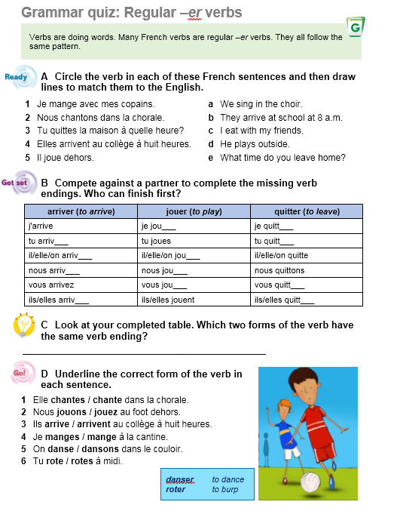
Feuille de travail

Slide 10
Les réponses
quitte
monte
retrouve
surfe
regarde
arrive
comencent
adore
déteste
jouons
discutons
aimes

Slide 11
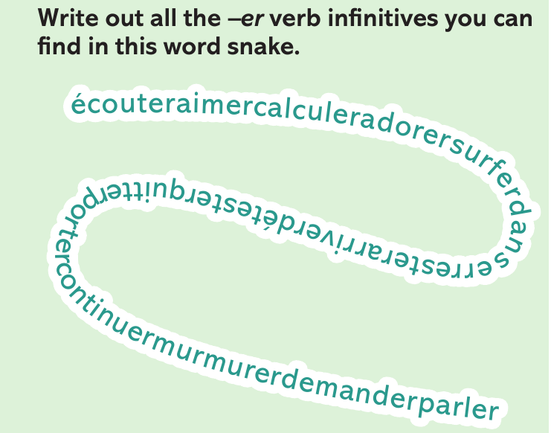
Les réponses
ÉCOUTER = TO LISTEN
AIMER = TO LIKE
CALCULER = TO CALCULATE
ADORER = TO LOVE
SURFER = TO SURF
DANSER = TO DANCE
RESTER = TO STAY
ARRIVER = TO ARRIVE
DÉTESTER = TO HATE
QUITTER = TO LEAVE
PORTER = TO WEAR
CONTINUER = TO CONTINUE
MURMURER = TO WHISPER
DEMANDER = TO ASK
PARLER = TO TALK

