Slide 1
Burning fuels: Learning objectives
To be able to carry out a practical to compare fuels
To understand how to make your test a fair test
To be able to recall characteristics of a good fuel

Slide 2
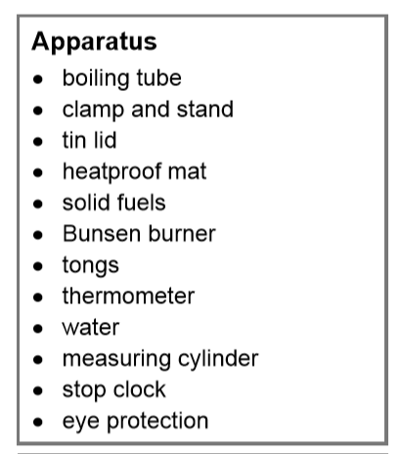
Burning Fuels
CW
28/10/2018
Stick into your book. Label the diagram
Aim
To compare the energy released by different fuels.
Hypothesis
Different fuels release different amounts of energy when they burn.
Method
Label this diagram using words from the apparatus list

Slide 3
Burning Fuels
Self assess. /7
Aim
To compare the energy released by different fuels.
Hypothesis
Different fuels release different amounts of energy when they burn.
Method
Label this diagram using words from the apparatus list
boiling tube
thermometer
clamp and stand
water
(solid) fuel
heatproof mat
tin lid

Slide 4
Burning fuels gap filler
Fill in the missing words using the words in the box at the bottom of page

Slide 5
Burning fuels gap filler
Swap books and peer assess /8
heat
boiling
same
measuring cylinder
Bunsen burner
thermometer
fuels
distance

Slide 6
Risk Assessment
What hazards do you have to consider?
Hair tied back
Ties tucked in
Bags under desks
No sitting down
Seats tucked under
Goggles
Lit splints allowed to extinguish on heat mat
Take care to ensure boiling tubes don’t roll off desks
Do not touch broken glass – alert teacher

Slide 7
Before you begin
Get into groups of four (A,B,C,D)
Person A from each group to fetch clamp and stand
Person B from each group to fetch goggles, heat mat, stopwatch, thermometer and measuring cylinder.
Spirit lamps to be used rather than solid fuels in tin lids. These are to be used one at a time . Person C to fetch first fuel
Boiling tubes to be fetched only when clamp stand set up. Think carefully about how high up you set it. Person A to start setting up with assistance from person C.
Spirit lamps to be lit using splint from lit Bunsen burners around the room. Person D to light when ready to begin.

Slide 8
Record your results in the table and answer the questions.

Slide 9
Packing up: without talking.
Person A from each group to dismantle and return clamps and stand
Person B to replace boiling tube and spirit burners MAKE SURE THE FLAMES ARE EXTINGUISHED.
Person C from each group to return stop clock, measuring cylinder and heat mats
Person D from each group returns goggles neatly.

Slide 10
Burning fuels: evaluation and conclusion
Complete your conclusion and evaluation by answering the questions.

Slide 11
Fuel comparisons
Fuel | Easy to light? | Produced smoke or soot when burned? | How much energy is released on burning?
Coal | Difficult | Yes | 30KJ/g
Natural gas | Very easy | No | 55KJ/g
Oil | Easy | Yes | 45KJ/g
Which fuel is easiest to light?
Natural Gas
Which gives out the most smoke or soot when it is burned?
Coal
Which fuel gives out the most energy per gram when it is burned?
Natural gas
Which fuel is solid?
Coal
Use you answers to add to your table of advantages and disadvantages of different fuels

Slide 12
Plenary
Use what you have learnt, your own ideas and knowledge to write down what you think makes an ideal fuel.
An ideal fuel is one that is reasonable cheap, plentiful and easily transported. It should be easy to light, give out lots of energy on burning but not too much soot and smoke. Ideally it should be renewable.

