Slide 1
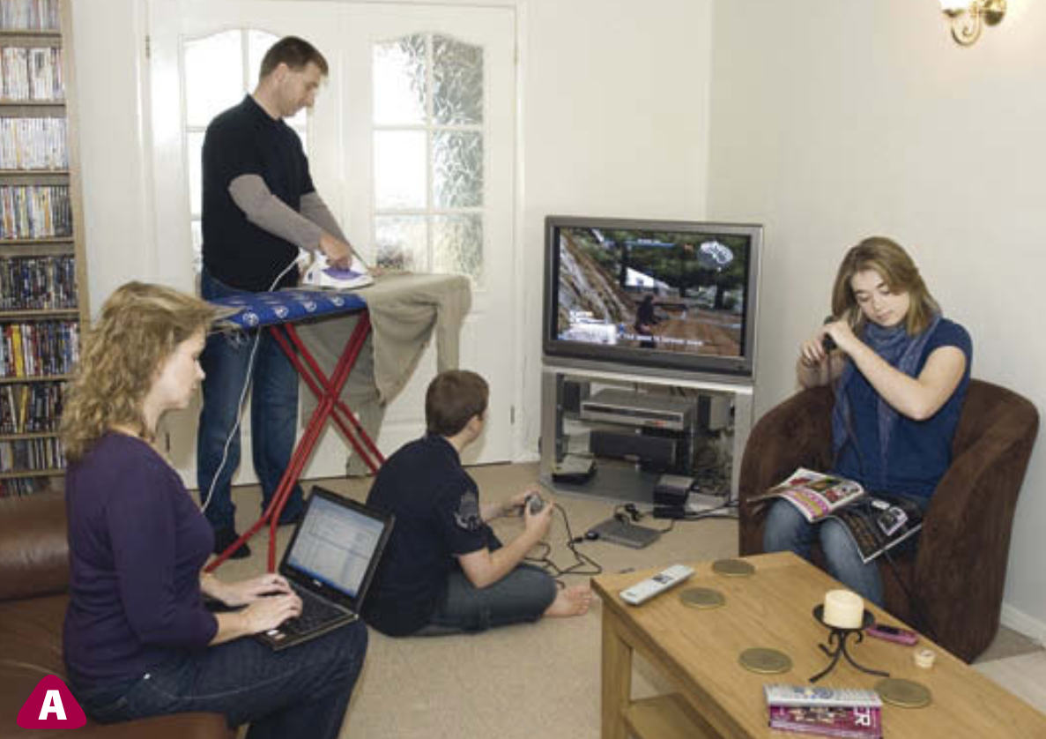
C/W
24/03/2019
8Kd1 – Power & Efficiency
 List all the things that are using energy in this picture, IN ORDER of which will use the most to run
 Explain your order.
Why don’t we all have the same order?

Slide 2
Key questions
What does the power rating of an appliance tell us?
What does efficiency mean?
What do Sankey diagram show us?

Slide 3
C/W
24/03/2019
8Kd1 – Power & Efficiency
The amount of energy an appliance uses depends on:
i) How ____ it is used for.
ii) How _______ it uses energy. For example electric ovens can transfer 5000 J of energy every second. We say the power rating is 5000 watts (W) or __ kW.
What is the most energy hungry appliance in the home?
long
quickly
5

Slide 4
 Copy and complete the table as we look at the different appliances.
Appliance | Power rating | Energy transfer (Electrical → ?)

Slide 5
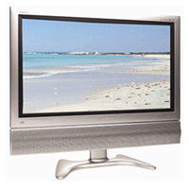
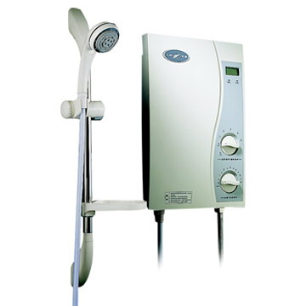
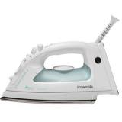
Write down these appliances down your page in order of power rating.
Add the energy transfer.
11 W
How are the lightbulbs different?
200 W
60 W
400 W
8000 W
1000 W

Slide 6
Would you cook a chicken this?
What does efficiency mean?
60 W

Slide 7
https://www.youtube.com/watch?v=-zvCUmeoHpw

Slide 8
Key questions
Must… | Should… | Could…
What do Sankey diagrams show us? | What does efficiency mean? | How can we draw accurate Sankey diagrams to represent energy transfers?

Slide 9
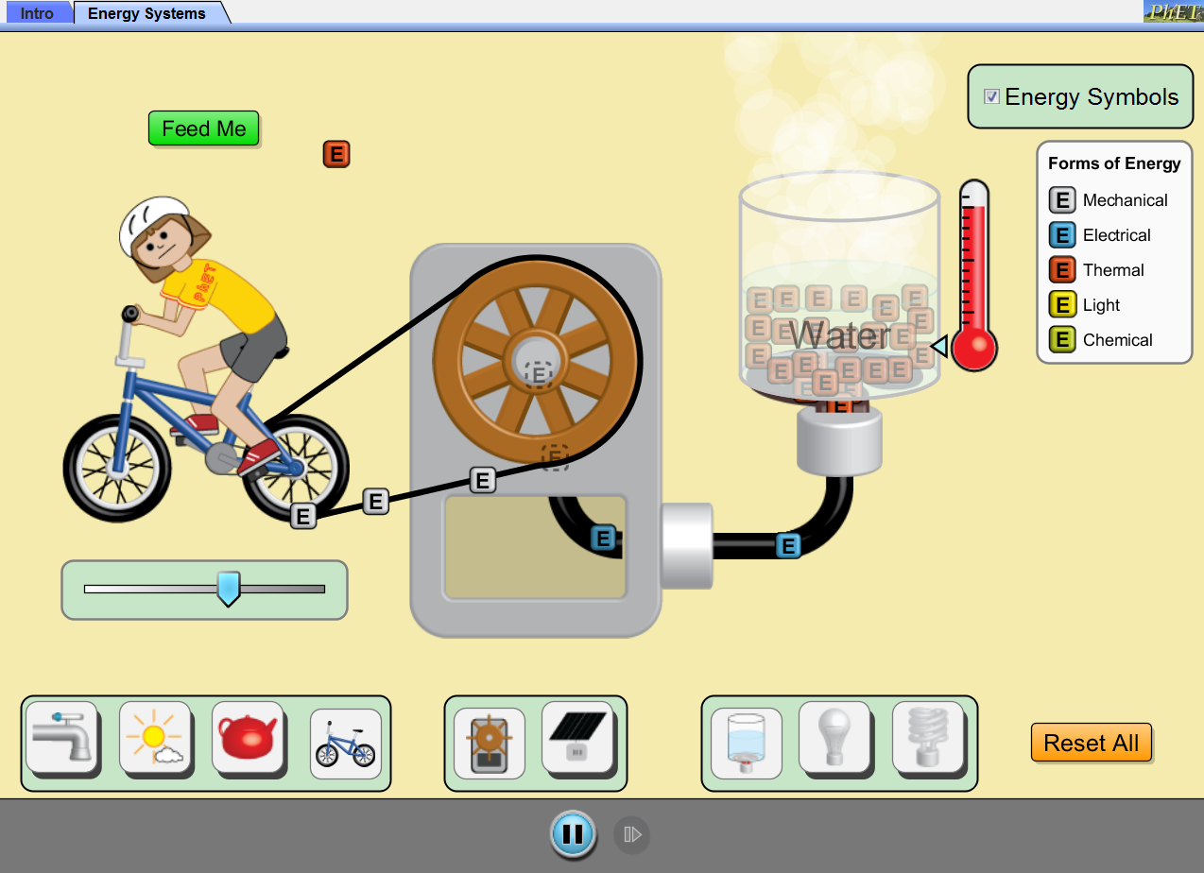
How could we show this on a diagram?
 Click image to run simulation.
How much energy was transferred usefully?
How much energy was wasted?
Notes:
Use this PhET animation if practical not possible!

Slide 10
https://www.youtube.com/watch?v=-zvCUmeoHpw

Slide 11
 Copy and complete.
How efficient do you think the human body is?
energy
Efficiency is a measure of how much ______ is usefully transferred.
The more efficient an energy transfer is the ____ energy is wasted.
less

Slide 12
Is the human body very efficient?
How can you tell?
Efficiency = 25 %

Slide 13
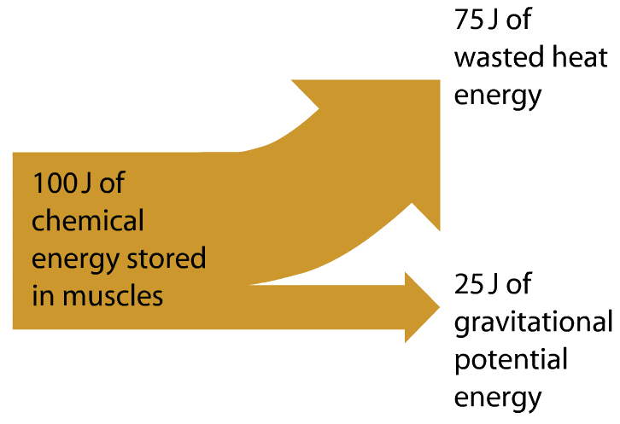
Is it going to be easy to draw curved arrows like this?

Slide 14
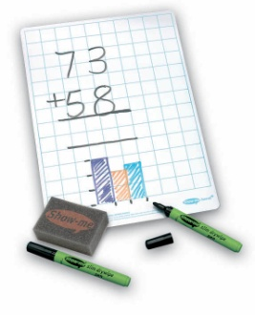
Sketch a straight line Sankey diagram for the climber on your whiteboard.
Adjust it as you watch the next video.

Slide 15
https://www.youtube.com/watch?v=-zvCUmeoHpw

Slide 16
Sketch a straight line Sankey diagram for the climber on your whiteboard.
Adjust it as you watch the next video.

Slide 17
Draw your Sankey diagram out neatly on your graph paper. Make sure you label it fully with amounts of energy in joules and the type of energy

Slide 19
Stick in and complete your worksheet.

Slide 20
Self assess.

Slide 21
Key questions
What does the power rating of an appliance tell us?
What does efficiency mean?
What do Sankey diagram show us?

Slide 22
Homework
N.a

Slide 23
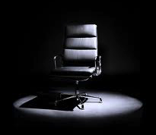
 Give a clue or definition for these keywords.
Hot Seat

Slide 24
Hot seat
 Give a clue or definition for these keywords.
Power

Slide 25
Hot seat
 Give a clue or definition for these keywords.
Sankey diagram

Slide 26
Hot seat
 Give a clue or definition for these keywords.
Efficiency

Slide 27
Hot seat
 Give a clue or definition for these keywords.
Joule

Slide 28
Hot seat
 Give a clue or definition for these keywords.
Watt

Slide 29
Hot seat
 Give a clue or definition for these keywords.
Energy

Slide 30
Reqs
Demo
Power meter connected to mains socket. Different appliances to test power of.
Lightbulb cooker with piece of chicken to cook in lesson (ready to switch on a start of lesson).
Worksheets
8kd1_power_and_efficiency

