Slide 1
Reqs
Mining worksheet
Smartphone recycling image
Optional Demo: Extracting copper from Malachite (Materials needed on slide 14).
Extension/Homework
W/S 8He-4

Slide 2
Objectives
Recall that metals can be recycled.
Recall how some elements are found in their native states.
Recall how metals are extracted from ores taken from the Earth’s crust.
Explain the advantages of recycling metals.
Evaluate the environmental effects of quarrying and mining.
Describe how metals are extracted from their ores by heating with carbon or electrolysis.
Explain why the method used to extract a metal is related to its position in the reactivity series and the cost of the extraction process.

Slide 3
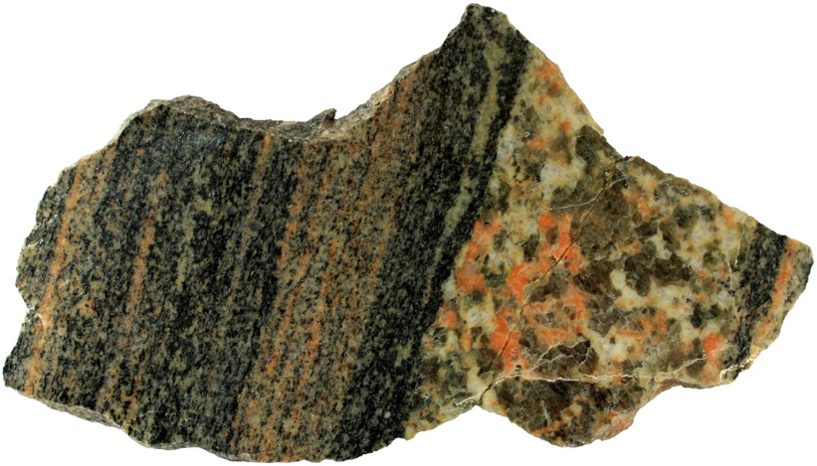
C/W
24/02/2019
8He – Materials in the Earth
Starter
Describe the rock labelled A on the left-hand side of the sample.
The rock has interlocking crystals which are arranged in bands or layers.
Explain what type of rock this is.
This is a metamorphic rock because it has interlocking crystals arranged in bands.
A

Slide 4
Ores
Watch the video.
Complete the wordfill below
An ore is a type of rock containing m_________ from which a useful substance can be e___________.
Metal ores contain metals such as iron, copper, and aluminium, typically bound in c___________ with oxygen.
The word ore is generally used when the c_____________ of the useful s__________ is high enough that it is economically viable to mine and extract.
Some metals such as Gold and Silver are found as pure elements; this is called the native state.

Slide 5
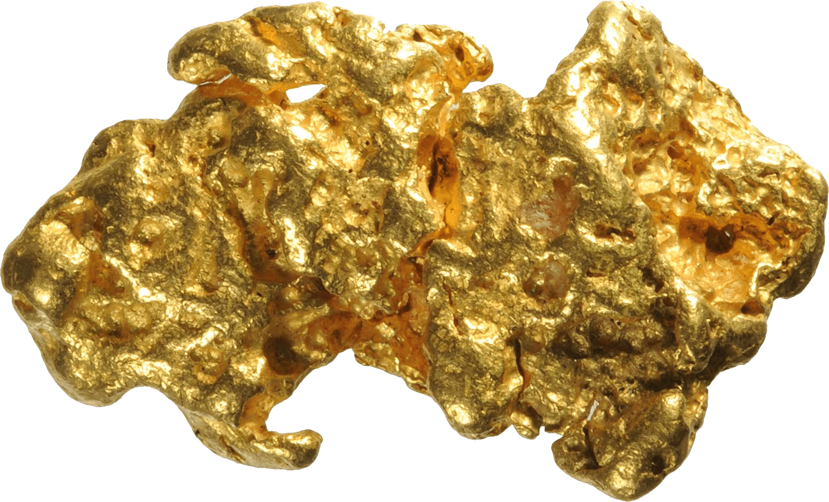
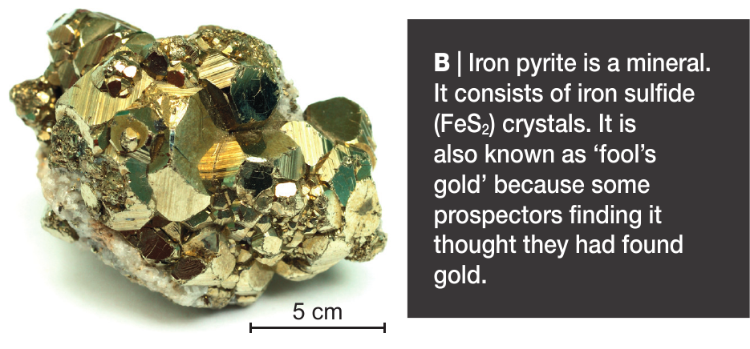
A| Gold (Au)

Slide 6
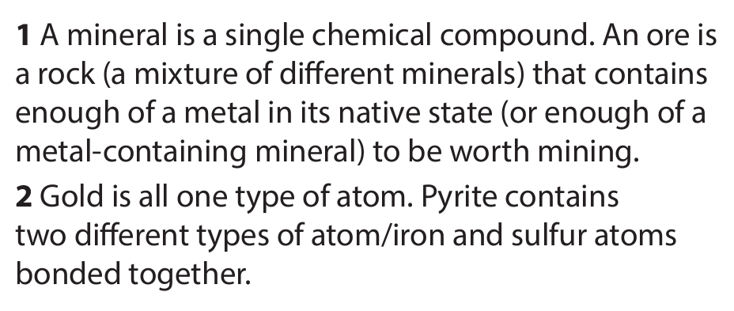

Slide 7
Mining
Watch the following video then answer the following two questions in your books in FULL SENTENCES.

Slide 9
Use the information on the following slides and videos to fill out your worksheets

Slide 10
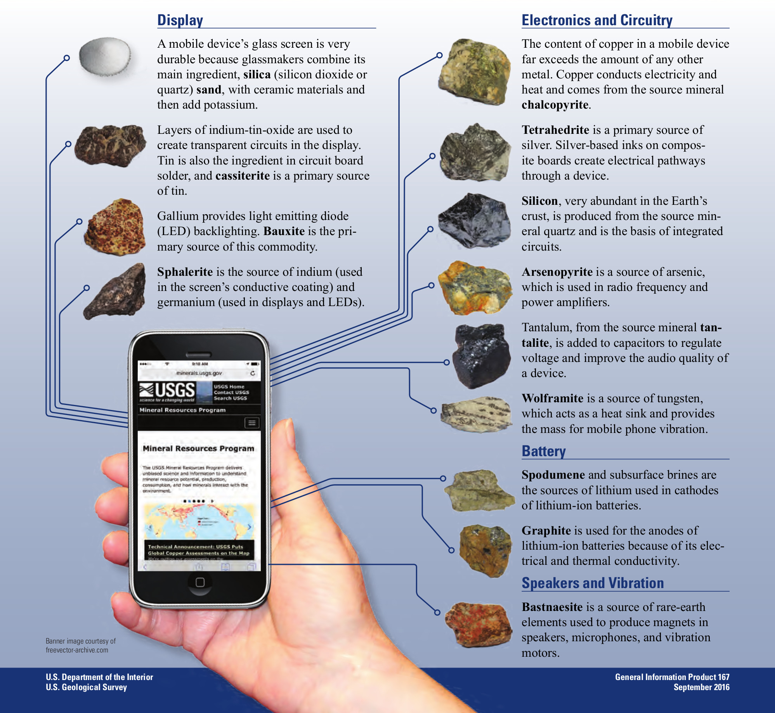
Why are we reliant on mining?
Modern devices such as cell phones as well as devices we could use to gain cleaner energy such as wind turbines and solar cells depend on small quantities of rare ores.

Slide 11
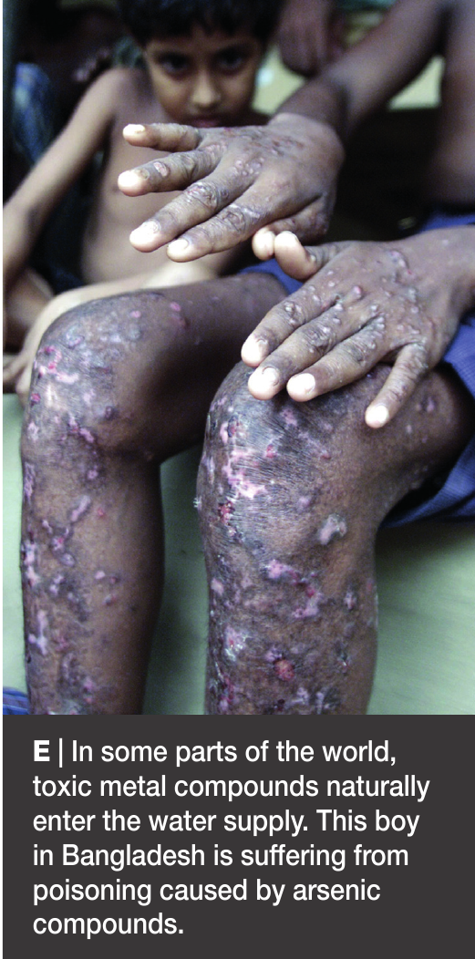
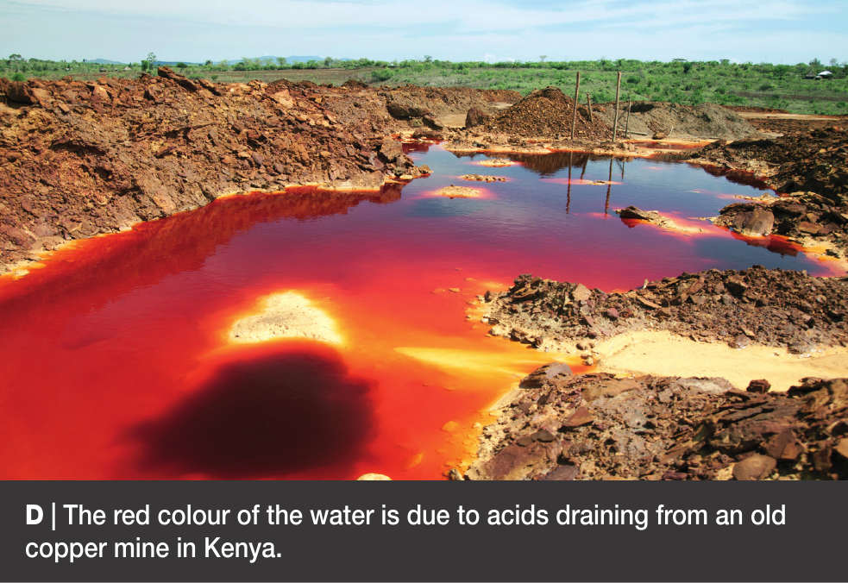
What is the issue with this?
These ores can be both rare (as in they can only be mined from certain places/countries) as well as expensive to obtain.
There is also an environmental and health cost.
Quarry Impacts
https://www.twig-world.com/film/quarrying-impacts-1768/

Slide 12
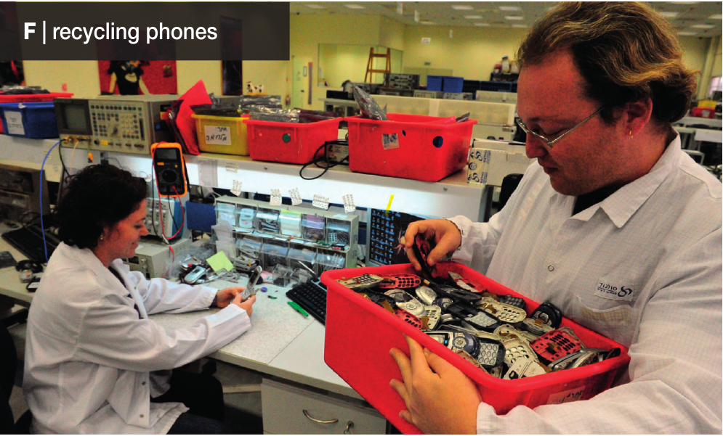
How could fix/minimise these issues?
Recycling:
Cuts down on mining/quarrying pollution
Cuts down on pollution in landfills (recyclables taken out)
Allows metal supplies to last longer
Needs less energy then extracting the metal from scratch.
How else can we minimise the impacts?
https://www.twig-world.com/film/quarrying-managing-damage-1769/

Slide 13
Recycling Smartphones
Glue the image into your books
Notes:
Interesting extra for students. Details the ores ect in a smartphone and how often they are recycled. Class discussion depending on ability.

Slide 14
Optional Demonstration: Extracting Copper from Malachite.
Notes:
Optional and can take a while. Complete as part of an extra lesson if needed.

Slide 15
Extension/ H/W
Complete W/S 8He4

Slide 17
 Give a clue or definition for these keywords.
Hot Seat

Slide 18
Hot seat
 Give a clue or definition for these keywords.
Mining

Slide 19
Hot seat
 Give a clue or definition for these keywords.
Ore

Slide 20
Hot seat
 Give a clue or definition for these keywords.
Native state

Slide 21
Hot seat
 Give a clue or definition for these keywords.
Quarry

Slide 22
Hot seat
 Give a clue or definition for these keywords.
Compound

