Slide 1
Anaerobic Respiration

Slide 2
Objectives
• Recall what happens in anaerobic respiration in humans. • Explain why aerobic and anaerobic respiration occurs in humans at the same time. Recall that anaerobic respiration releases less energy than aerobic respiration. • Model anaerobic respiration using a word equation. -Describe and explain how breathing rate and heart rate are affected by exercise. Explain why exercise is recommended to help people with cardiovascular disease.
• Describe how lactic acid is removed from tissues. -Explain why anaerobic activity cannot be sustained. • Analyse and explain the changes in heartbeat and breathing rate during and after exercise (including EPOC/oxygen debt).
-Explain the effects of poisons that disrupt certain metabolic processes.

Slide 3
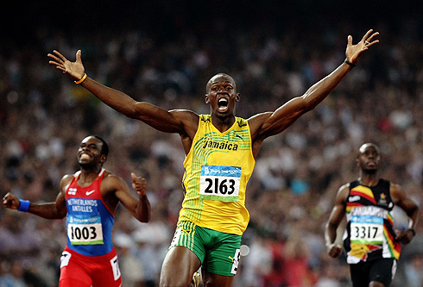
What will happen if more oxygen is needed by my cells than my lungs can take in?
What happens to my heart rate and breathing rate as I run? Why?
I will get tired quickly?! What if I don’t get enough oxygen?

Slide 4
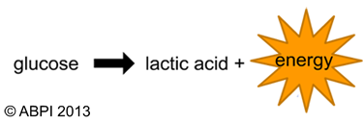
Anaerobic respiration
Anaerobic respiration is a type of respiration that does not use oxygen. It is used when there is not enough oxygen for aerobic respiration. It can be summarised by the following equation:
Much less energy is released
Toxic chemical. Body can withstand a small amount for a short time.
This type of respiration may be used when, for example, an animal is being chased by a predator or a person is vigorously exercising.

Slide 5
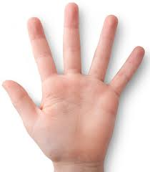
A quick practical
Sitting on your chair, raise your left arm and clench and unclench your hand for 30 seconds.
Now hold your breath whilst you do it…does it feel different?
That burning feeling?
That is the build up of lactic acid in your muscles.

Slide 6
Brainstorm everything that happens to you during vigorous exercise.

Slide 7
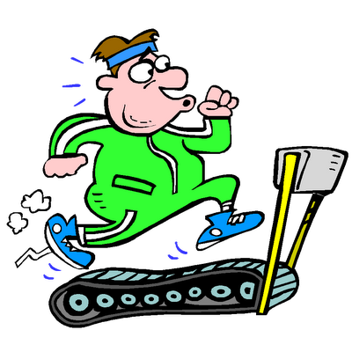
Why exercise is recommended to help people with cardiovascular disease?
Take your pulse for 1 minute & write it down in the back of your book.
Exercise for one minute and take your pulse again. What happened?
glucose
When we exercise ______ & ______ need to get to the muscles faster, so our _____ needs to get to them faster, meaning the heart has to beat _____.
We also have to ______ faster to get the extra oxygen required.
oxygen
blood
faster
breathe

Slide 8
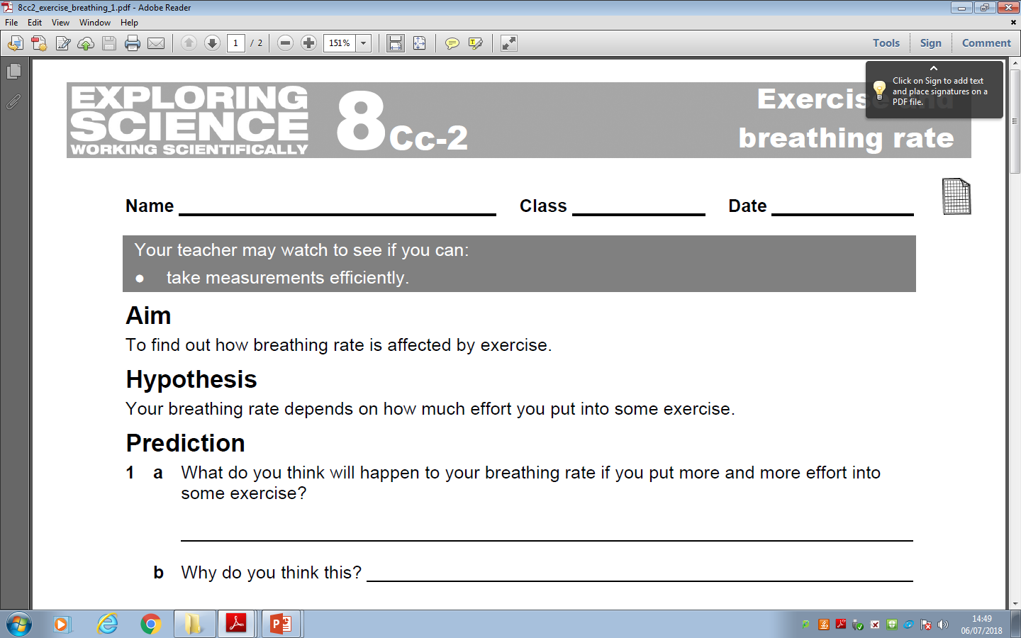

Slide 9
https://www.activeteachonline.com/product/view/id/335/page/50/mode/dps?modal=/player/animation/id/390818

Slide 10
Not enough oxygen!
glucose
➔
lactic acid
+
energy
When anaerobic respiration takes place, lactic acid is also produced.
Lactic acid builds up in the muscle cells and prevents the muscles from doing their job. This is thought to cause fatigue and sometimes cramp.
After exercise, the body needs to remove the lactic acid before it causes damage to cells.

Slide 11
Oxygen debt
Lactic acid is broken down by oxygen.
lactic acid
+
oxygen
➔
carbon dioxide
+
water
After activity that has lead to anaerobic respiration, the person involved breathes heavily and their heart rate remains high to supply the body with the oxygen it needs.
The amount of oxygen needed to remove all the lactic acid after exercise is called an oxygen debt.
Notes:
Photo credit: Jupiterimages Corporation
Teachers notes
Respiration Worksheet 3 accompanies this slide.

Slide 12
Copy and complete the word fill below.
Anaerobic respiration
Sometimes your body cannot provide your _______ with enough oxygen. However because your cells still need energy they start to use ________ respiration.
muscles
anaerobic
Glucose → Lactic acid (+energy)
In this process they break down _______ without oxygen but it does not release as much _______. It also produces _________which builds up and can cause cramp.
glucose
energy
lactic acid
What happens to the lactic acid?
Words to use:
oxygen muscles glucose energy anaerobic lactic acid respiration poisonous

Slide 13
Anaerobic respiration equations

Slide 14
Lactic Acid
Video
https://www.activeteachonline.com/product/view/id/335/page/50/mode/dps?modal=/player/video/id/389228
https://www.activeteachonline.com/product/view/id/335/page/50/mode/dps?modal=/player/interactive/id/388803
Task

Slide 15
Quick Quiz-No hands up, I will choose you
What is the equation for anaerobic respiration?
What is the difference between the terms aerobic and anaerobic?
Which process provides more energy?
How might exercise affect the rate of respiration?

Slide 16
Thumbs true or false
Respiration is a fancy way of saying breathing
Glucose and oxygen are the reactants of anaerobic respiration.
Energy is released in both aerobic and anaerobic respiration.
Both forms of respiration produce the same amount of energy.
Lactic acid is a product of anaerobic respiration

Slide 17
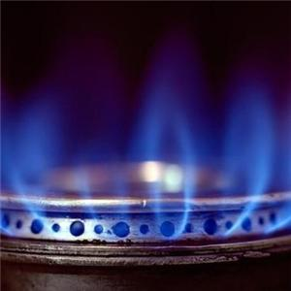
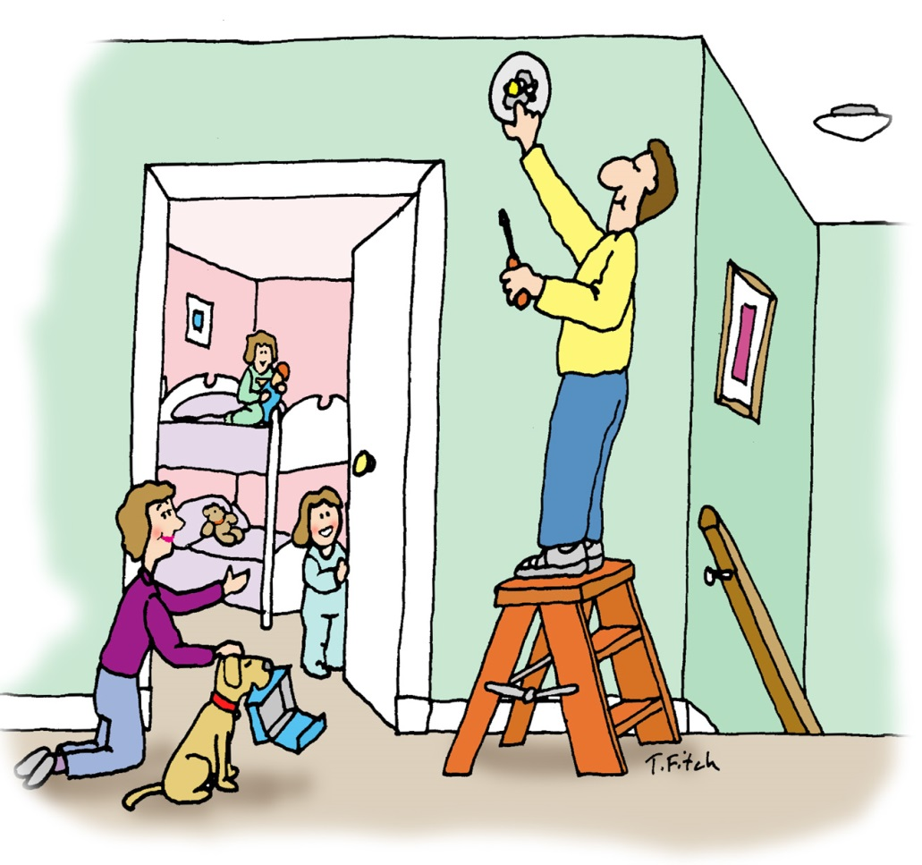
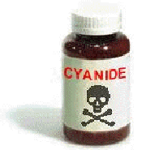
Other poisons…
Carbon monoxide
How do these chemicals affect respiration?
Hydrogen cyanide stops aerobic respiration and so kills cells.

Slide 18
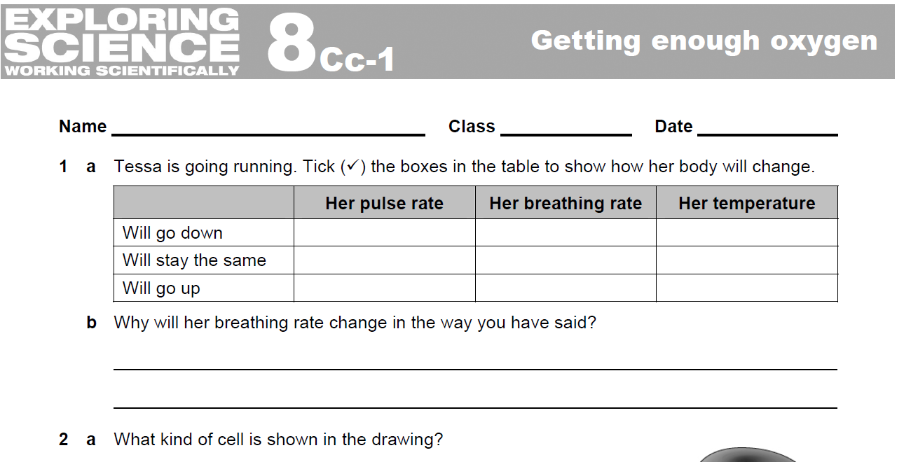

Slide 19
