Slide 1
Requisitions
Class practical:
8Ec-2 Candle Height
worksheets:
8Ec-2 Candle height

Slide 2
Objectives
Identify variables that need to be controlled in a given experiment.
Plan ways in which to control a simple control variable.
Explain the need for a fair test.
Plan ways in which to control more than one variable.
Justify the choice of control variables.

Slide 3
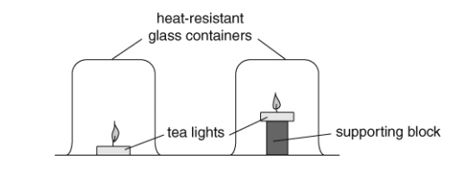
CW
8Ec Fair Testing
What are variables?
@hpscience

Slide 4
Types of variables
Can use KS3 doddle presentation
https://www.doddlelearn.co.uk/app/teacher/launch-content/3df671f8-171f-4948-9159-84ef9f20c8e8
The variable that you chose the values of in an investigation
The variable that is measured in an investigation.
A variable other than the independent variable, which could affect the dependent variable and so needs to be controlled (kept the same) there many be several controlled variables

Slide 5
a. size of container, type of fuel used to make tea light, size of tea light, length of time tea light has already been burning (affects size of pool of liquid fuel at base of wick), length of wick.
b In all cases, make sure identical apparatus used, and that the tea lights have the same size pool of melted fuel at the base of the wick.

Slide 6
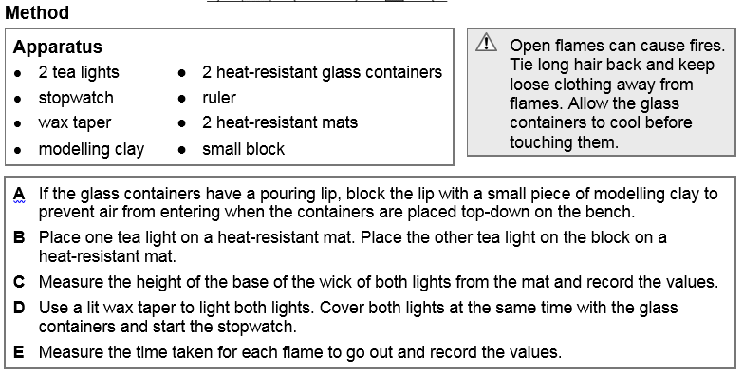

Slide 7
Results should show that tea lights nearer the top of the container go out first.
Combustion of the hydrocarbon in the fuel produces carbon dioxide. Although carbon dioxide is a gas that is heavier than air, it is also hot and so collects at the top of the container. This excludes oxygen, so the nearer the flame is to the top of the container, the quicker it will be surrounded by carbon dioxide and so go out.
All other variables that could have affected the time were controlled.

