Slide 1
RACISM

Slide 2
How does institutional racism feed into employment practices?
People of colour are less likely to be employed. Statistics show that 68% of BAME (black Asian and other minor ethnicities) are employed and compared to the 78% of white/Caucasian people it is considerably less.
This results in an ethnic gap between both pay and accumaltive profit of the ethnicities
Employment is also affected by institutional racism by putting off BAME people as they face discrimination.
Institutional racism also affects prisons, for example the percentage of BAME people in prisons are considerably higher than whites. The percentages being
Black men are 26% more likely than white men to be remanded in custody.

Slide 3
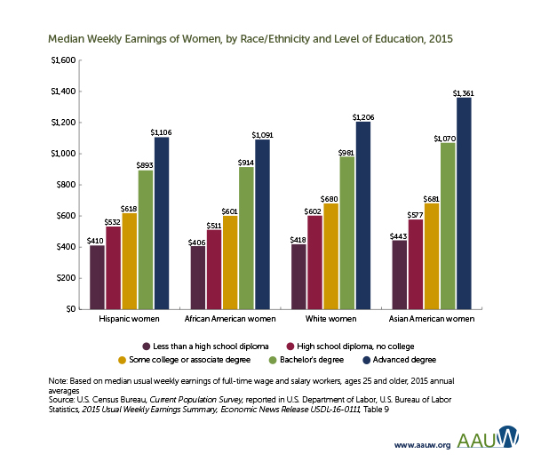
What is the ‘ethnicity pay gap’? Research and offer examples of this
The ethnicity pay gap is a Marxist belief that people get payed differently depending on their ethnicity
for example the difference between black people and white people can be shown in this diagram.

Slide 4
How do multinational companies respond to the black lives matter movement?
One way in which multinational companies responded to the black lives matter movement was using the black lives matter movement to raise awareness. This also raises sales and gets support from society.
Another way in which multinational companies responded to the black lives matter was by putting the black lives matter as their logo’s on social media for a while, This boosted popularity and therefore sales.
Companies like Sainsbury’s, Argos and body shop opposed the movement itself of black lives matter as companies used it as a economic tactic to boost sales and it worked but it capitalised off of equality and was therefore immoral

Slide 5
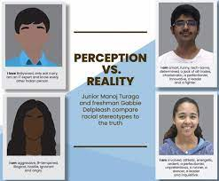
How does this feed into racial stereotypes?
It fed into racial stereotypes as it was seen as white men (who own a majority share of companies) were capitalising as black people
It also supports self stereotypes of the economy taking advantage of anything regardless of morals for the sake of money.

