Slide 1
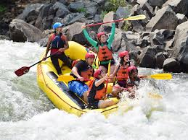
Starter
1. We do snowboarding in winter but we do rafting in summer
..................................................................................................................
2. We do canyoning because it is really fun
..................................................................................................................
3. We do toboganning because it is interesting
..................................................................................................................
EXT 4. We like to do rafting because we think that it’s super!
O..................................................................................................................

Slide 2
Starter
1. We do snowboarding in winter but we do rafting in summer
..................................................................................................................
2. We do canyoning because it is really fun
..................................................................................................................
3. We do toboganning because it is interesting
..................................................................................................................
EXT 4. We like to do rafting because we think that it’s super!
O..................................................................................................................

Slide 3
Starter
1. We do snowboarding in winter but we do rafting in summer
On fait du snowboard en hiver mais on fait du rafting en été
2. We do canyoning because it is really fun
On fait du canyoning car c’est vraiment amusant
3. We do toboganning because it is interesting
On fait de la luge car c’est interessant
EXT 4. We like to do rafting because we think that it’s super!
On aime faire du rafting car on pense que c’est super (or nous aimons faire du rafting car nous pensons que c’est super)

Slide 4
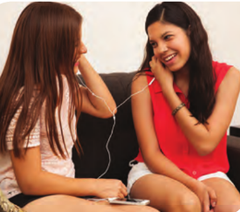
Tu aimes faire ça?
En classe
Lundi quatre juillet

Slide 5
Objectives
To talk about what you like doing.
Using AIMER + the INFINITIVE

Slide 6
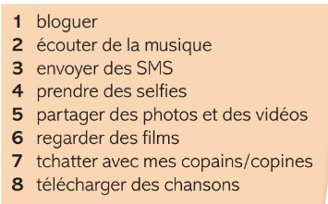

Slide 8
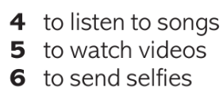

Slide 9
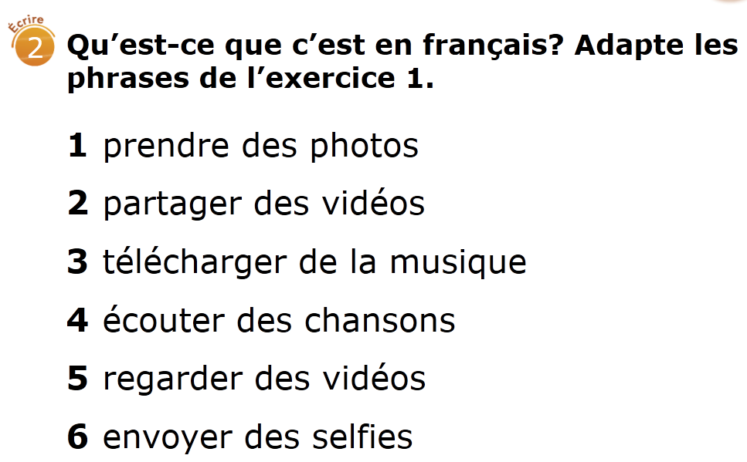

Slide 10
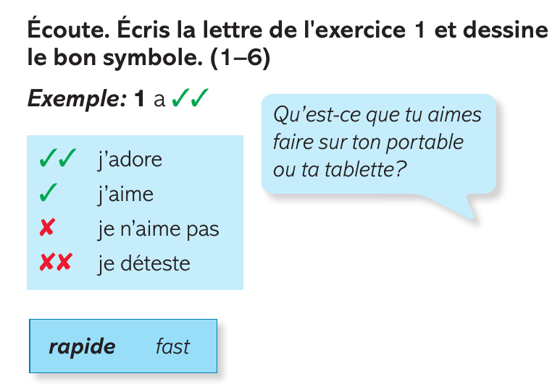

Slide 13
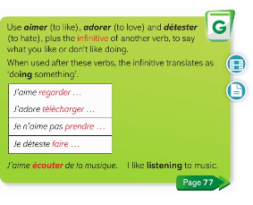

Slide 14
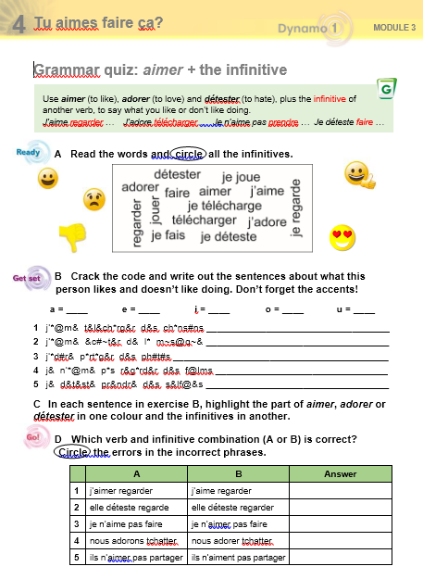
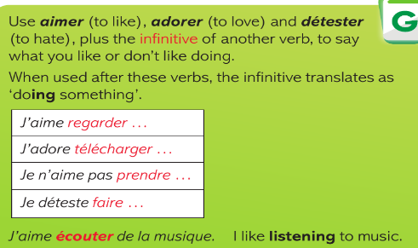

Slide 15
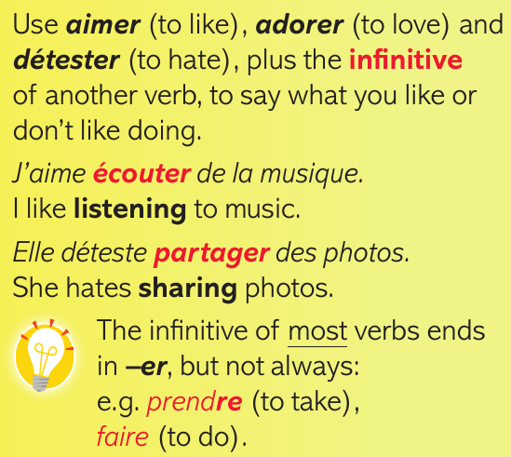

Slide 17
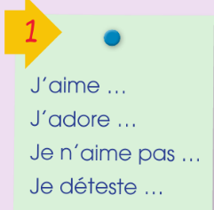
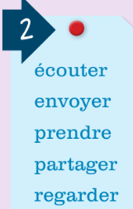
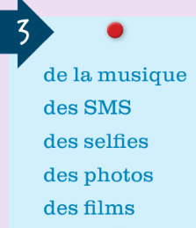
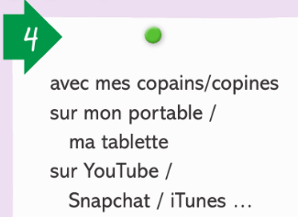
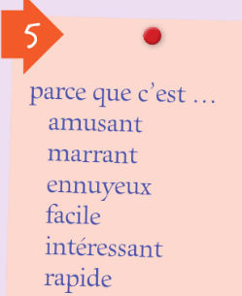

Slide 20
