Slide 1
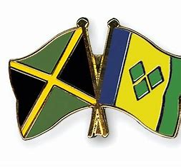
☺My culture ☺
By Havana Harris 7P1

Slide 2
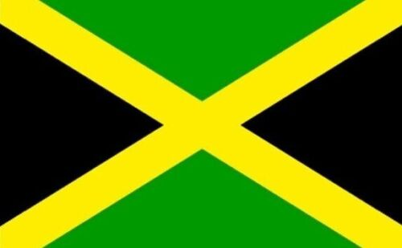
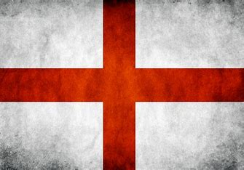
Where am I from ? What are my connected lands?
I was born here in England but my connected lands are St Vincent and Jamaica.
My mums side is St Vincent
And my dads side is Jamaican

Slide 3
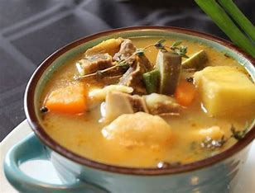
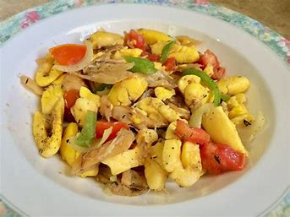
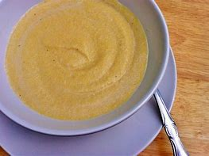
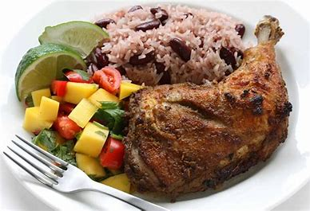
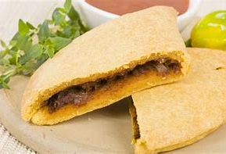
☺My Cultural Foods !☺
Some foods that I really enjoy that are traditionally Jamaician are :
Jerk Chicken
Saltfish & Ackee
Jamaican Patty
Cornmeal Porridge
Fish Tea
(p.s. I'm not very familiar with my St Vincent foods and that’s why I have only put Jamaican foods)

Slide 4
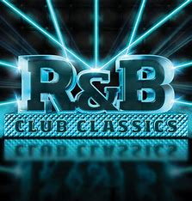
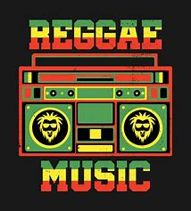
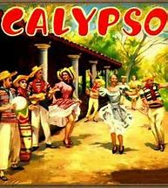
My Cultural Music ☺
Jamaicans and Vincentians usually listen to reggae, calypso and R&B type of music
Some well know reggae singers are Bob Marley and Coffee
My personal favorite reggae song is one love by Bob Marley <3

Slide 5
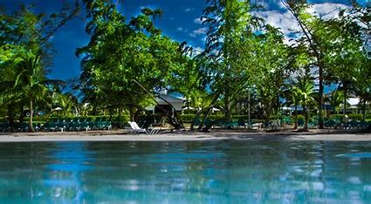
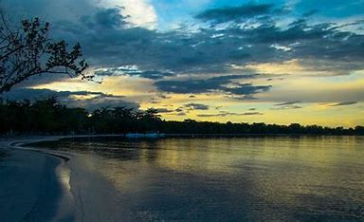
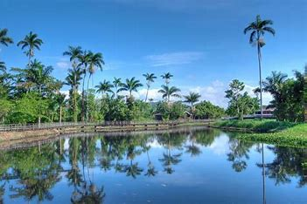
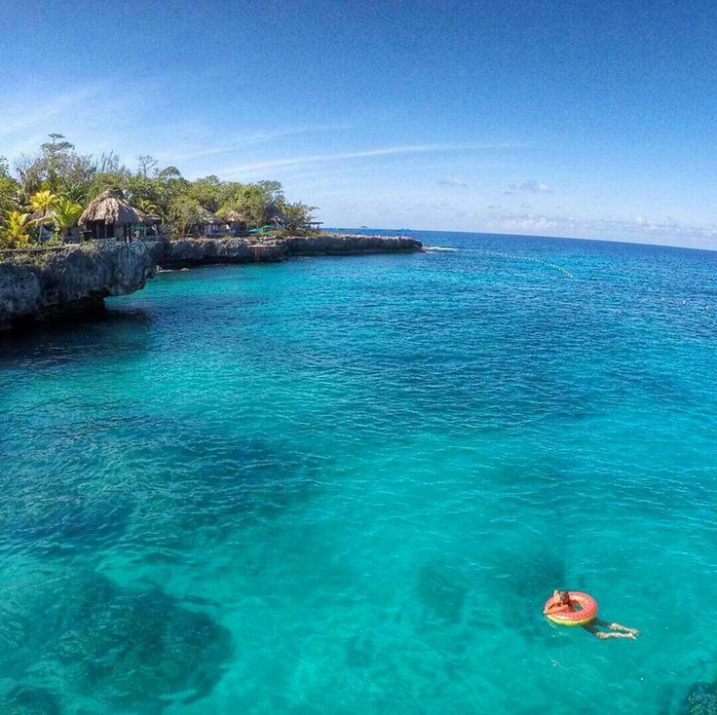
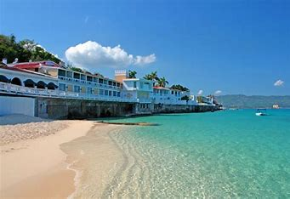
Jamaican Landscape
Here are some pictures of Jamaica:
(---- This is Montego Bay. I've been here.

Slide 6
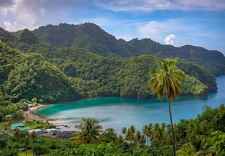
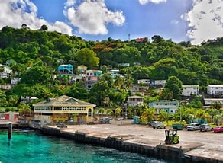
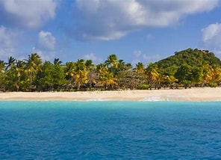
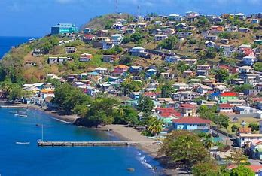
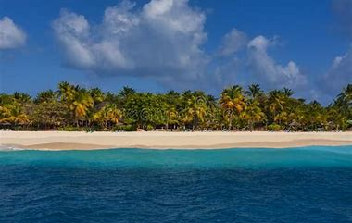
St Vincent Landscape
Now you will see some pictures of St Vincent:
I hope you enjoyed this PowerPoint bye <3

