Slide 1
Objectives
Recall the three states of matter and identify solids, liquids, gases.
State the meaning of: mixture.
State the meaning of: sieving, filtering, insoluble, suspension.
Describe what the three states of matter are like.
Identify mixtures.
Describe how insoluble solids can be separated from a liquid.
Group materials using their states of matter as justification.
Classify mixtures as suspensions, colloids and solutions, on what they look like and whether they separate on standing.
Classify colloids as foams, emulsions, gels or aerosols on what they are made up of.
Justify the decision to separate a mixture in a certain way.

Slide 2
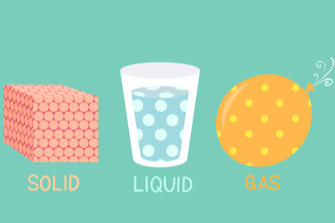
CW
7Ea Mixtures
What are the 3 states of matter?
Answer in full sentences
Think of examples of each
@hpscience

Slide 3
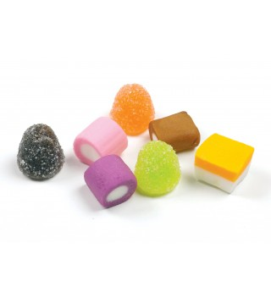
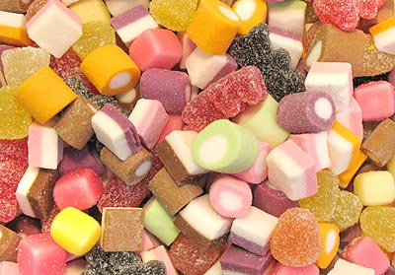
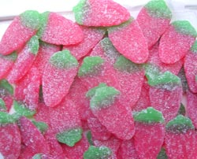
What is a mixture?
This is a mixture of sweets. It is a collection of different types of sweets.
The different types of sweets can be separated.
This is not a mixture of sweets. There is only one type of sweet.

Slide 4
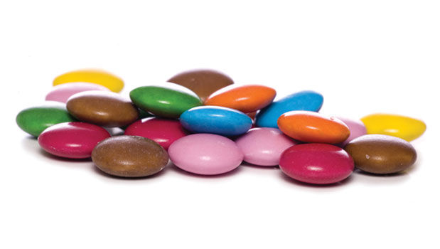
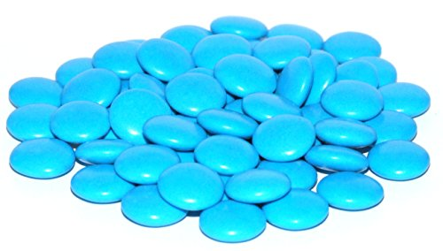
Which one is the mixture? Why?
A mixture is made from different substances that are not chemically joined.
Mixture
Separated

Slide 5
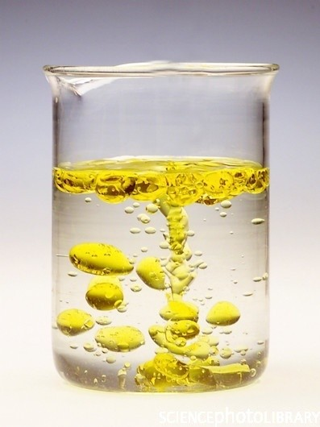
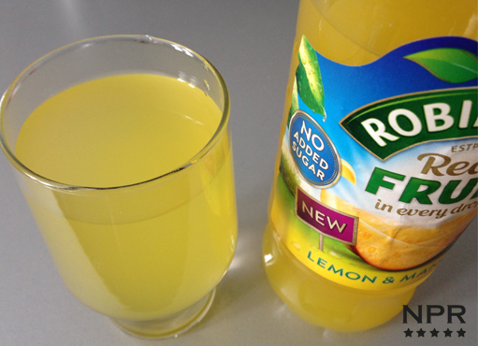
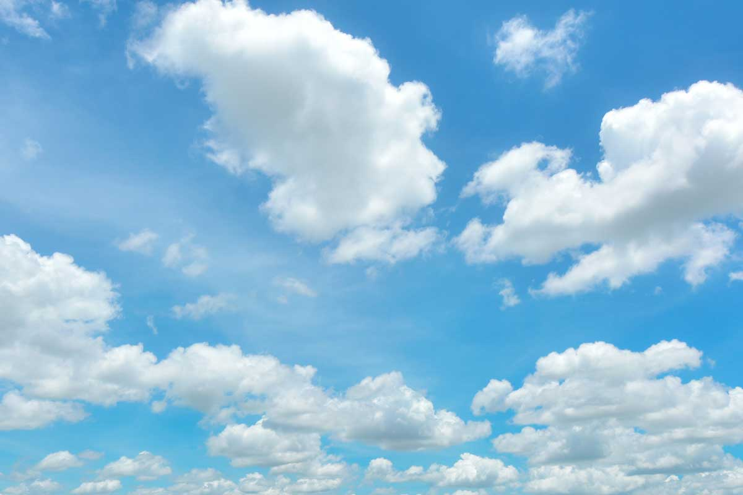
Can you give examples of a mixture of liquids/gases?
Oil and water
Squash
Air

Slide 6
Why is waste water a mixture?

Slide 7
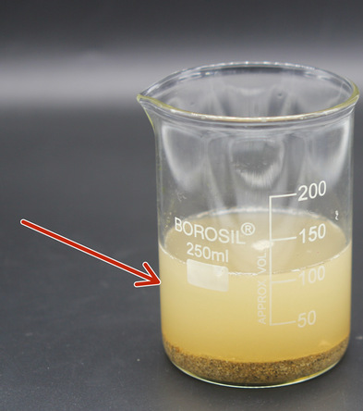
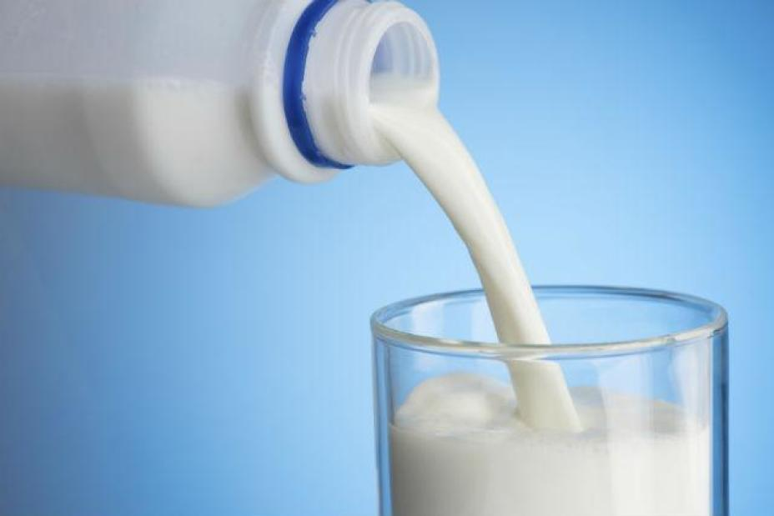
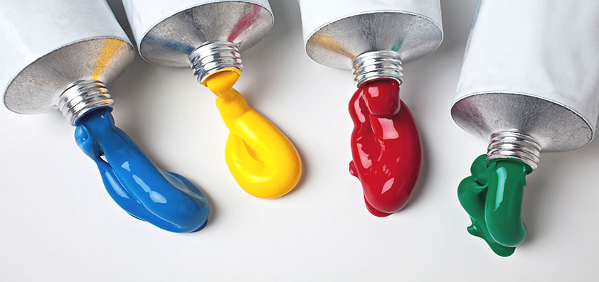
Suspension – a mixture of two substances that separate if it is not stirred (often a solid + liquid). E.g. …
Colloid – when one substance is dispersed in another substance, and do not separate easily. A colloid is cloudy or opaque. (either substance could be solid, liquid or gas) E.g. …

Slide 8
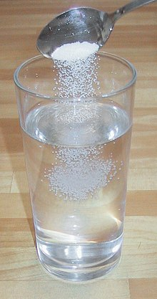
Solution – a mixture when the solid dissolves in the liquid. This mixture is clear/transparent. E.g …

Slide 9
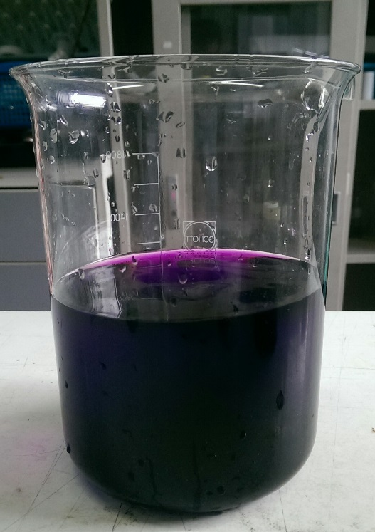
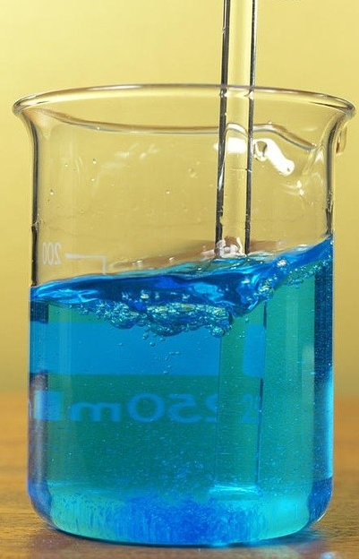
1. Which one of these are clear/transparent?
B
C
D
E
A
2. Which one of these are colourless?
A, B and D are clear/ transparent.
A is colourless

Slide 10
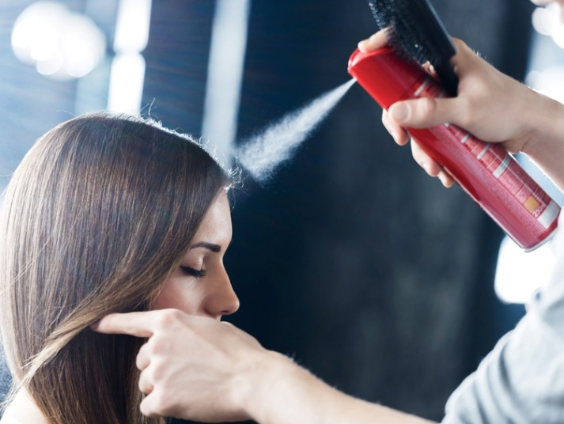
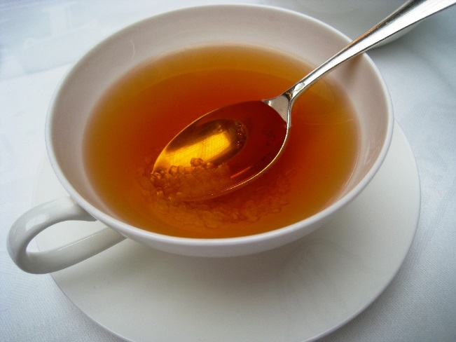
Join the words to their examples in your books.
Hairspray
Suspension
Sweet tea
Colloid
Solution
Pond water

Slide 11
How do we separate the solid that has settled at the bottom of the beaker from the water?

Slide 12
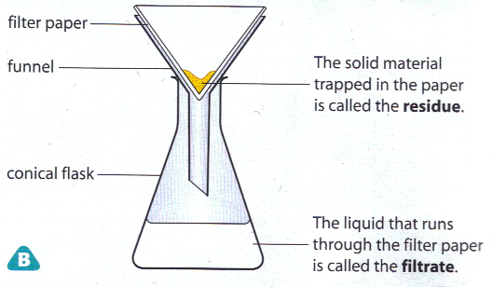
Filtering
Filtering is used to separate a solid from a liquid.
What equipment do we use, in a lab, to filter a mixture?

Slide 13
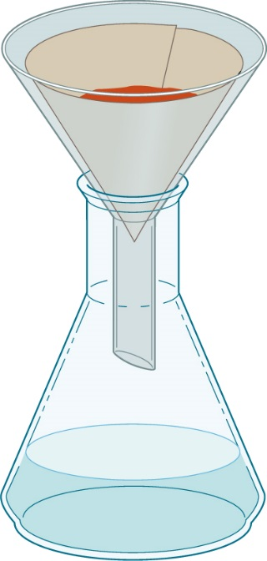
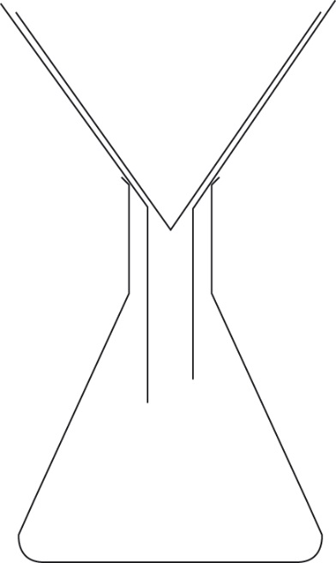
Picture or diagram?
This is a picture of the apparatus used for filtration.
This is a simple diagram of the apparatus used for filtration.
filter paper
filter funnel
conical flask

Slide 14
Explain how water is treated in steps while you watch the video.
1.
2.
3.
4.
https://www.activeteachonline.com/product/view/id/295/page/74/mode/dps?modal=/player/animation/id/312550

Slide 15
Waste water is screened where large objects like twigs are removed.
It is then passed through fine filters or left to stand in ‘settlement ponds’ where small suspended solids settle out when the water is still.
The water is then filtered through a thick layer of sand
Chlorine is added to water to kills the microbes.

Slide 17
Complete ws Ea6/7

