Slide 1
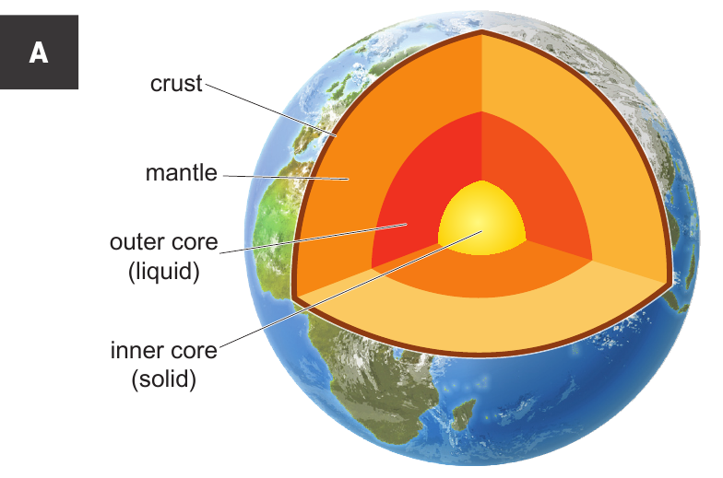
8Hb Igneous and Metamorphic
CW
Do Now:
Using the lines on the diagram, draw in labels to name each layer of the earth.

Slide 2
Add in a fact about each layer on your diagram

Slide 3
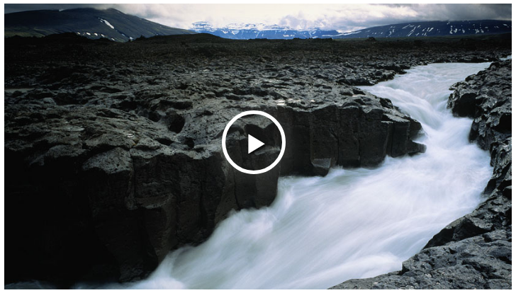

Slide 4
Igneous rocks
Copy & Complete
ooling
olidifcation
Rocks that form by the c_______ and s____________ of molten rock (magma and lava). I________ rocks are the most common of the three types of rock on Earth.
S____________ and m___________ rocks make up only about one-twentieth of the crust.
E__________ igneous rocks are formed when lava cools at the surface, while I___________ igneous rocks are those that cool and form underground
gneous
edimentary
etamorphic
xtrusive
ntrusive
What is the difference between magma and lava?

Slide 5
Cooling Speed and Crystal Size
Copy & Complete
If molten rock cools down fast, it forms rocks containing small crystals; such as basalt. This tends to happen above the ground.
If molten rock cools down slowly, if forms rocks containing large crystals; such as gabbro or granite. This tends to happen deep below the ground.

Slide 6
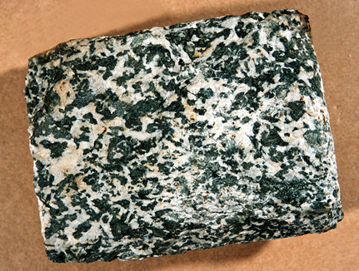
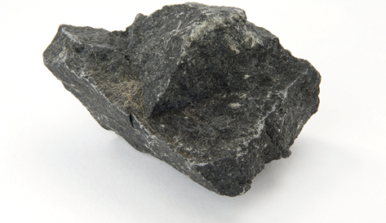
Basalt and Gabbro
Would these rocks have interlocking or rounded grains?
Which rock is Gabbro? Which rock is Basalt?
Explain your choice using crystal/grain size.
Gabbro
Basalt

Slide 7
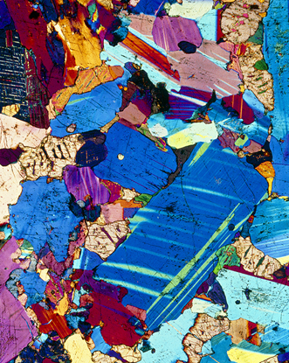
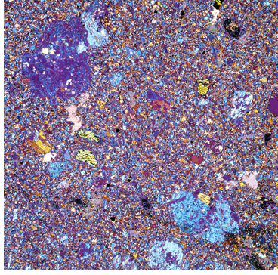
This photograph shows a thin section of basalt through a microscope.
There are many small grains and crystals showing that the liquid rock has cooled quickly on or near the surface of the Earth.
This photograph shows a thin section of gabbro through a microscope. The large crystals can clearly be seen.

Slide 8
Complete this activity to investigate how crystal cooling happens in volcanoes.
Notes:
Explaining crystal size in terms of particles is in the assessment so you need to ensure they understand how these two concepts could be linked.

Slide 9
Particle Model
While a liquid (molten rock), the particles have room to move around. As they cool down (solidify), the particles form a grid pattern and become unable to move.
The slower the cooling, the larger the grid/crystals as here is more time for the particles to become ordered

Slide 11
Metamorphic rocks
Copy & Complete
Naturally occurring rock that has been transformed by h___ and p_______ in the Earth's crust.
The rocks transformed in this way may start the process as s_________ or i_______.
Typical metamorphic rocks include sl____ , which is formed from sh____ , and m_____ which is formed from l__________.
Metamorphic rocks always contain interlocking grains and usually have different properties from the original rock.
eat
ressure
edimentary
gneous
ate
ale
arble
imestone

Slide 12
Turning a Rock into a Metamorphic Rock

Slide 13
Look at the diagram. At which of the numbered places will you find metamorphic rocks? Explain your answer.
At position 2. This is existing rock that is heated by the molten rock next to it.

Slide 14
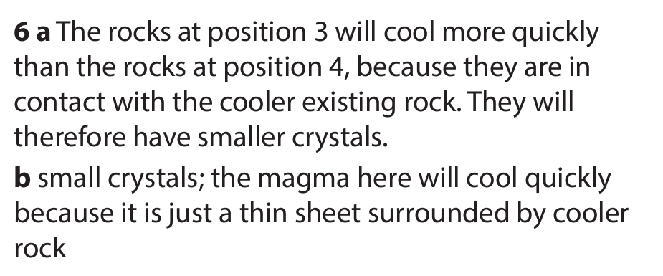

Slide 15
Extension/ H/W
Complete W/S 8Hb7

Slide 17
 Give a clue or definition for these keywords.
Hot Seat

Slide 18
Hot seat
 Give a clue or definition for these keywords.
Magma

Slide 19
Hot seat
 Give a clue or definition for these keywords.
Extrusive

Slide 20
Hot seat
 Give a clue or definition for these keywords.
Intrusive

Slide 21
Hot seat
 Give a clue or definition for these keywords.
Metamorphic

Slide 22
Hot seat
 Give a clue or definition for these keywords.
Igneous

Slide 23
Hot seat
 Give a clue or definition for these keywords.
Lava

