Slide 1
7Fb: Indicators
Do Now:
What are some everyday substances that are alkali?

Slide 2
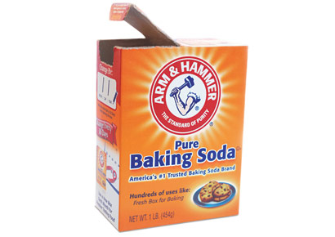
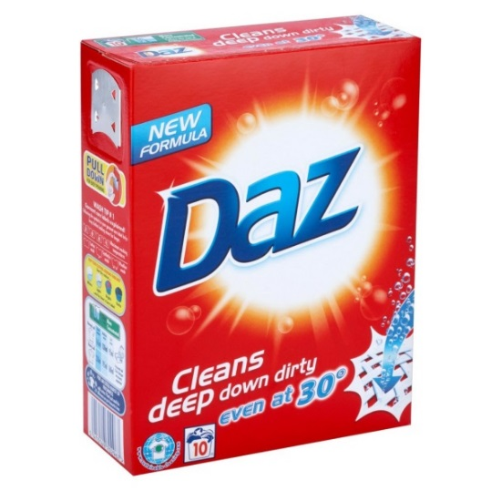
Alkali
Write Down
An alkali is a compound that can be used to neutralize an acid.
It turns litmus paper blue.
An alkali contains hydroxide ions (${OH}^{−}$)

Slide 3
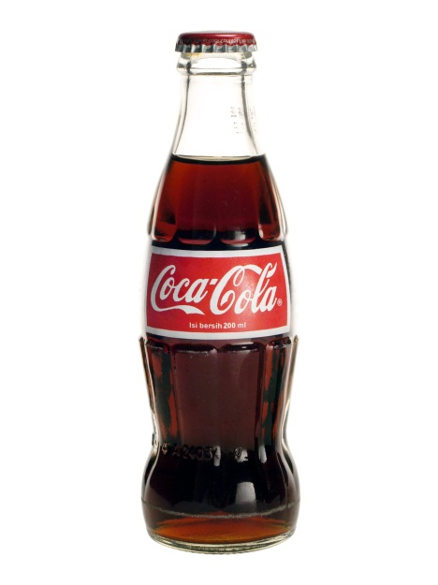
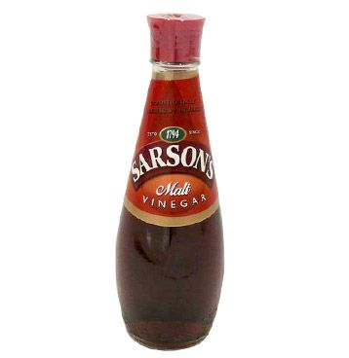
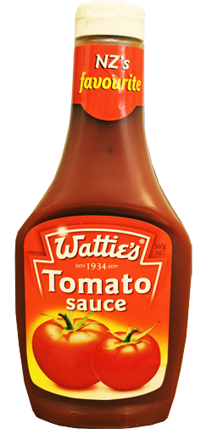
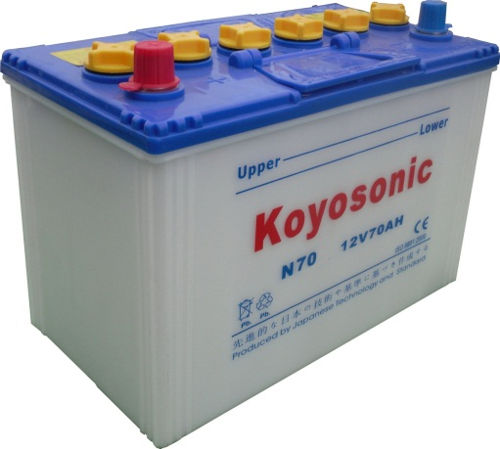
Acids
Write Down
An acids is a compound that can be used to neutralise an alkali.
It turns blue litmus paper red
An acid contains hydrogens ions ($H^{+})$

Slide 4
7Fb: Indicators
Do Now:
What are some everyday substances that are alkali?

Slide 5
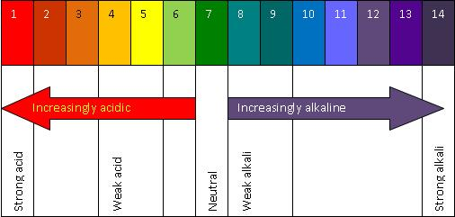
pH Scale
Stick pH scale into your book
Copy & Complete
The pH scale tells us how acidic or a______ a substance is.

Slide 6
pH Scale
Answers
The pH scale tells us how acidic or alkaline a substance is.

Slide 7
Copy & Complete
I________ are substances that change ______ to tell you if something is acidic, a______, or n_______.
They are often made from coloured p______, e.g. Red Cabbage

Slide 8
Copy & Complete
Indicators are substances that change colour to tell you if something is acidic, alkaline, or neutral.
They are often made from coloured plants, eg. Red Cabbage
Discuss in pairs what do you think indicator means?

Slide 9
Litmus
Litmus is a commonly used indicator, it is made from lichen, which grows on stone and rock.

Slide 10
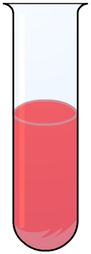
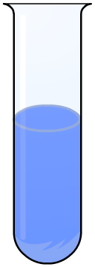
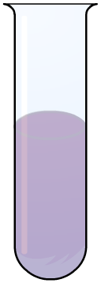
Litmus
Write Down
Litmus can be blue or red.
Blue litmus turns red under acidic conditions (< pH 4.5), and red litmus turns blue under alkaline conditions (> pH 8.3).
What colour do you think litmus is under neutral conditions?
alkali
neutral
acid

Slide 11
The litmus test
Notes:
Teacher notes
A is alkaline
B is acidic
C is neutral

Slide 12
Making indicators from plants

Slide 13
How would the pH scale for red cabbage indicator be different universal indicator?

Slide 14
Practical: Red Cabbage Indicator
Health and Safety
Must wear goggles.
Acids and Alkalis are corrosive therefore must be handled with safely and sensibly.
Working with hot water, be careful when pouring hot water to avoid any burns. Run under cold tap if an accident occurs.
Anyone messing will be banned from doing practicals for this unit.

Slide 15
Table of Results
Write Down
Name of Substance | Colour of Cabbage Juice | Acid or Alkali?

Slide 16
Table of Results
Write Down
Name of Substance | Colour of Cabbage Juice | Acid or Alkali?
Toothpaste | Green | Alkaline
Lemon Juice | Pink | Acidic
Vinegar | Pink/Purple | Acidic
Washing Up Liquid | Blue | Alkaline
Baking Powder | Green | Alkaline

Slide 17
Table of Results
Write Down
Name of Substance | Colour of Cabbage Juice | Acid or Alkali?
Baking Powder | Green/Blue | Alkaline
Washing Up Liquid | Blue | Alkaline
Vinegar | Pink | Acidic
Soap | Purple | Alkaline
Milk | Blue/Purple | Neutral
Lemon Juice | Pink | Acidic

Slide 18
Method
Making your Indicator
Soak the cabbage in some hot water in a small beaker
Using your Indicator
Put one substance into a circle on the spotting tile. Write the name in a results table.
Add a few drops of cabbage juice. Write the colour in your table.
Repeat using another substance.

Slide 19
Answer the following questions in your books

Slide 20
Answers

Slide 21
Extend

Slide 22
Answer

