Slide 1
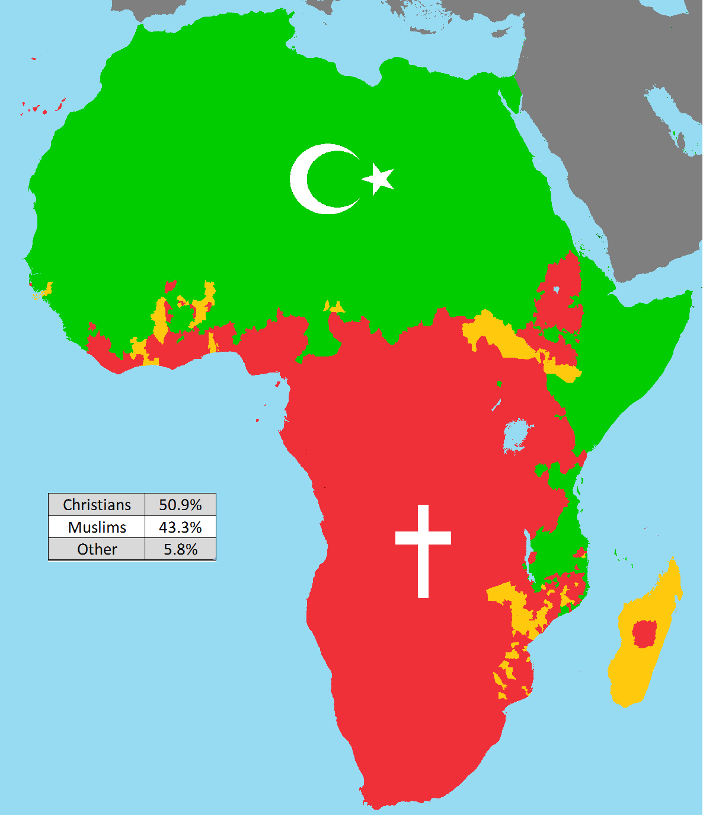
Black History: Indigenous African Religions and Beliefs.
Starter Discussion:
What does this map show?
What do you know about the spread of Islam and Christianity in Africa?
CHALLENGE: What do you think the yellow colour represents? (clue: what were the indigenous religions?)
Map of religion in Africa 2020.

Slide 2
How did Christianity and Islam spread?
https://vimeo.com/113801439

Slide 3
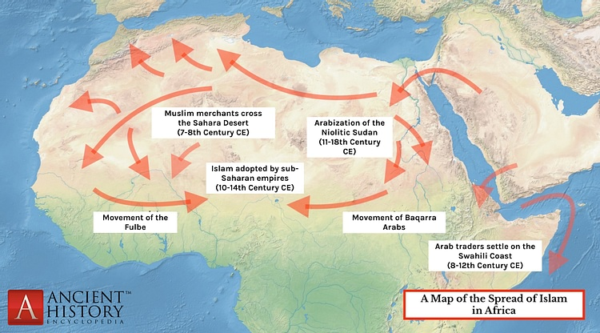
1. Islam in Africa:
Following the conquest of North Africa by Muslim Arabs in the 7th century CE, Islam spread throughout West Africa via merchants, traders, scholars, and missionaries.
African rulers usually either tolerated the religion to enable trade, or converted to it themselves.
There was sometimes violent resistance by supporters of traditional African beliefs such as animism and fetish, spirit and ancestor worship.

Slide 4
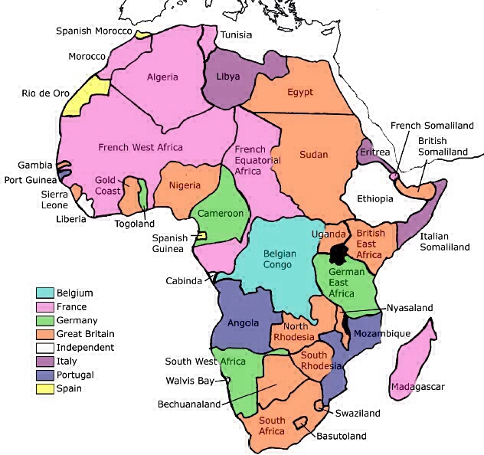
2. Christian Missionaries and The British Empire
Christian missionaries saw the colonialist voyages to Africa as an opportunity for them to spread the teaching of the Christian faith.
They used some of the British Empire’s resources and then in turn the empire coerced them to use their teaching to subdue the Africans.
The missionaries emphasized teachings of never questioning authority and accepting colonial rule as ordained by God.

Slide 5
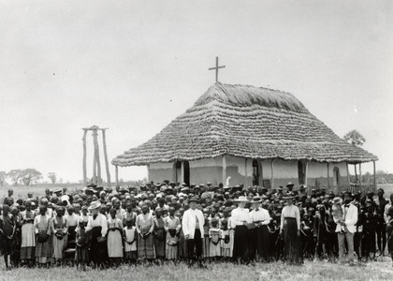
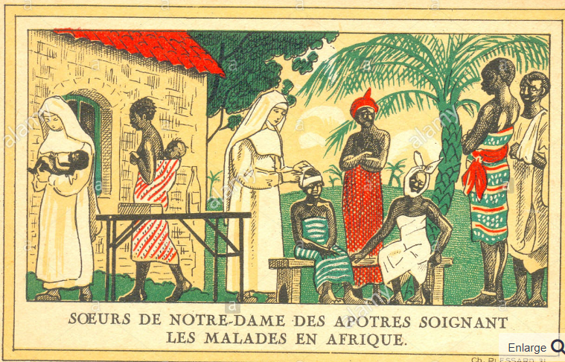
When missionaries came to Africa the villages often welcomed them and gave them land to build their churches on. The missionaries also used their land to build schools where the African children were educated.
The indigenous people who accepted the teachings of the missionaries could send their children to the schools and tended to become educated as preachers and teachers.
The missionaries also built clinics to treat diseases. Sometimes, after their children were healed by the missionaries’ medication, the parents converted and attended church and embraced the Christian teachings.

Slide 6
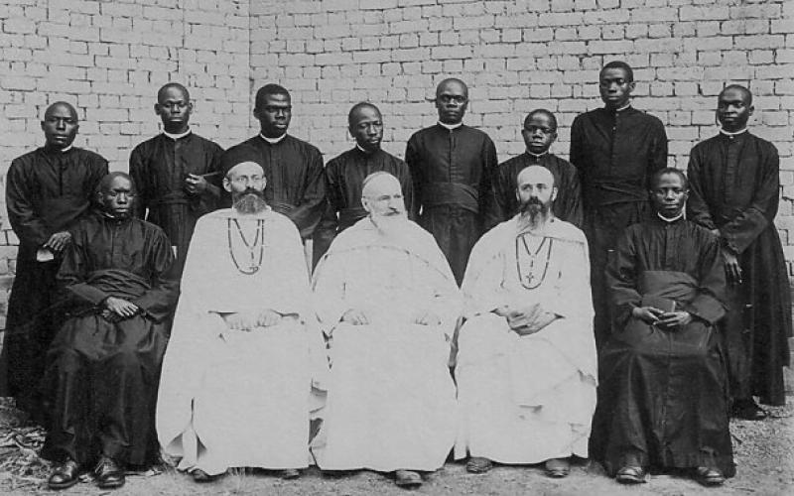
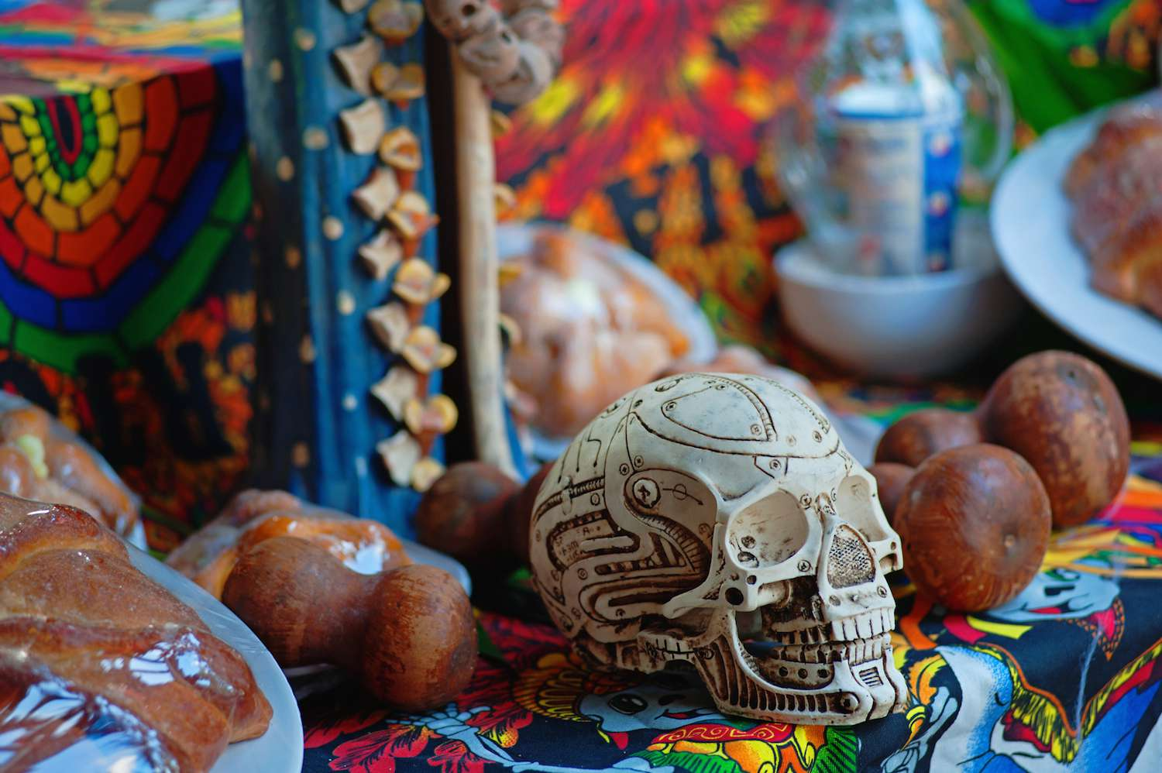
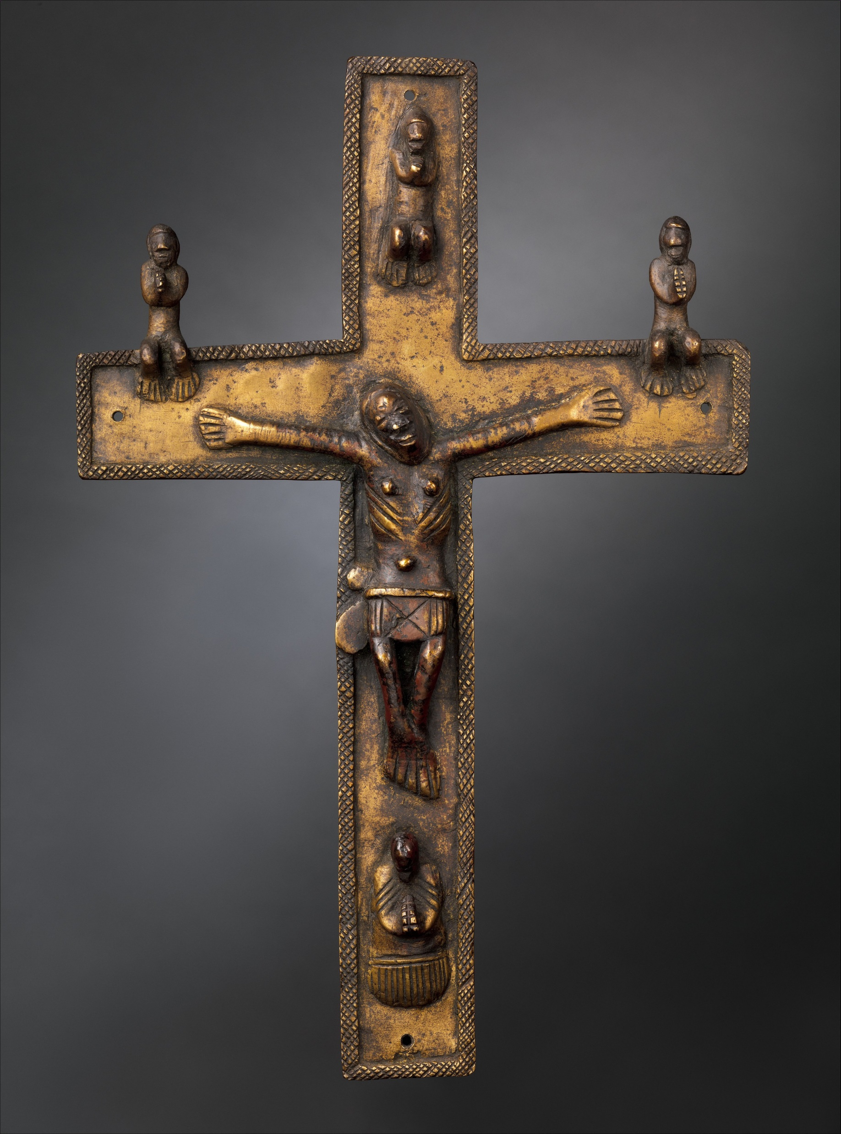
In other areas when missionaries did not always see the conversion numbers that they wanted so they began to allow their congregants to mix African spiritualism with Christianity.
African spirituality beliefs stated that people communicated to God through ancestors. Some missionaries allowed their congregants to pray through dead relatives to the Christian God to gain more members.
When converted Africans sent their children to missionary schools their African names were changed to Christian names. This was done partly because some of the missionary teachers who were often European did not want to learn the local language or how to pronounce the names. Often the missionaries taught that the African names were pagan.

Slide 8
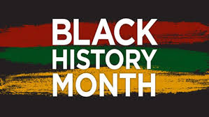
In pairs you will receive one Indigenous African Religion to read about.
You will have one A4 piece of paper on which to present what you have learned.
You can present any aspects that you find interesting with a mixture of information, pictures and drawings.
Your work must be of the highest quality as it will be used for the Black History Month Exhibition

Slide 9
Clear Title
In pairs you will receive one Indigenous African Religion to read about.
You will have one A4 piece of paper on which to present what you have learned.
You can present any aspects that you find interesting with a mixture of information, pictures and drawings.
Your work must be of the highest quality as it will be used for the Black History Month Exhibition
Picture
____________________________________
____________________________________
____________________________________
____________________________________
____________________________________
____________________________________
Picture
____________________________________
____________________________________
Picture

Slide 10
Now present your poster to the wider group…
ZULU
KONGO
DINKA
BANTU

Slide 11
PLENARY
Write a sentence in the speech bubble to reflect what you have learned today about Indigenous African religions or about Black History in general…

Slide 12
Plenary
Did you notice any similarities between the various indigenous religions?
What differences can you find between these indigenous religions and Christianity and Islam?
How do you think Islam and Christianity changed the African societies after their introduction?

Slide 13
Supreme God - Many African religions believed in a supreme god that created the world. Some examples include the gods Oludmare of Nigeria and Katonda of Uganda. In some religions this god may be prayed to for help, but in others the supreme god does not interact with humans.
Nature Spirits - Beneath the supreme god are a number of spirits who mostly live in nature including animals, water, and the earth.
Ancestral Spirits - The spirits of dead ancestors often played an important part in traditional African religion. By honoring these spirits, believers hoped that the spirits would help them or would talk to the supreme god on their behalf.
Sacrifice - Most Ancient African religions offered some sort of sacrifice to their gods or the spirits. This sacrifice varied from small items, like a portion of food or drink, to much larger items like cattle or even human sacrifice.
Rites of Passage - Traditional religions played an important role in the rites of passage. These included rituals surrounding marriage, entering adulthood, birth, and death.
What differences can you find between these indigenous religions and Christianity and Islam?

