Slide 1
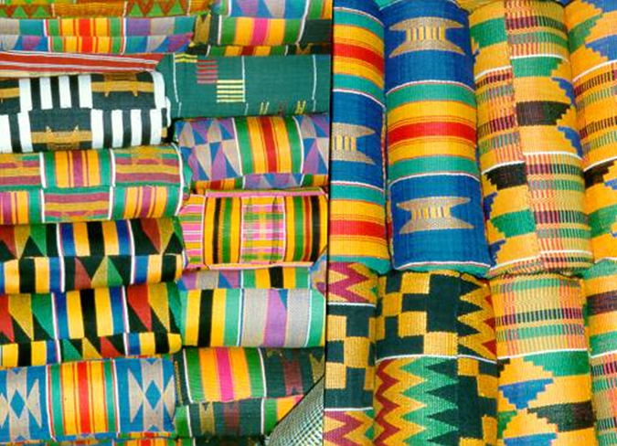

Slide 2
The image
What is the first thing you notice?
What shapes and patterns do you see?
What do you think it is used for?
Where do you think it came from?
How do you think it was made?

Slide 3
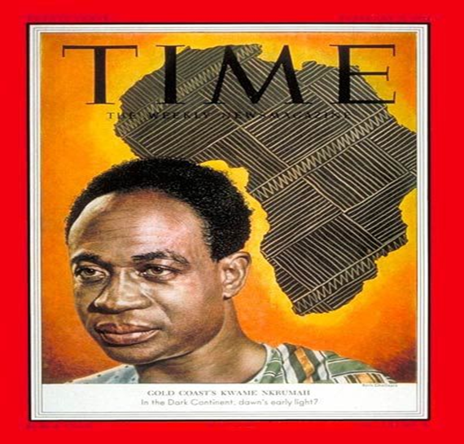
11/10/2020 What makes kente cloth special?
Today we will:
Consider the significance of the kente cloth
Design our own kente inspired pattern

Slide 4
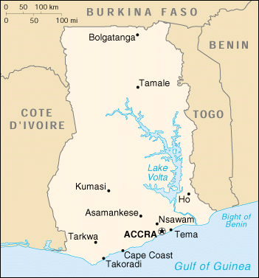
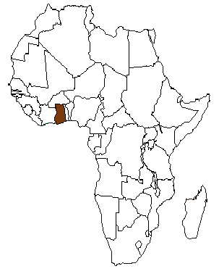
Where is it from?
GHANA

Slide 5
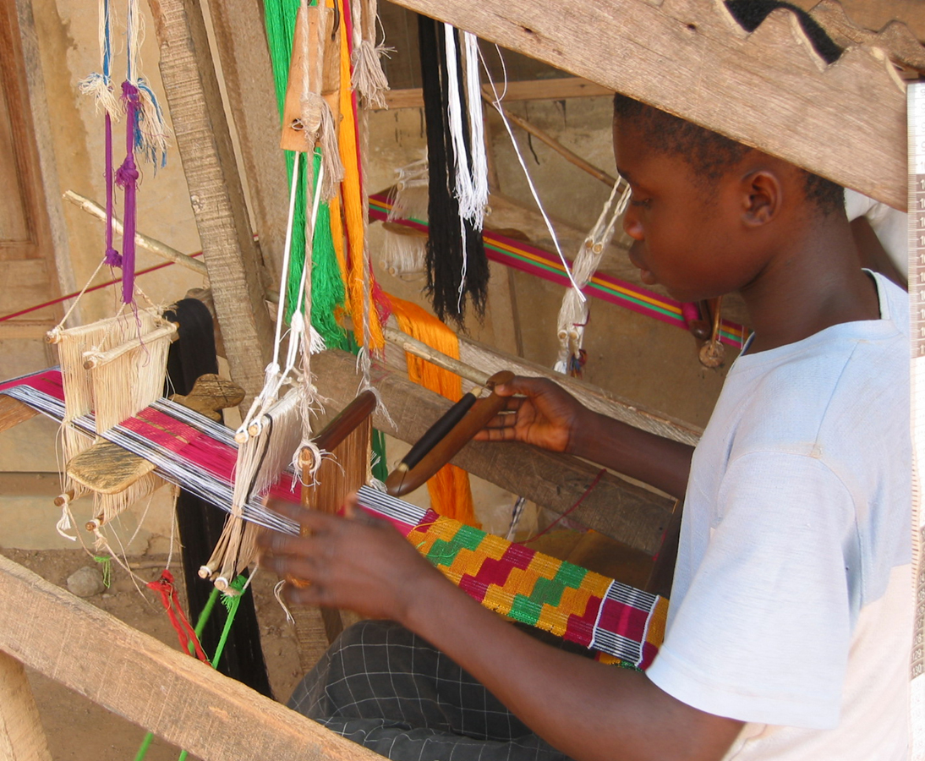
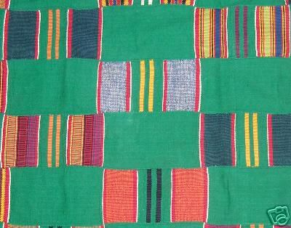
Kente cloth – find clip
Kente Cloth is a cloth hand woven by the Asante people in Ghana.
Kente cloth is special as it is worn as a piece of clothing and each cloth design has a name and a special/unique meaning.
The origins of kente cloth date back to the 12th century.
In the past royalty and important figures of society wore the cloth, for special occasions but today kente cloth is worn by people of all social status.
Each design of cloth has a deep symbolic meaning and is used to say something - a form of social and political commentary. It is a visual representation of values (what is seen as important), history, social codes of conduct and religious beliefs.

Slide 6
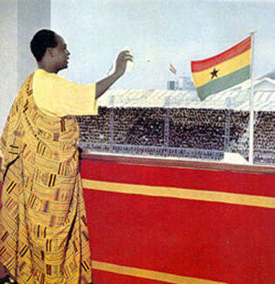
Case Study: Kwame Nkrumah’s kente cloth
Name of cloth: Mmeeda – “something that has not happened before”
Ghana’s first president, Kwame Nkrumah (KWA-may nnh-KROO-mah), wore a kente cloth with this Mmeeda design on February 12, 1951, the day he was released from prison.
Nkrumah had been jailed for opposing the British government, which had made Ghana its colony in 1908. His political party won in the elections held four days before his release. On the day he was freed, Nkrumah wore this design to emphasize that this historic event was “something that had not happened before.”
In 1957, Ghana became an independent country under Nkrumah’s leadership, and he became the country’s first president in 1960. While in office, Nkrumah continued to wear kente cloths to communicate with the Ghanaian people. For instance, when he waved from a balcony following the announcement of Ghana’s independence from Britain, Nkrumah wore a cloth called Adwini asa, or “I have done my best.”

Slide 7
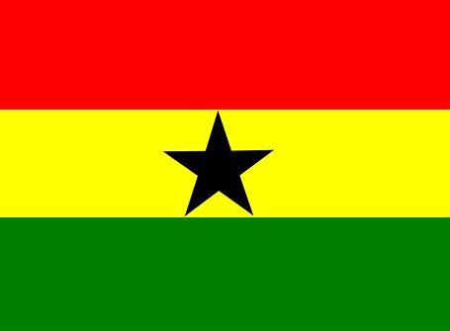
Colour
The choice of colours is important in each kente cloth design, as each colour has a meaning. Nkrumah’s choice of colours reinforced his status of leadership. His choice of colours for the Ghanaian flag also has symbolic meaning. Red for the blood of those who died in the struggle for independence, gold or yellow for the country’s mineral wealth, green for the rich forest and black for the star of freedom for all Africa. These colours can be seen again and again for other African countries.

Slide 8
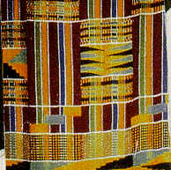
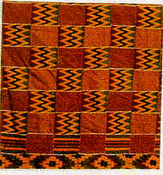
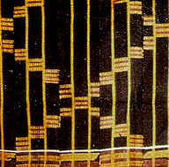
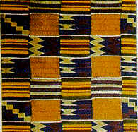
Can you match the cloth to the meaning?
A – KYEMPEM -‘Thousand shields’
B – ABUSUA YE DOM -‘Extended family is a force’
C – NYANKONTON - ‘God’s eye brow’(the rainbow)
D - SIKA FUTORO - ‘Gold dust’

Slide 9
Answers
NYANKONTON
‘God’s eye brow’
(the rainbow)
KYEMPEM
‘Thousand shields’
SIKA FUTORO
‘Gold dust’
ABUSUA YE DOM
‘Extended family is a force’

Slide 10
Colour – what does it mean to you?
What is your favourite colour?
What do certain colours mean to you?
Make a colour code of at least five colours e.g.
Red:
Yellow:
Green:
Pink:
Black:
Colour can be an important form of symbolism

Slide 11
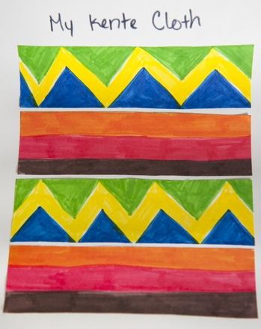
Creative task
Design your own kente inspired pattern to represent/show something e.g.–
Who you are
An event that has happened this year or in your life
A mantra or phrase you live by (e.g. ‘try my best’ ‘always be kind’)
The 3 R’s of the school motto – Respect, Responsibility, Resilience
Rules –
Include horizontal/ vertical straight lines
Your colour choices must have meaning (use your own colour code or the Asante inspired code)

Slide 12
Kente colours
YELLOW can mean the yoke of an egg, ripe fruits and vegetables and gold. It symbolizes preciousness, royalty, wealth, spirituality, vitality and fertility.
PINK is seen as a lighter red and is connected with tenderness, calmness, pleasantness and sweetness. RED is linked with blood.
Red is used as a symbol of heightened spiritual and political mood, sacrifice and struggle.
BLUE is associated with the blue sky. It is used to symbolize good fortune, peacefulness, harmony and love related ideas.
GREEN is associated with vegetation, planting, harvesting and herbal medicine. It symbolizes growth, vitality, fertility, prosperity, fruitfulness and abundant health.
PURPLE is viewed in the same way as maroon and is used in rituals and healing purposes. Females mostly wear purple cloths. MAROON has a close resemblance to red-brown which is associated with the color of Mother Earth. It is associated with healing and the power to repel malevolent spirits.
WHITE is linked with the white part of an egg and the white clay used in spiritual rituals, healing rites and festive occasions. Sometimes it symbolizes contact with spirits and deities. It is used in combination with black, green or yellow to express spirituality, vitality and balance.
GREY derives its symbolism from ash. Ash is used for healing and spiritual cleansing rituals to re-create spiritual balance when spiritual blemish has occurred. It is also used in rituals for protection against spirits.
SILVER is associated with the moon. Silver ornaments are usually worn by women and are used in naming ceremonies, marriage ceremonies and other community festivals. It symbolizes serenity, purity and joy.
GOLD is important for the value and social prestige associated with the precious mineral. Gold dust and gold nuggets were used for making exchanges (like money) and for making valuable royal ornaments. It symbolizes royalty, wealth, elegance, high status, supreme quality, glory and spiritual purity.
BLACK is important because of the idea that new things get darker as they get older. Black symbolizes spiritual energy, talking with the spirits, antiquity and spiritual potency

Slide 13
Final thought
In the United States and other countries outside of Africa, kente cloth has become an important symbol of identification with Africa. Kente is often used at African American graduations and other ceremonies celebrating achievement.
Some Ghanaians feel that American uses of kente cloth have become more a generic symbol for anything African and worry about this.
It is important to remember the complicated message in each cloth’s design and that kente comes from a specific country (Ghana) with its own particular history.

