Slide 1
7Gb Particles
CW
Do Now:
What are the properties of solid, liquids and gases?
Solids | Liquids | Gases

Slide 2
Requisitions
Equipment | Worksheets
 | 7Gb1

Slide 3
Property | Solids | Liquids | Gases
Have a fixed shape
Can change shape
Have a fixed volume
Volume can change
Can be easily compressed
Cannot be easily compressed
Can flow easily
Pick one observation and try to explain it

Slide 4
The Scientific Method
What do you think these words mean?
Observation
Hypothesis
Prediction
Experiment

Slide 5
Match the Definition and Write Down
Theory
A hypothesis that explains how and why something happens
Observation:
What you think will happen in an experiment
Hypothesis:
A scientific procedure
An idea about how something works that can be tested using experiments. Plural = hypotheses
Prediction:
Experiment:
Something that you see happening

Slide 6
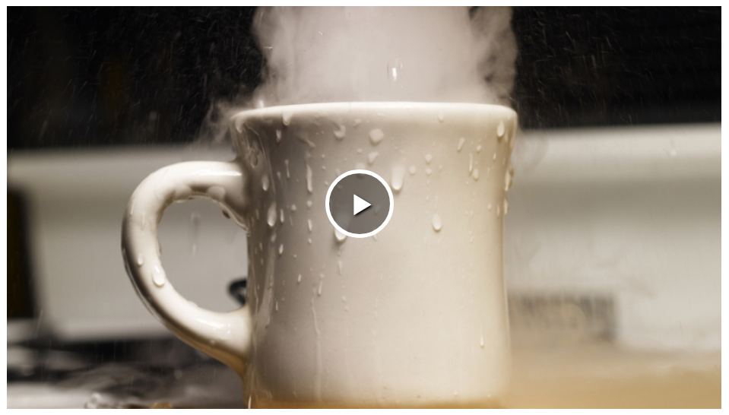
Notes:
https://www.twig-world.com/film/changing-states-of-matter-1472/

Slide 7
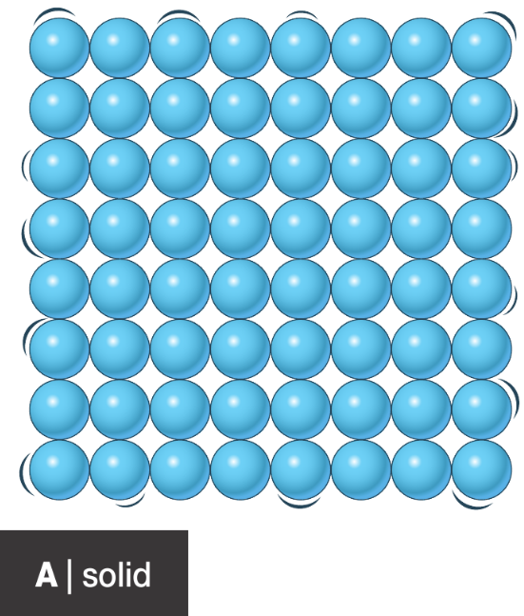
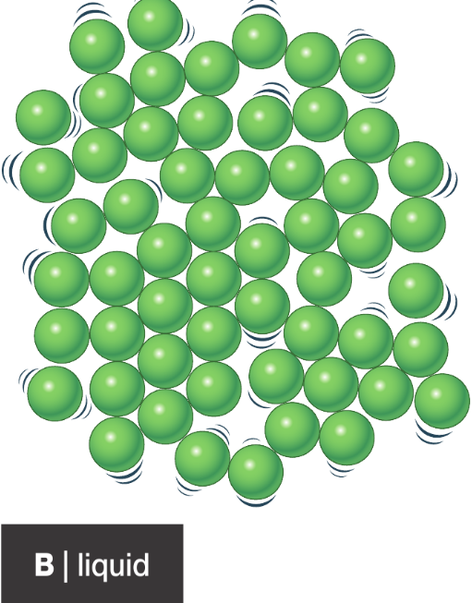
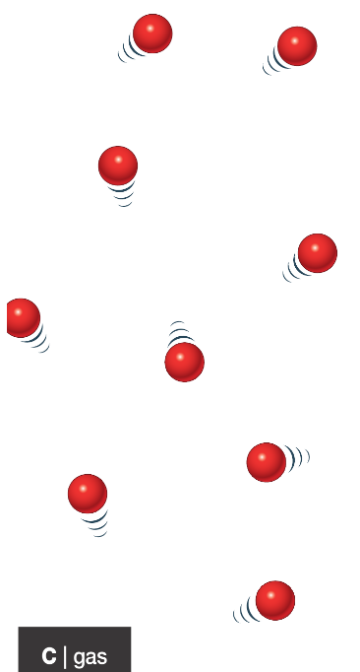
The Particle Theory
Draw the particle theory diagrams of a solid, liquid and gas. Under each diagram, include 3 key notes about how the diagram should be drawn.

Slide 8
State of matter
Theory
Picture
Observations explained
Describe the forces of attraction in a liquid?
Worksheet 7Gb1 –cut and stick

Slide 9
