Slide 1
CW
7Ia2: How Our Bodies Use Food
Do Now:
How can we compare the energy stored in different types of food?
What do we use energy for?

Slide 2
Requisitions
Equipment | Worksheets

Slide 3
Copy & Complete
live
We need lots of energy each day to stay a______ , g_______, and keep w_____.
We get our energy from f_____. Energy is measured in j____ (J).
1J is a tiny amount so we use ___________ instead of joules
1kJ = __________J
row
arm
ood
oules
kilojoules
1000

Slide 4
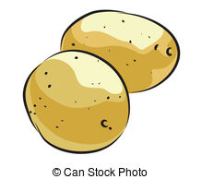
Energy in Foods
Amount of Energy
High | Medium | Low
Sort these foods into three groups – high, medium and low energy.
Apple, White bread, peas, baked beans, banana, carrots, hamburger, boiled egg, lamb, beef, white toast, pear, tomatoes, wholemeal bread, margarine, chips, boiled potato, cheese, pitta bread, orange, milk, tea with milk, coffee with milk, water, cornflakes, poppadum, fried egg

Slide 5
Amount of Energy
High | Medium | Low

Slide 6
Energy in Foods
Watch the video and note down any interesting points. For example: how much energy do adults need?

Slide 8
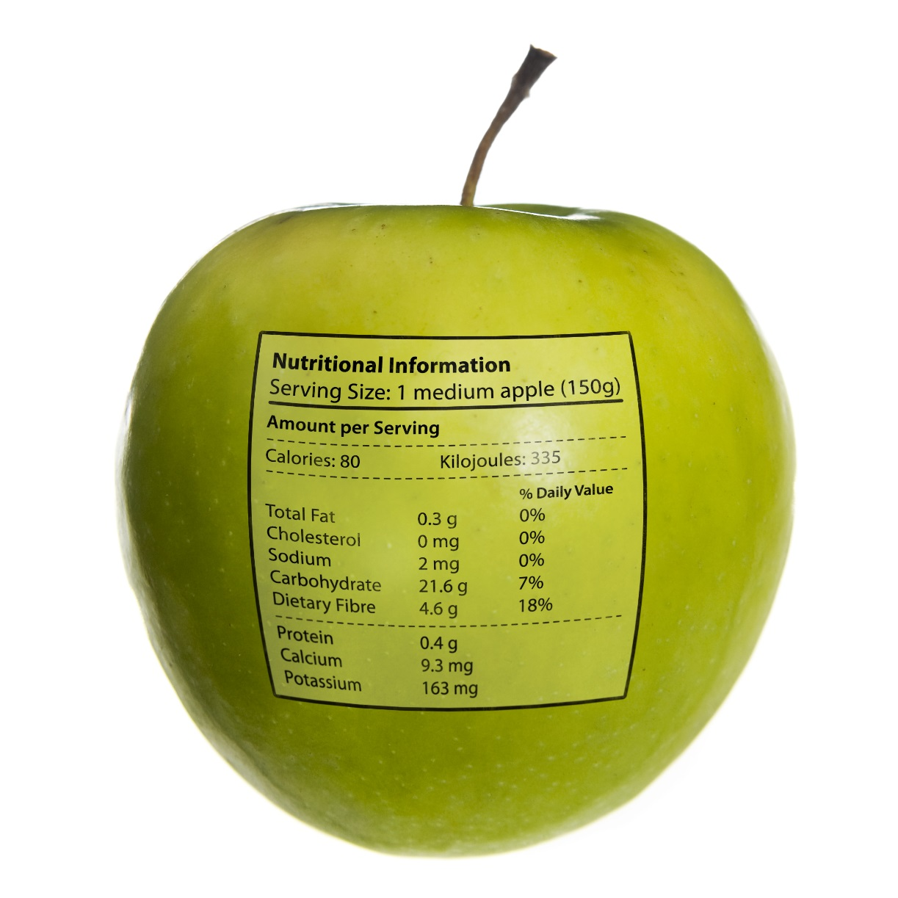

Slide 9
Comparing Foods
There is a huge range of foods available in supermarkets.
People who are trying to eat a healthy diet often buy foods labelled Fat Free or Diet.
However, they are not always getting the product with the lowest energy.

Slide 10
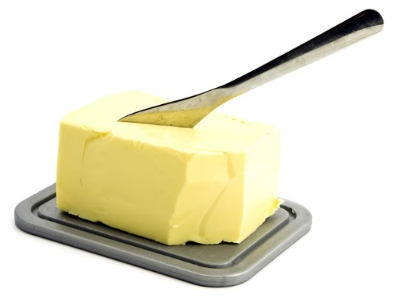
Spreads
We measure the amount of energy stored in food by using the same amount (100g) for all the foods.
Which of these products do you think contain the highest and lowest amounts of energy?
Spread | Energy per 100g (kJ)
Butter | 3030
Hard margarine for baking | 2775
Spreadable butter | 2975
Sunflower oil spread | 2183

Slide 11
Yogurts
Which of these products do you think contain the highest and lowest amounts of energy?
Yogurt | Energy per 100g (kJ)
Natural | 330
Low fat | 256
Greek style | 516
Fat free | 220

Slide 12
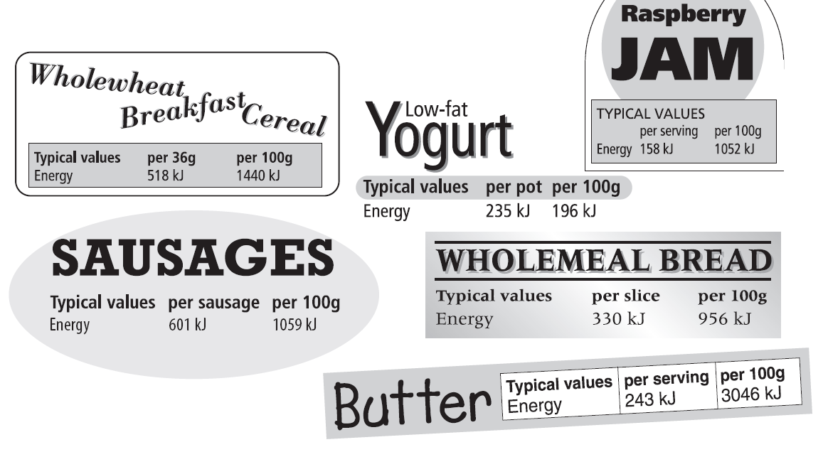
My Food Diary
As a class, we will plan what a person would eat for a day.
Fill in your table with the amount of each food they had & the total energy for the meals

Slide 13
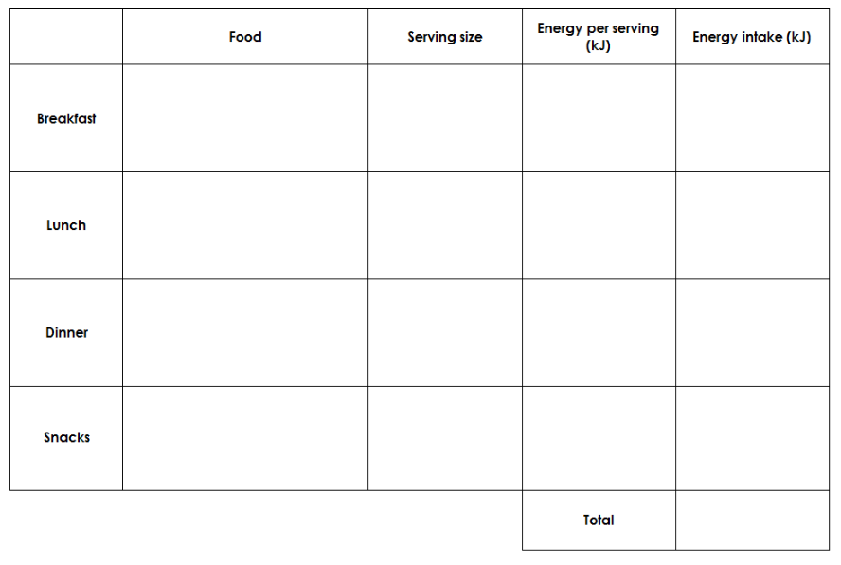

Slide 14
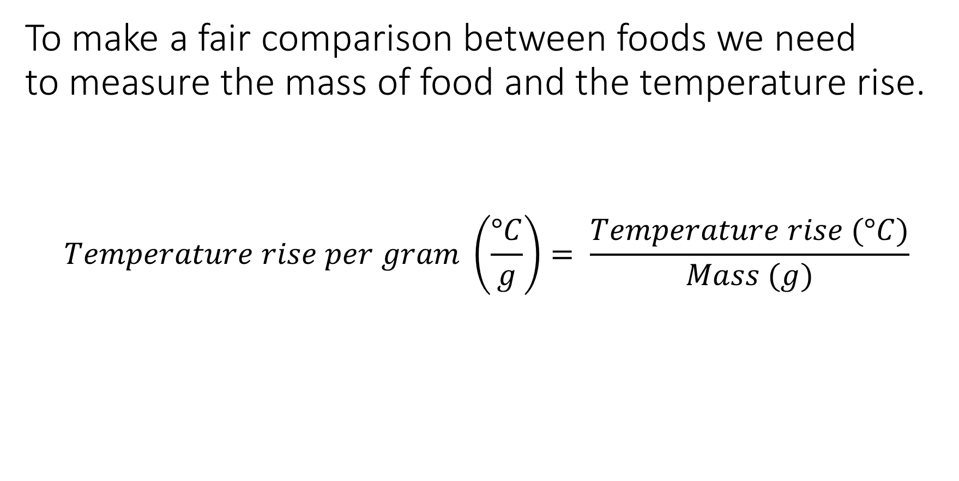
Write Down
To make a fair comparison between foods we need to measure the mass of food and the temperature rise.
$$Temperature rise per gram \left(\frac{°C}{g}\right)= \frac{Temperature rise (°C)}{Mass (g)}$$

Slide 15
Temperature Rise per Gram
Try These
Food | Mass Burnt (g) | Temperature Rise (°C) | Temperature rise per gram of food (°C/g)
Salted Peanuts | 4.0 | 24
Cashew Nuts | 3.0 | 18
Sunflower Seeds | 2.0 | 12
Raisins | 5.0 | 15
Dried Apricots | 15.0 | 27

Slide 16
Ratios
Write Down
Ratios help us compare the energy stored by different foods.
Example
1g of bread raises the temperature by 2°C and 1g of cheese raises it by 4°C. We can write the ratio as:
Temperature rise for 1g of bread °C : Temperature rise for 1g of cheese °C
2 : 4
1 : 2

