Slide 1
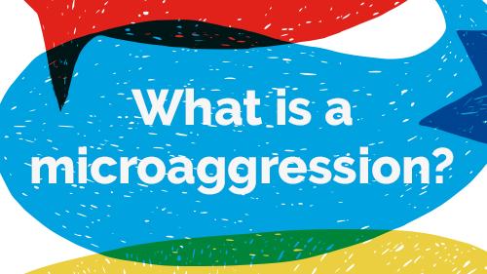
Notes:
Brief but damaging
https://www.rpharms.com/recognition/inclusion-and-diversity/microaggressions

Slide 2
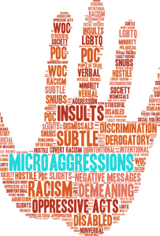
Understanding Microaggression
Microaggressions are defined as the everyday, subtle, intentional — and oftentimes unintentional — interactions or behaviours that communicate some sort of bias towards historically marginalised groups.

Slide 3
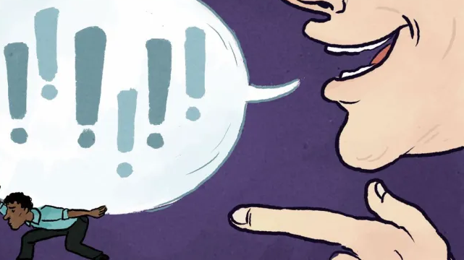
How are microaggressions different to discrimination?
The difference between microaggressions and overt discrimination or macroaggressions, is that people who commit microaggressions might not even be aware of them.

Slide 4
Biases towards…
They can be intentional and unintentional and are based on biases (either conscious and unconscious) associated with our race, religion or belief, ethnicity, sexual orientation, gender and disability.

Slide 5
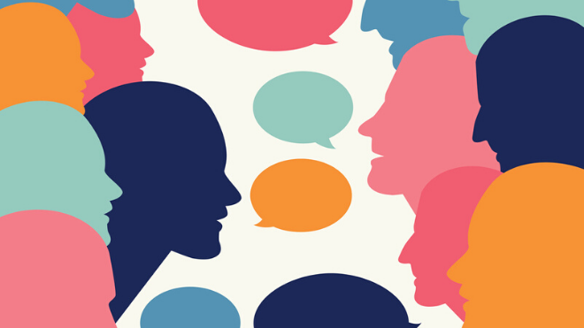
What do microaggressions look like?
Microaggressions are verbal, non-verbal snubs and insults which communicate hostile, derogatory or negative messages and behaviours that target a person based on their protected characteristic or belonging to a marginalised group.

Slide 6
What kind of Asian are you?

Slide 7
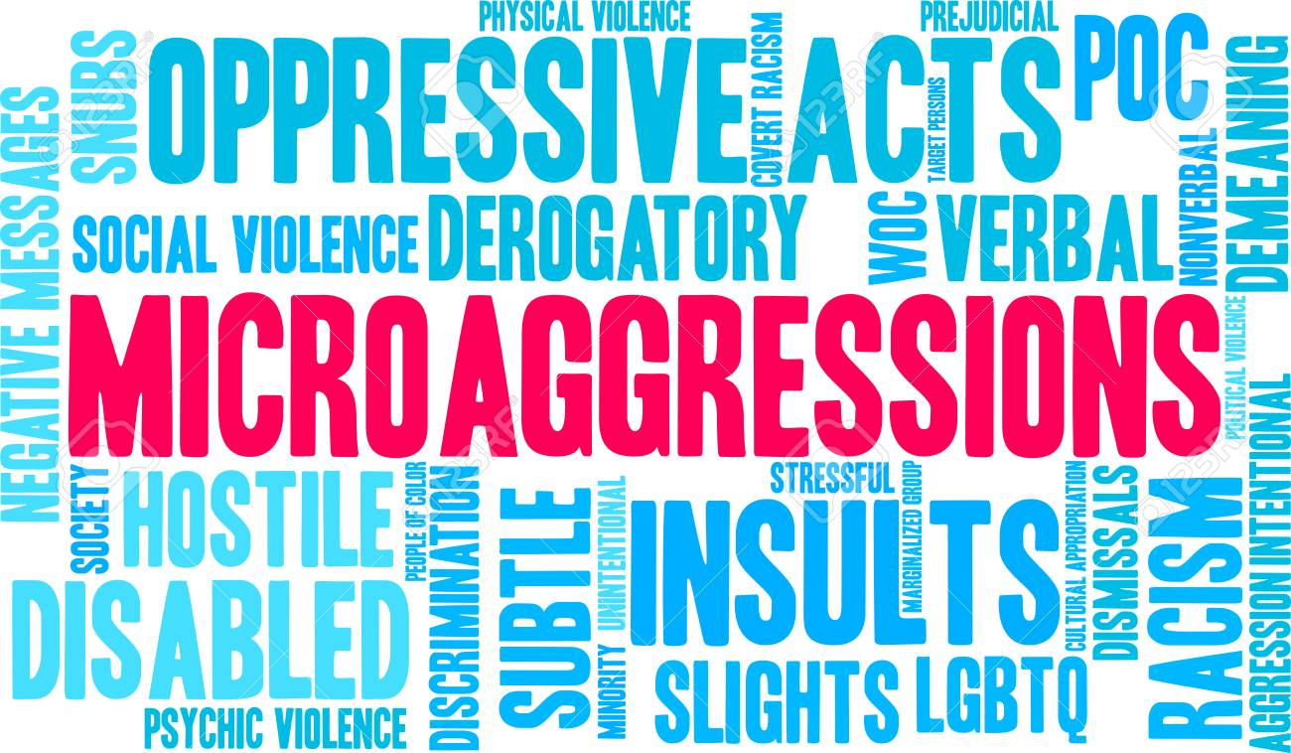
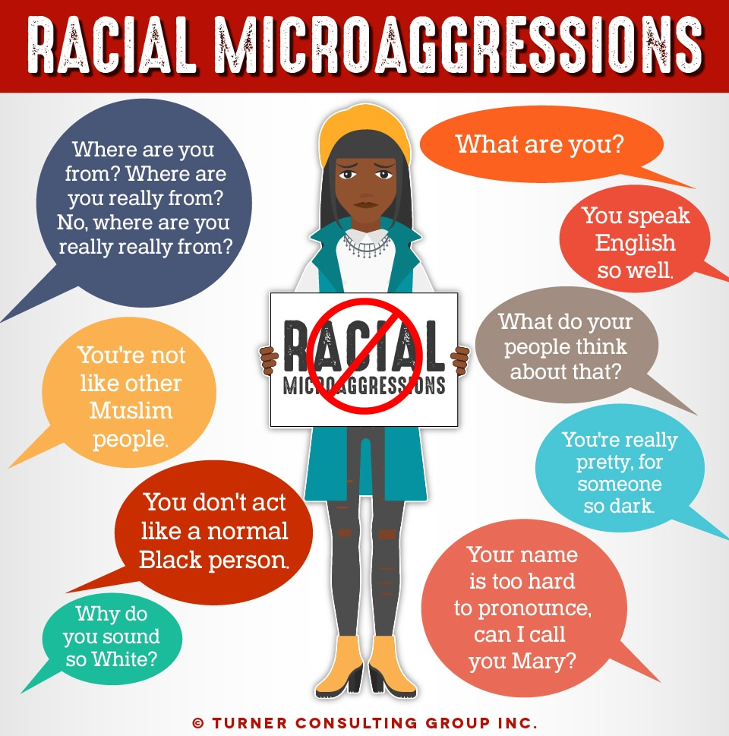
1
5
6
7
2
8
3
9
4

Slide 8
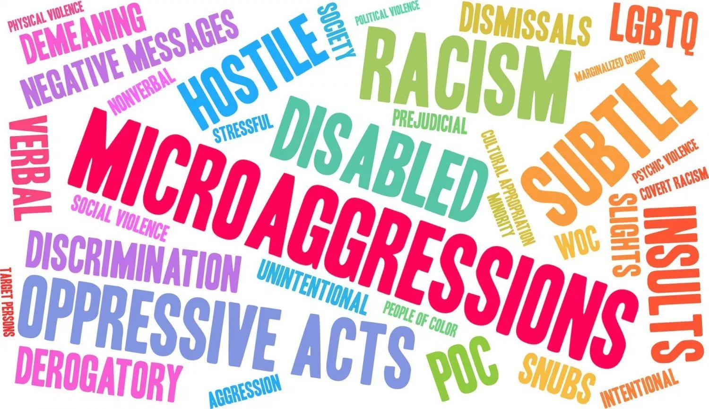
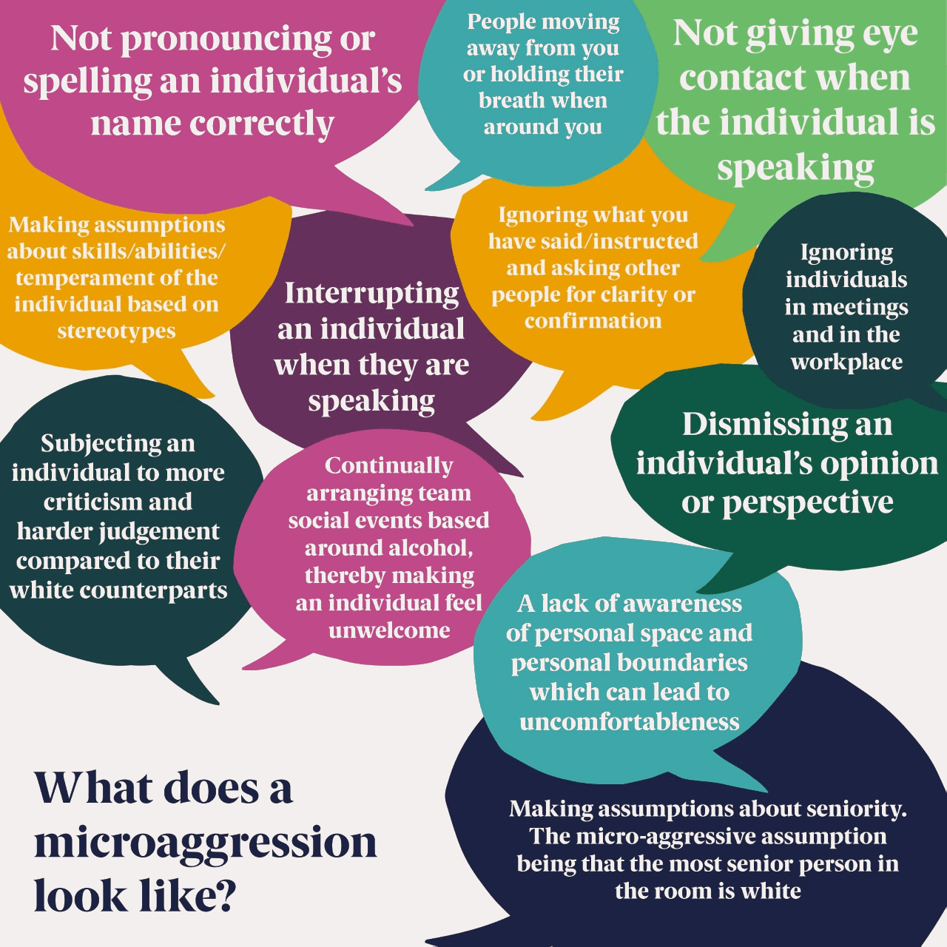

Slide 9
In groups
You are going to sort through different examples of microaggressions
You will need to identify the theme, microaggression and the message this portray
1
2
3
Notes:
Explain the themes relate to America but still important to the UK
How are they seen in the UK?
E.g. meritocracy
https://sph.umn.edu/site/docs/hewg/microaggressions.pdf

Slide 10
Ascription of intelligence
1
2
3

Slide 11
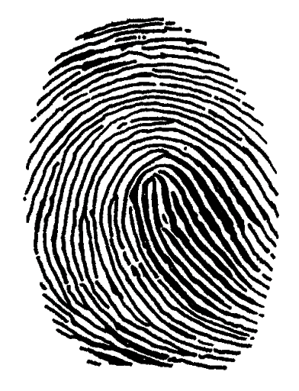
Colour Blindness
1
2
3

Slide 12
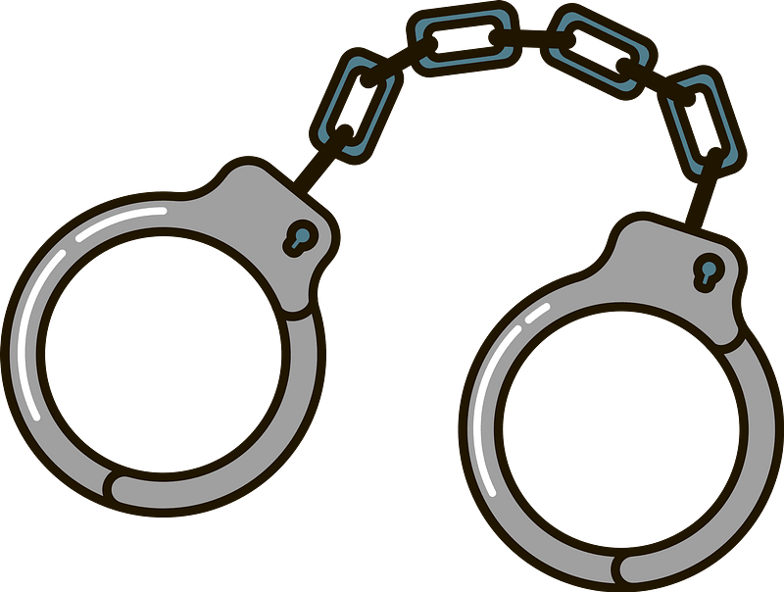
Criminality
1
2
3

Slide 13
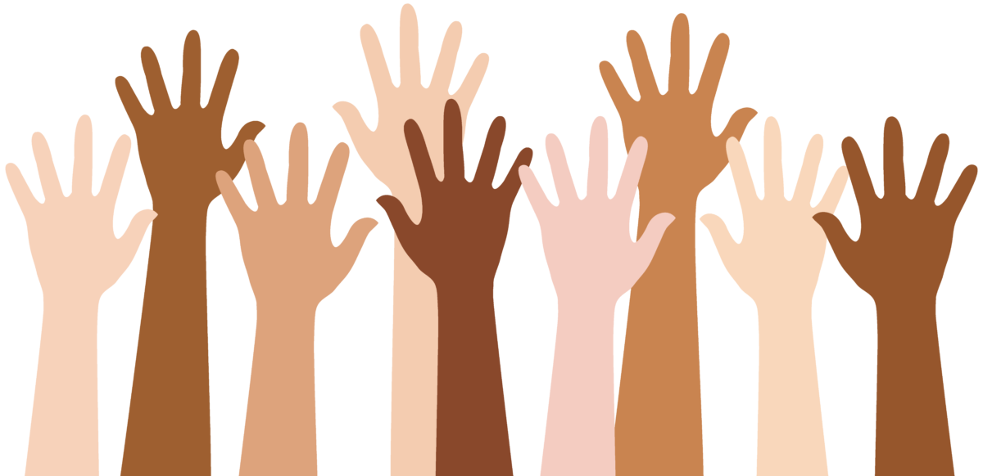
Denial of individual racism
1
2
3

Slide 14
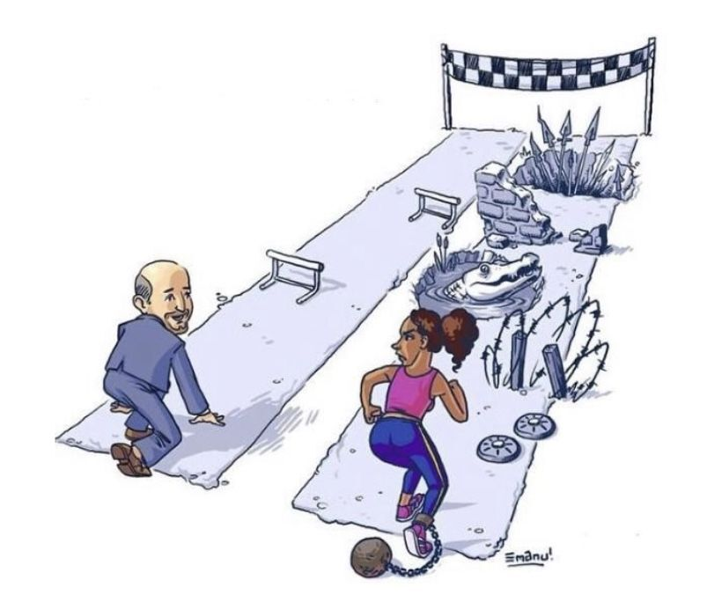
Myth of meritocracy
1
2
3

Slide 15
Pathologising cultural values & communication styles
1
2
3

Slide 16
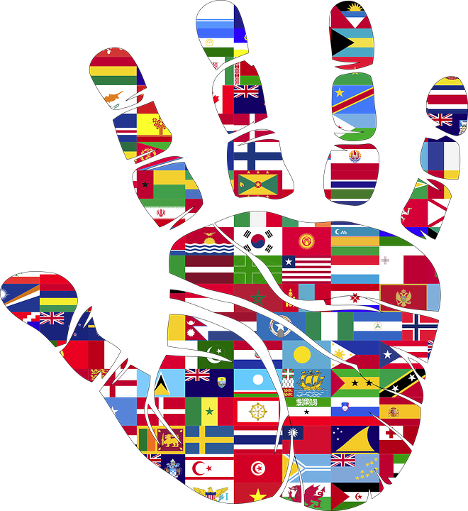
Second class citizen
1
2
3

Slide 17
Environmental microaggressions
1
2
3

Slide 18
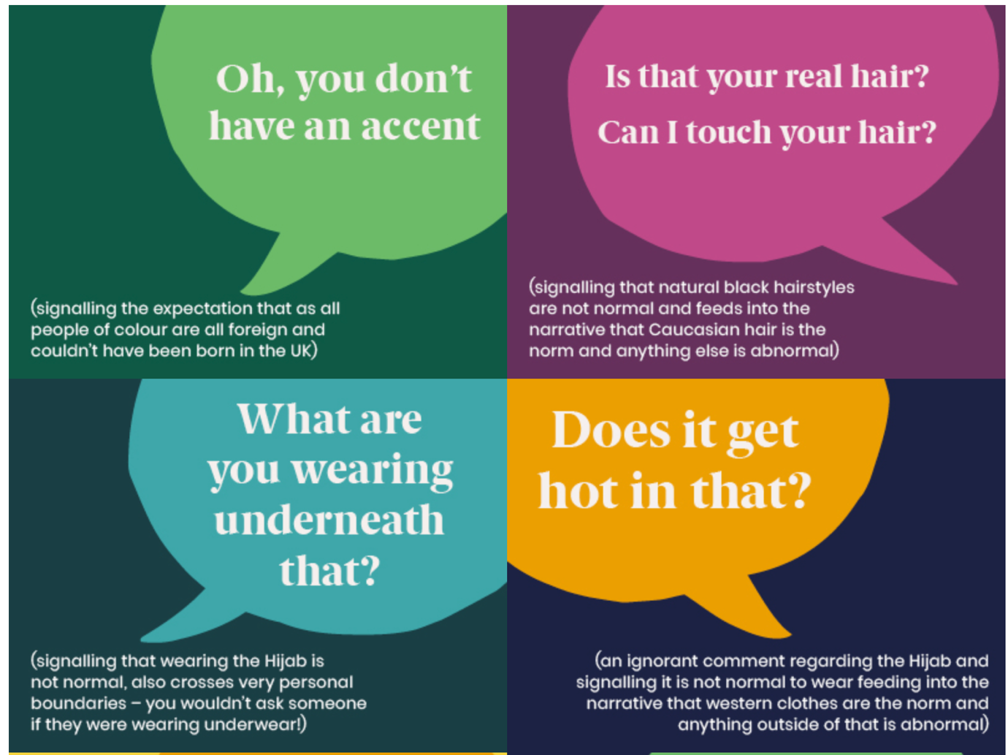

Slide 20
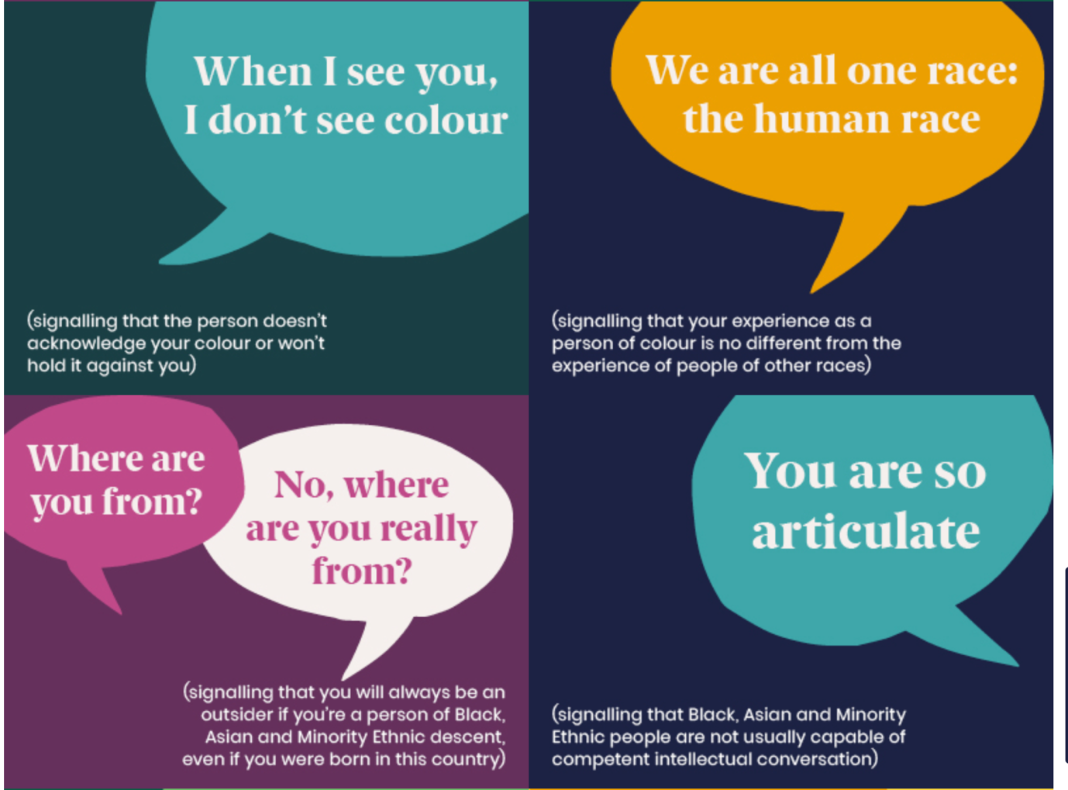

Slide 21
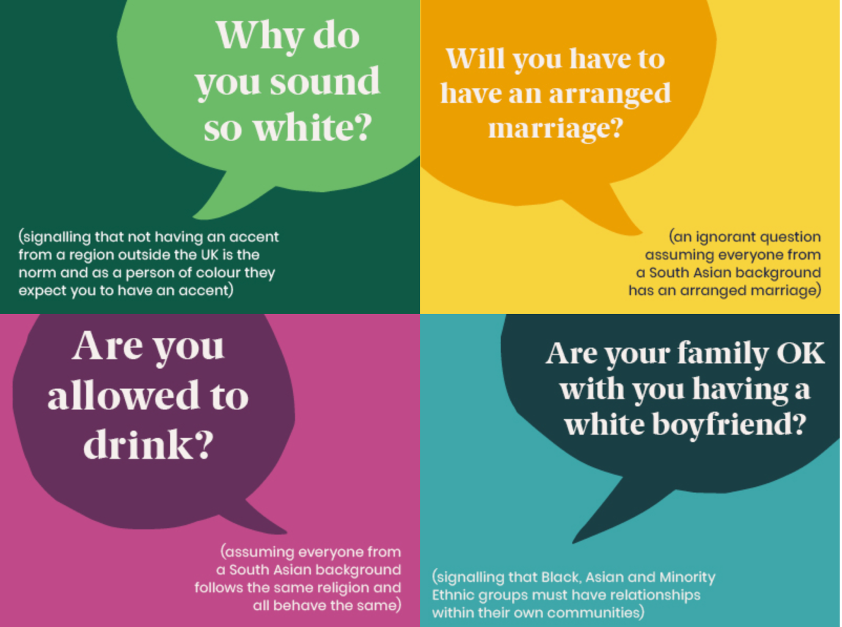

Slide 22
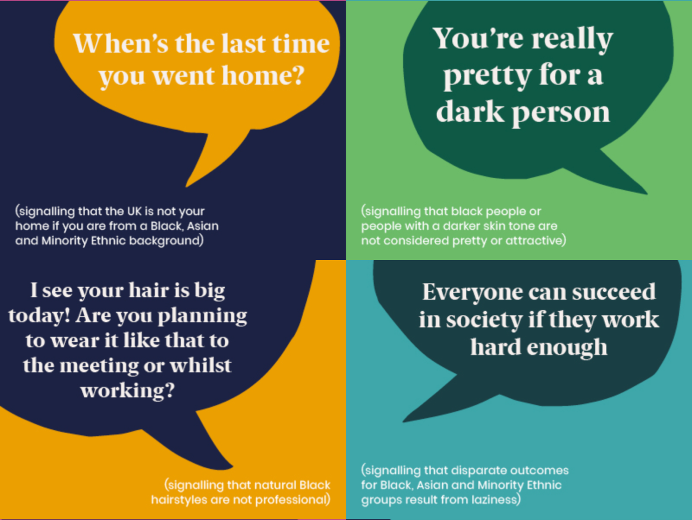

Slide 24
Why are people from some ethnic minority groups in the UK less likely to take a coronavirus jab?

