Slide 1
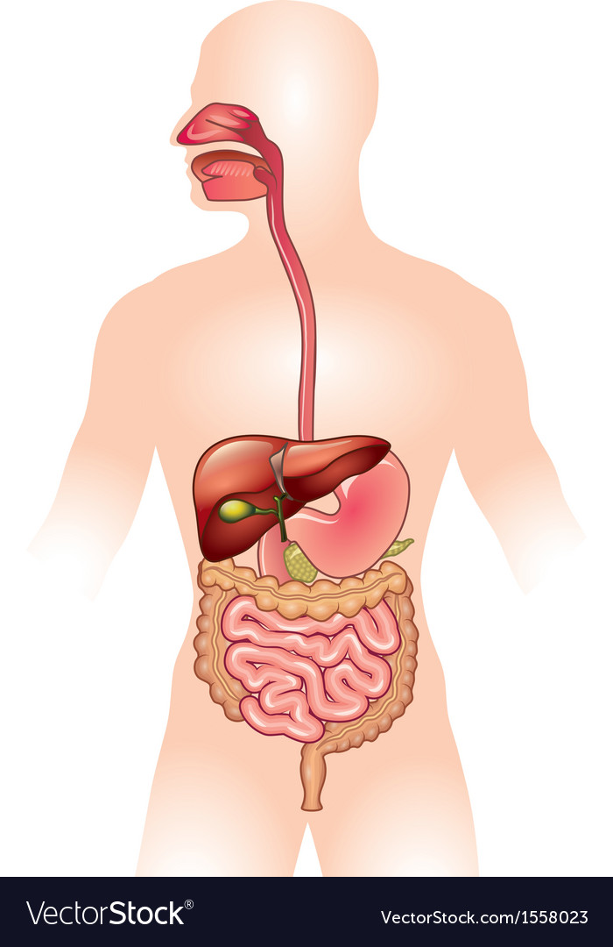
CW
8Ad Digestion
In the back of your books. List the organs of the digestive system.
@hpscience

Slide 2
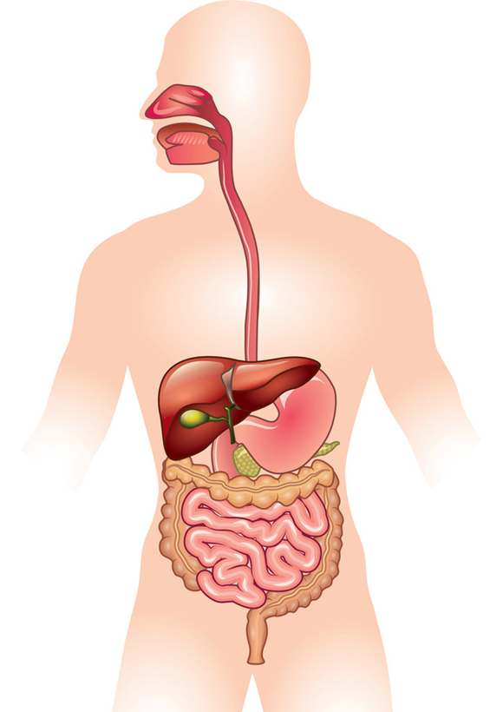
Mouth
Gullet (Oesophagus)
Stomach
Small intestine
Large intestine
Rectum
Anus

Slide 3
RESOURCES – This could easily be a 2 hour lesson
Lesson Worksheet – 8Ad1 (very good) or write lots of notes.
Homework worksheet – 8Ad7 (mid to higher level challenge)
Digestive system annotated diagram
Demo – Stocking model.
Order the stocking model. Crush food in pestle and mortar (teeth) add pretend saliva. Transfer to plastic bag (stomach) add bile and stuff. Squeeze and churn. Pour into stocking (small intestine) over large bowl. Soluble substances pass through. Solids stay behind. Cut hole in bottom of stocking (anus) squeeze out a poo.
Demo – Starch, amylase, iodine visking tubing
Practical – Do an enzyme practical if you want – e.g. Starch / amyalse

Slide 4
RECAP – DO NOT COPY
The body requires the nutrients to grow and repair and to function properly.
These nutrients come from the food that we eat.
The food you eat has to be digested before the nutrients can be used by the body.

Slide 5
Food has to be digested before the nutrients can be used by the body.
Digestion turns large insoluble molecules (proteins, fats and carbohydrates) into smaller soluble substances (e.g. amino acids and glucose).

Slide 6
The organs of the digestive system work together to digest food.
Once the food is digested into small soluble substances it can be absorbed into the circulatory system to be transported.

Slide 7
Stick this diagram in your books and read it.
Be ready to answers the teachers questions!

Slide 8
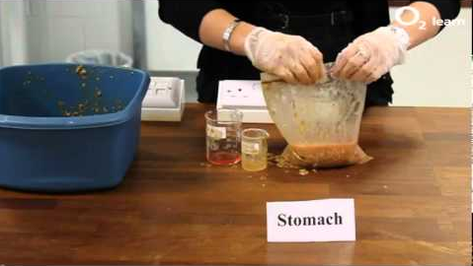
Use the annotated diagram and the stocking model demo to explain digestion.
Watch this video if you’re not sure. Do not show it in class. It’s 6 minutes and its rubbish quality
https://www.youtube.com/watch?v=aemI64NAK08

Slide 9
Have a go on this activity once the students have a rough idea of what these organs do.
https://www.activeteachonline.com/default/player/interactive/id/350154/external/0

Slide 10
Complete question 1 on worksheet 8Ad1 and stick it in your book. Do not fold it.

Slide 11
Enzymes
Enzymes (biological catalysts) are substances produced by the body that help break down large molecules into smaller molecules.
They speed up this process a lot.
Catalyst – a substance that speeds up a reaction

Slide 12
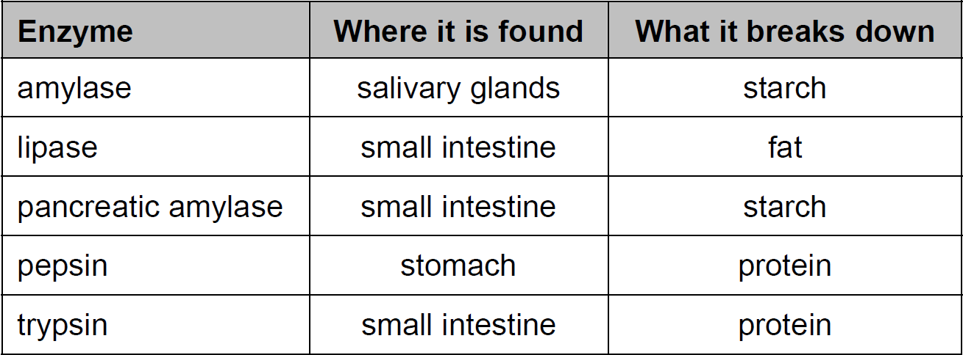
Here are a list of enzymes and their functions.

Slide 13
The way in which enzymes work is complicated, so we use models to think about them.
A good model tries to represent the way something behaves. A model about digestive enzymes needs to try to show that:
● enzymes break down large molecules into smaller ones
● enzymes do not get used up as they carry out their tasks
● enzymes change shape as they work
● each enzyme only works on one particular type of molecule
● digestive enzymes break the links (bonds) between atoms in larger molecules.

Slide 15
Complete question 2 on worksheet 8Ad1.

Slide 16
Read this but don’t bother making notes on it.
They can also make your farts stink real bad.

Slide 17
Bacteria in the gut
https://www.activeteachonline.com/default/player/video/id/350360/external/0

Slide 18
Homework
worksheet 8Ad7
Good extension, keep their books in class and they complete the homework as a test at home. The questions are similar to test style questions.

Slide 19
Objectives
Identify and recall the main parts of the human digestive system.
Explain why digestion is necessary.
Describe the functions of the organs in the human digestive system.
Describe the role of enzymes as catalysts in digestion.
Recall some benefits and drawbacks of bacteria in the digestive system.

Slide 20
Objectives
Describe what happens during ingestion, absorption and egestion.
Explain how food is moved through the digestive system.
Use a model to describe basic enzyme action.

Slide 21
Objectives
Evaluate different models of basic enzyme action.

