Slide 1
Francesca’s Grandad’s Guyanese Sayings

Slide 2
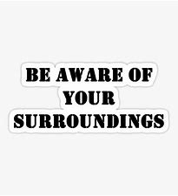
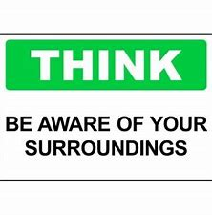
“Dance a battam look a top”
“Dance a battom look a top" means when your down at the bottom enjoying yourself you need to be careful who's at the top watching.

Slide 3
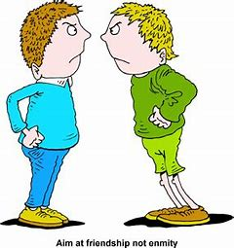
“Contrary breeze ah mek crow and eagle light on one line"
“Contary breeze ah mek crow and eagle light on one line" and it means when there's a problem sometimes enemies are forced together to solve a problem.

Slide 4
“Cuss when yuh ah guh, nah when yuh ah come out."
"cuss when yuh ah guh, nah when yuh ah come out." and it means you may curse the place you have come from but in the future you may have to return home.

Slide 5
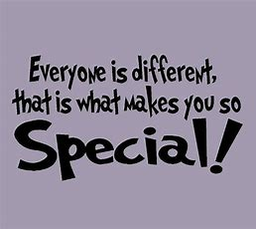
"All cassava get same skin but all nah taste same way"
"All cassava get same skin but all nah taste same way" means though may people look alike because of their mode of dress, they are different in all their ways.

Slide 6
“Cow deh a pasture he nah remember seh dog and butcher deh til he see am"
“Cow deh a pasture he nah remember seh dog and butcher deh til he see am" means just when you think you are safe, danger is lurking nearby.

Slide 7
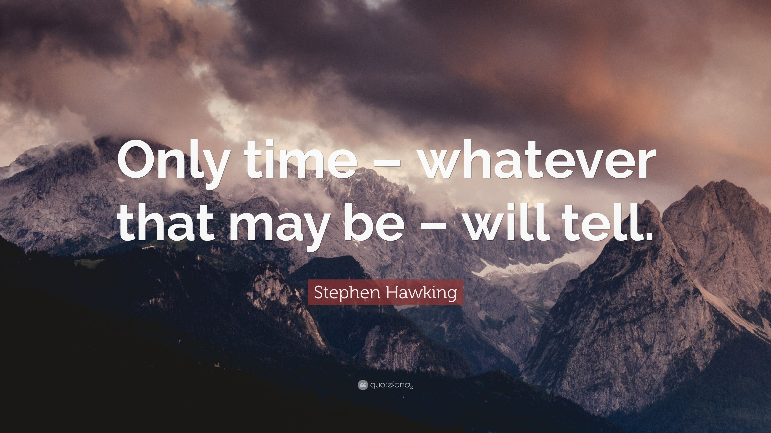
"Lil boy nah climb ladder turn into big man"
"Lil boy nah climb ladder turn into big man" means only time can make you what you will be.

Slide 8
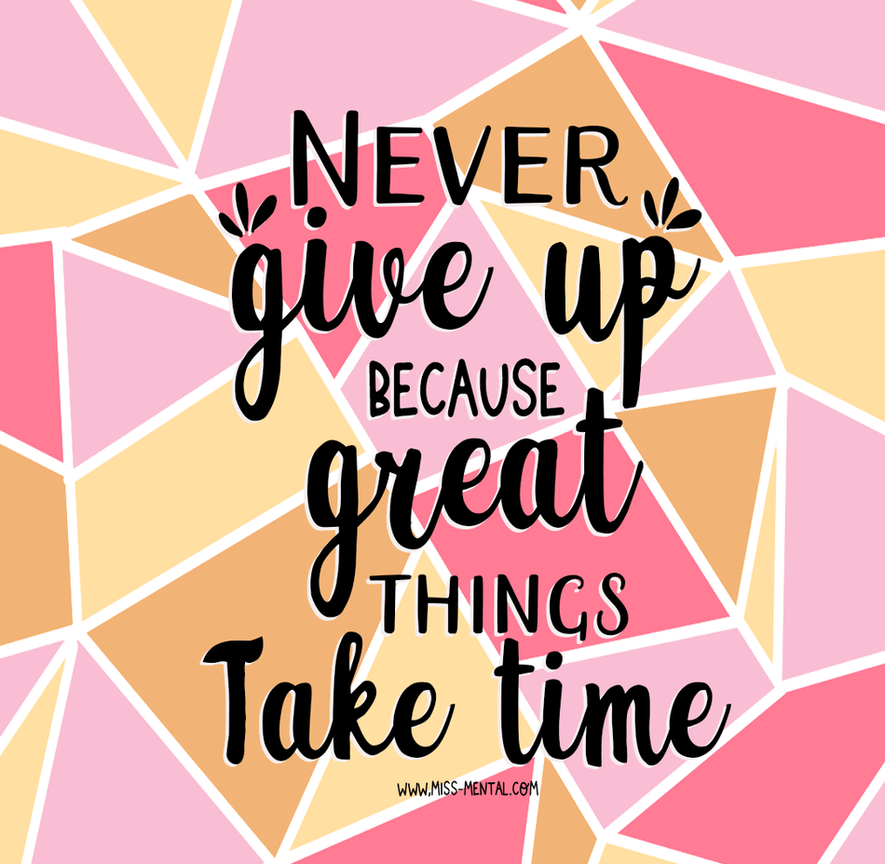
Nah one time a fire mek peas boil"
"Nah one time a fire mek peas boil" meaning some things take a long time to be completed.

Slide 9
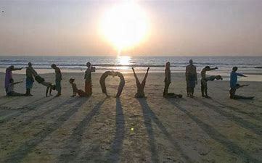
“One kiss nah done lips."
“One kiss nah done lips" means a source of enjoyment is always available where it was once found.”

Slide 10
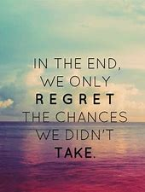
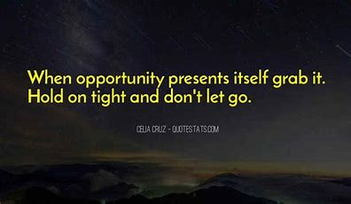
“Rain ah fall ah roof yuh put barrel fuh ketch am."
“Rain ah fall ah roof yuh put barrel fuh ketch am" means there is an opportunity for everyone and you must try to grasp it.

Slide 11
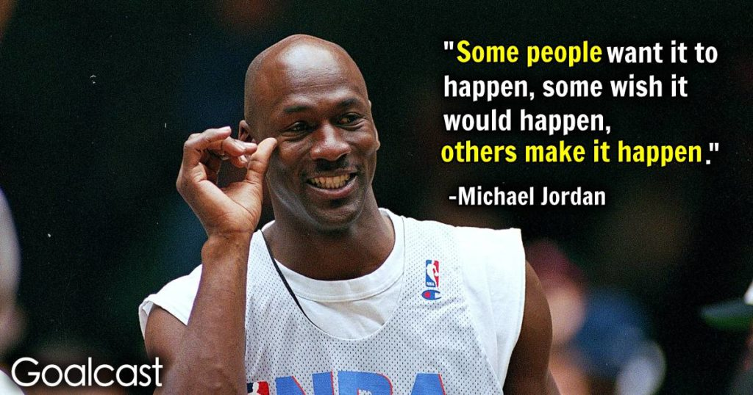
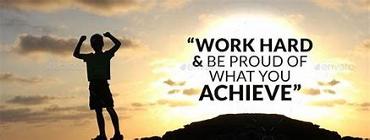
“Slow fire ah boil hard cow-heel"
“Slow fire ah boil hard cow-heel" means if you persevere you can make great accomplishments.

Slide 12
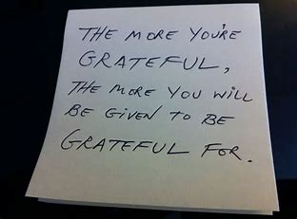
“Never cuss bridge that you cross”
“Never cuss bridge that you cross" means be grateful for favours from anyone because someday you may need another.

Slide 13
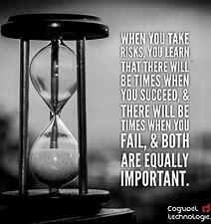
“When you want fuh swim river yuh gat fuh plunge inside fuss"
“When you want fuh swim river yuh gat fuh plunge inside fuss" means you have to take risks when you attempt new ventures.

