Slide 1
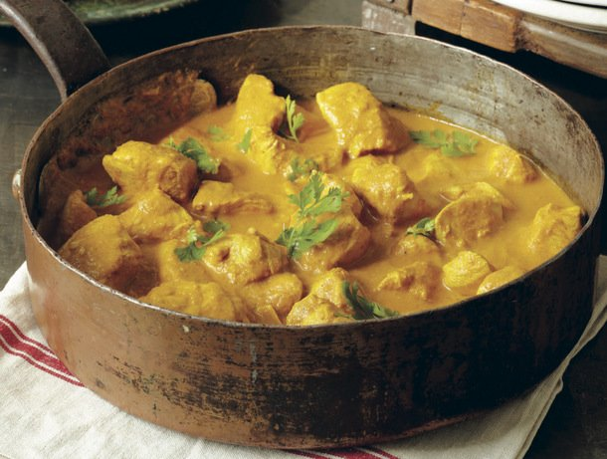
7Gd Diffusion
CW
Do Now:
If I was to start making curry at the front of the room – what would happen?

Slide 2
Requisitions
Equipment | Worksheets
Diffusion Kettle, Red and Blue Food colouring Perfume Skittles Stopwatch
Other suggestions: https://edu.rsc.org/resources/diffusion-in-liquids/685.article

Slide 3
Requisitions
Equipment | Worksheets
Optional: Colourless Gelatin in petri dish, potassium manganate (VII) Stopwatch Body spray
Other suggestions: https://edu.rsc.org/resources/diffusion-in-liquids/685.article

Slide 4
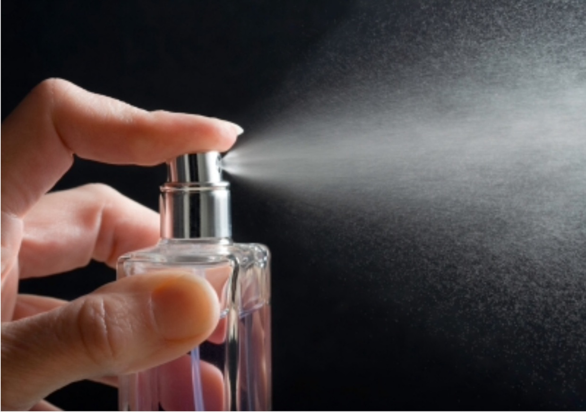
Put your hand up when you smell the perfume

Slide 6
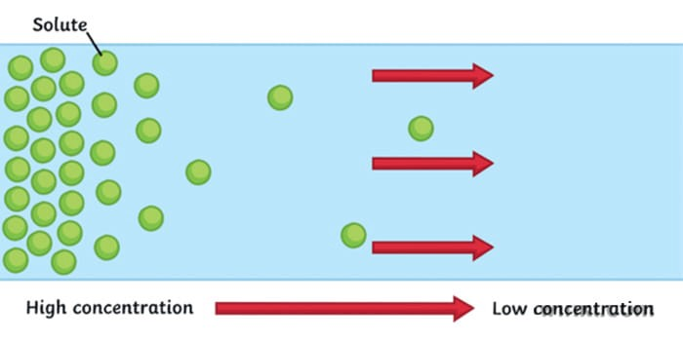
Diffusion
Write Down
Sketch the diagram
Diffusion is when particles spread and mix with each other without anything moving them
How can we use the particle model to describe diffusion?

Slide 7
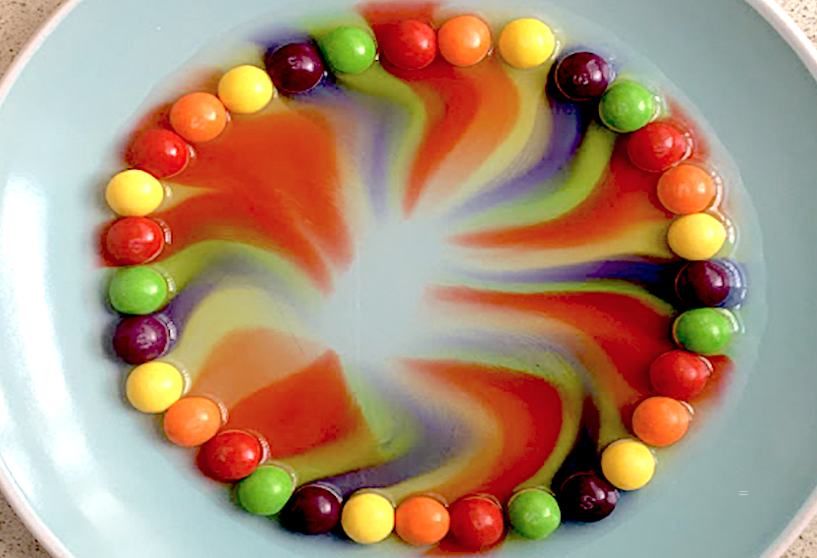
Diffusion
Write Down
Particles will spread from an area of high concentration to an area of low concentration

Slide 8
In substances there are spaces between the particles. Liquid and gas particles are free to move into these spaces, causing the mixing of the two substances.
Which will diffuse more quickly – gas or liquid?

Slide 9
Diffusion Practical – Temperature 1
Aim: To compare diffusion in a liquid for different temperatures Equipment:
Beaker
Food Colouring
Hot Water
Ice Water
Stopwatch
Method:
Fill a beaker with ice water
Add a drop of food colouring to one side of the beaker. Start the stopwatch
Stop the stopwatch when the food colouring reaches the other side of the container. DO NOT STIR
Record your results and repeat using hot water.
Predict: Will the hot water or ice water cause the colour to diffuse quicker?

Slide 10
Diffusion Practical – Temperature 2
Aim: To compare diffusion in a liquid for different temperatures Equipment:
Petri Dish
Skittle
Stopwatch
Hot Water
Ice Water
Method:
Fill a beaker with ice water
Add a skittle to one side of the beaker. Start the stopwatch
Stop the stopwatch when the food colouring reaches the other side of the container. DO NOT STIR
Record your results and repeat using hot water.

Slide 11
Considering your results.
Which temperature caused the colour to diffuse the quickest?
Draw a diagram to show your results at the beginning, middle and end of your experiment
Why do you think that is? Use the particle theory to explain your answer
How could you improve your experiment to make ti more accurate?
What other factors do you think would influence the rate of diffusion?

Slide 12
Comparing Diffusion in States of Matter
Diffusion in solids – get a shallow dish of colourless gelatin, and place a single large crystal of potassium manganate(VII) in the centre. Time how long it takes to see evidence of diffusion.
Diffusion in liquids – get a beaker of cold water that has been allowed to stand undisturbed for several hours, then add a single large crystal of potassium manganate(VII) by dropping it down a drinking straw whose end is at the bottom centre of the beaker. See if diffusion happens more quickly or slowly in liquids than in solids.
Diffusion in gases - spray a strong smelling body spray into a large beaker for a few seconds. Time how long it takes for the smell to reach your nose.

Slide 13
Comparing Diffusion in States of Matter
Diffusion in solids – get a shallow dish of colourless gelatin, and place a single large crystal of potassium manganate(VII) in the centre. Time how long it takes to see evidence of diffusion.
Diffusion in liquids – get a beaker of cold water that has been allowed to stand undisturbed for several hours, then add a single large crystal of potassium manganate(VII) by dropping it down a drinking straw whose end is at the bottom centre of the beaker. See if diffusion happens more quickly or slowly in liquids than in solids.
Diffusion in gases - spray a strong smelling body spray into a large beaker for a few seconds. Time how long it takes for the smell to reach your nose.

Slide 14
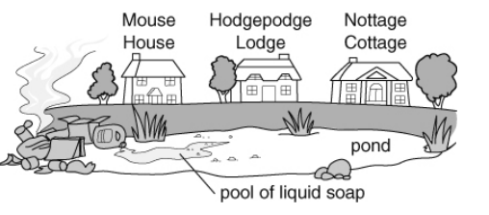
7Gd-8 A Rubbish Problem
1. Someone has dumped rubbish at a pond. Liquid soap has leaked from the rubbish into the pond and the rubbish is starting to smell. It is a hot, windless day.
a. The smell and the liquid soap both spread. What is this spreading caused by?
 | True |  | Dissolving
 | Diffusion |  | Distraction
 | Dispersion |  | Wind
b. Mrs Gupa is the first to complain to the council about the smell. Which house does she live in? Explain your answer

Slide 15
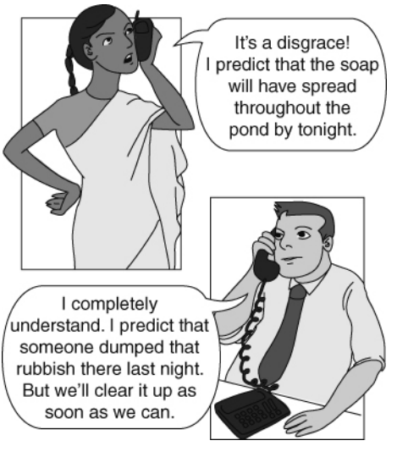
2. The man from the local environment agency has phoned Mrs Gupta.
a. What is a prediction?
 | Saying what you think will happen
 | Saying what has happened
 | Pronouncing your words correctly
 | Explaining what has happened
b. A scientific prediction is one that can be tested. Which person makes a scientific prediction?

