Slide 1
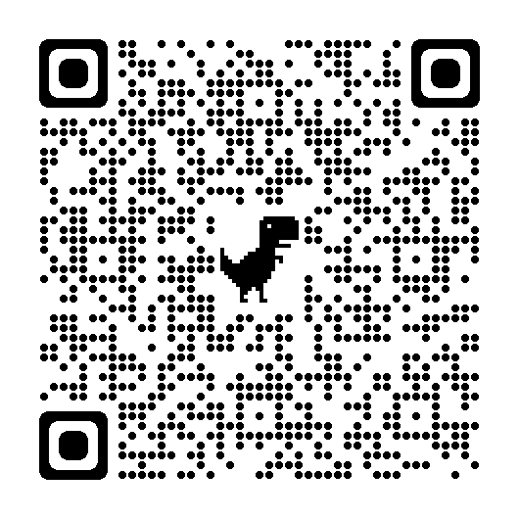
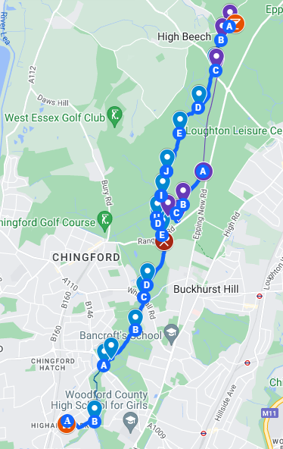
1. Scan with your camera app or a QR reader:
2. Share your location with:
firefly@
highamsparkschool.co.uk
Map and further instructions recommended to you on Firefly or search “School walk” on Firefly.

